Slide 1
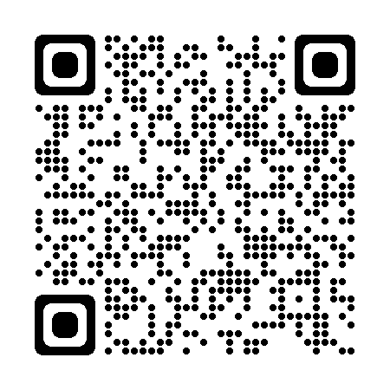
Reaching Communities through Patient Navigation:
Evidence for Action
ACS NNRT is please to facilitate this webinar from national
thought leaders from the Community Preventive Service Task Force
(CPSTF)and the Professional Oncology Navigation Task Force.
During this webinar, participants will learn about the systematic
review evidence used as the basis for this CPSTF recommendation.
You will also learn about The Community Guide, a resource that
houses CPSTF findings, systematic review evidence, promotional
materials, and implementation tools. As you listen to the presentation,
you may be inspired to implement patient navigation through the
lens of the Oncology Navigation Standards of Professional Practice
(PONT Standards) as well as share this information with others.
Share this free resource to decrease cancer burden with the
Comprehensive Cancer Control coalitions by incorporating patient
navigation and screening evidence base strategies programs and
policies to improve health and prevent disease in communities.
Follow us:
LinkedIn
May 2, 2023
Archived webinar
@NNRTnews
navigationroundtable.org
The American Cancer Society National Navigation Roundtable (ACS NNRT) was established in 2017. The ACS NNRT is a national coalition of 80 member organizations to advance navigation efforts that eliminate barriers to quality care, reduce disparities, and foster ongoing health equity across the cancer continuum. The American Cancer Society provides organizational leadership and expert staff support to the ACS NNRT.

