Slide 1
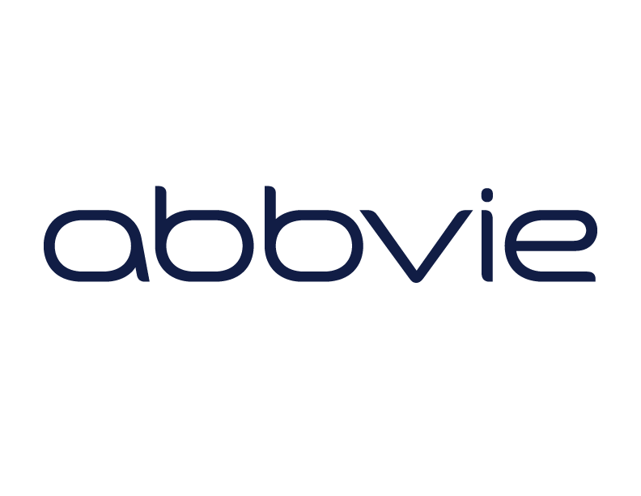
2020 Annual Meeting
Navigation in a New Era:
Crisis & Opportunity
New Member Orientation • September 29, 2020 • 1:00-1:45 PM ET

Slide 2
Zoom Best Practices
This meeting will be recorded.
You will be muted with your video turned off when you join the call. Use the buttons in the black menu bar to unmute your line and to turn on your video. *6 to unmute if joining by phone.
Please make sure your video is turned ON in breakouts.
Toggle between Gallery view and Speaker view at top-right of your Zoom window to view select participants or a single speaker.
This call takes place on the Zoom platform. To review Zoom’s privacy policy, please visit zoom.us/privacy
Questions? Type them in the chat box.
ZOOM Technical Support:
Kristen Wehling
American Cancer Society
In case of emergency: kristen.wehling@cancer.org

Slide 3
Thank you to our NNRT sponsors
and to our Annual Meeting Planning Committee!

Slide 4
Orientation Objectives & Agenda
Objectives
Understand the structure and role of the NNRT
Understand the work of the NNTRT task groups
Agenda
Welcome and Overview
Evidence-Based Promising Practices Task Group
Policy Task Group
Workforce Development Task Group
Close

Slide 5
History & Foundations
Established in 2017, the NNRT brings together organizations and individuals to address needs in the field of navigation that are best addressed through collective action:
Need for standardized outcome metrics (2011 supplement did not result in action; EHR initiatives)
Need for a centralized plan for building the evidence base for navigation (to demonstrate effectiveness, value, and ROI)
Need for clearly defined professional roles and responsibilities (distinguish lay/clinical navigation from other occupations)
Need for workforce development path forward (lay and clinical navigators)
Need for a sustainable model for funding: policy to establish navigation as a reimbursable service

Slide 6
Core Principles
What the Roundtable Won’t Do
What the Roundtable Will Do
Duplicate member organization roles
Compete with member organizations
Take on positions or projects that are in conflict with member organizations
Serve as a forum (collective action)
Provide the “Big Tent”
Identify unmet needs & gaps
Stimulate collaboration
Support Task Groups made up of experts to carry out key initiatives
Prioritize health equity
…dedicated to achieving health equity and access to quality care across the cancer continuum through effective patient navigation.

Slide 7
Who we are……..
“People desperately need help to get quality, timely cancer services. Patient navigation can provide such help. Unfortunately, there are barriers to moving patient navigation forward to all populations. Action MUST be taken.
This is the role of the NNRT – leveraging the voices of many organizations in the patient navigation field to take collective action to expand and sustain navigation programs and their highly skilled navigators. Patient Navigators serve those most in need.”

Slide 8
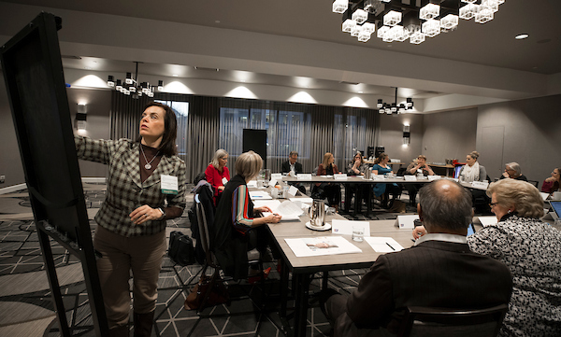
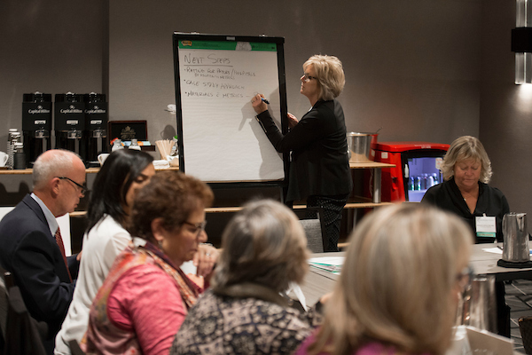
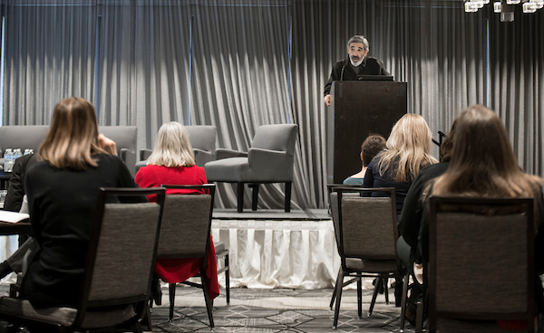
Structure
The Steering Committee meets monthly to provide leadership and vision to help advance the mission, and guide strategic planning and implementation of projects.
Work is conducted throughout the year through Task Groups that meet bimonthly.
An Annual Meeting affords member an opportunity to network, address important topics, review accomplishments and set the strategic agenda for the following year.
Four standing committees per the NNRT Bylaws that include the Executive Committee, Nominating Committee, Membership Committee, and Bylaws committee

Slide 9
2020-2021 Steering Committee & Leadership
Chair: Tracy Battaglia, MD, MPH, Boston University Schools of Medicine & Public Health
Vice Chair: Andrea (Andi) Dwyer, BS University of Colorado School of Public Health
Honorary Chair: Dr. Harold Freeman
Linda Burhansstipanov, MSPH, DrPH, Native American Cancer Research Corporation
Elizabeth Calhoun, PhD, MEd, University of Arizona
Linda Fleisher PhD, MPH, Fox Chase Cancer Center
Elizabeth Franklin, Ph.D., MSW, Cancer Support Community
Karen M. Freund, MD, MPH, Tufts University School of Medicine
Sharon Gentry, RN, MSN, ONN-CG, AOCN, CBCN, CBEC, Novant Health
Electra Paskett, Ph.D., The Ohio State University
Steve Patierno, PhD, Duke Cancer Institute
Angie Patterson BA, HON OPN-CG
Georgia Center for Oncology Research and Education
Elizabeth Rohan, PhD, MSW, LCSW, Centers for Disease Control and Prevention
Patti Valverde, PhD, MPH, Colorado School of Public Health
Dawn Wiatrek, Ph.D., Patrice Bowles, Nicole Erb: American Cancer Society Support Team

Slide 10
Member Organizations
Over 70 member organizations (120 individuals) representing academia, public health, advocacy/survivorship advocacy/survivorship groups, professional societies, industry, training and government agencies

Slide 11
Task Groups
Evidence Based Promising Practices
Beth Calhoun, PhD, Med Electra Paskett, Ph.D.
Policy
Elizabeth Franklin, Ph.D., MSW Elizabeth Rohan, PhD, MSW
Workforce Development
Linda Burhansstipanov, MSPH, DrPH Patti Valverde, PhD, MPH

Slide 12
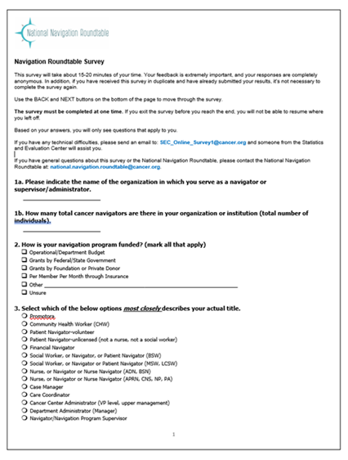
Evidence Based Promising Practices Task Group: Accomplishments & Updates
Task Group Goal: Focus is on establishing an evidence based/outcome driven patient navigation model.
Accomplishments of the Committee:
Accomplishment #1: The Task Group created and to identify metrics and barriers to implementing these metrics. The survey was completed by navigators and navigation program administrators. The survey was supported by a national navigation organization. A total of 778 participants completed the survey.

Slide 13
Evidence Based Promising Practices Task Group: Accomplishments & Updates
Accomplishment #2: A 12 article supplement in Cancer is underway that will include analysis of the data collected in the national navigation survey. Plans are for the supplement to be submitted for peer review in October.
Papers will include:
The leading paper will provide the overall description and purpose of the national survey and characteristics of respondents (types of roles, types of organizations) from the programs across the U.S., to describe what metrics programs report they are collecting across the cancer continuum.
An examination of predictors of length of time as a navigator (tenure) including education, type of patient navigator, training type, funding of program type, area of cancer continuum, geography and certification.
A paper on lay/unlicensed navigators that will differentiate roles and tasks for those who are considered lay vs. those who are licensed health professional navigators across the continuum of care.

Slide 14
Evidence Based Promising Practices Task Group: 2021 Goals
Develop case studies of navigation programs across the cancer continuum that have demonstrated financial sustainability (highlight how this was accomplished)
Develop a multi-media approach to disseminate the case studies

Slide 15
Policy Task Group: Background & Purpose
The Policy Task Group is composed of diverse stakeholders who utilize evidence and engage in initiatives to support the sustainability of the profession of navigation including but not limited to advocacy for reimbursement.

Slide 16
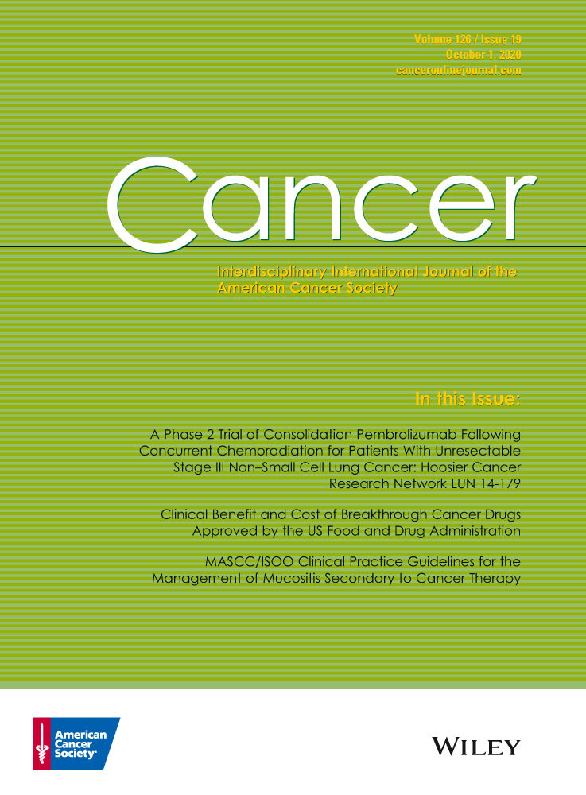
Policy Task Group: Accomplishments & 2021 Goals

Slide 17
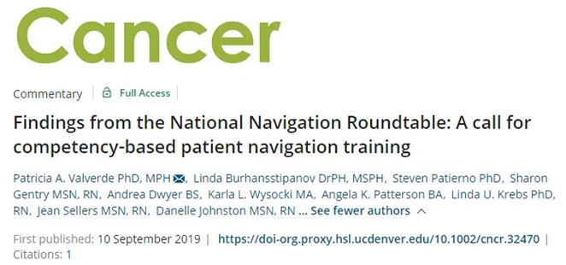
Workforce Development Task Group Accomplishments and Updates
Published a commentary in Cancer on competency-based PN training (Sep 2019)
Created a consensus list of PN competencies
Created a job description based on competencies
Developed one-page fact sheet

Slide 18
Workforce Development Task Group: Accomplishments and Updates
Ad hoc writing group for analysis and manuscript on PN supervision and training for Cancer supplement
Ad hoc group to develop, implement, analyze and write up COVID19 and PN manuscript
Continued to meet during COVID19
Creating the Workforce TG section of strategic plan

Slide 19
Workforce Development Task Group: 2021 Goals
Trainings (Resources and Tools)
Health Equity Lens (Health equity evolution (building or linking equity tools to help others)
Navigation in clinical and non-clinical settings
Resources and deliverables to help achieve cancer navigation throughout the continuum

Slide 20
Orientation Wrap Up: Join Us
Become a Member or Update your membership
Complete the Membership Information Sheet you will be receiving in the next few days
Participate in one of our Task Groups:
Evidence Based Best Practices
Workforce Development
Policy
Volunteer to serve on an NNRT Standing Committee
Nomination/Membership (Currently have 5 members but need 2 more)
By-laws Committee
Run for a spot on the Steering Committee
We will be filling 4 vacant positions and the Chair role at our 2021 meeting
Stay up to date through our website: https://navigationroundtable.org/

Slide 21
Thank you for joining the NNRT Orientation Session.
The main session will use the same Zoom link and start at
2:00 pm ET

Slide 22
2020 Annual Meeting
Navigation in a New Era:
Crisis & Opportunity
Main Session Part 1 • September 29, 2020 • 2:00-4:30 PM ET

Slide 23
Agenda
Welcome and Overview
Break out: Meet your Table Group
Navigation in 2020: Finding Opportunity in Crisis: Panel
Break out: Our 2020 Experiences
Keynote: Navigation and Health Equity
Break out: Keynote Applications
Wrap up and Next Steps

Slide 24
Zoom Best Practices
This meeting will be recorded.
You will be muted with your video turned off when you join the call. Use the buttons in the black menu bar to unmute your line and to turn on your video. *6 to unmute if joining by phone.
Please make sure your video is turned ON in breakouts.
Toggle between Gallery view and Speaker view at top-right of your Zoom window to view select participants or a single speaker.
This call takes place on the Zoom platform. To review Zoom’s privacy policy, please visit zoom.us/privacy
Questions? Type them in the chat box.
ZOOM Technical Support:
Kristen Wehling
American Cancer Society
In case of emergency: kristen.wehling@cancer.org

Slide 25
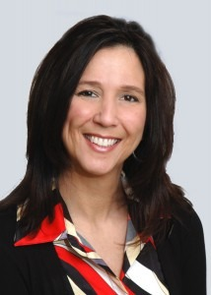
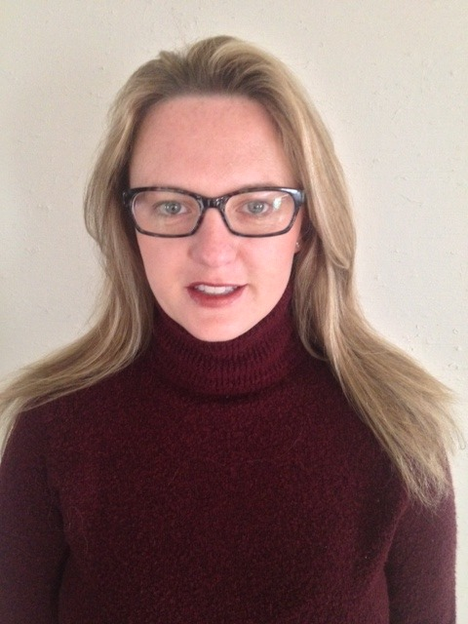
Welcome & Introduction
Tracy Battaglia, MD, MPH, Chair NNRT
Boston University Schools of Medicine
& Public Health
Andrea (Andi) Dwyer, Vice-Chair NNRT
University of Colorado Cancer Center School of Public Health

Slide 26
Special thanks to our NNRT sponsors
and to our Annual Meeting Planning Committee!

Slide 27
Navigation in 2020: A New Perspective
Why “Crisis and Opportunity”?
Highlighting common challenges faced this year (COVID 19, Social Justice, Natural Disasters)
Despite the many challenges, navigators always seem to find the opportunities to help others overcome the challenges
Navigation presents an opportunity to manage through crisis and chaos
How is this meeting different from other annual meetings?
We want this to be YOUR meeting
We want to learn about the experiences of our member organizations and use that to shape our future strategy
We are planning a series of shorter meetings to allow more of our membership to participate and engage
We want you to leave today inspired and ready to engage as an NNRT member

Slide 28
Breakout 1: Meet Your Table Group
Name
Org/Role
Location
Show & Tell
Note: You will be automatically returned to the main group after 7 Minutes.

Slide 29
Navigation in 2020: Finding Opportunity in Crisis

Slide 30
Finding Opportunity in Crisis: Navigator Panel
Before we get started
If you have questions for the panel, please send them by chat and we will post answers on the NNRT website by Monday, 10/5/2020.
*Zoom Etiquette Reminders: Please turn your camera off and mute your line during presentations
*Please include your questions for the speakers in the Zoom Chat Box and we will post the answers on the NNRT website by Friday.
Facilitator:
Andrea (Andi) Dwyer, Vice-Chair, NNRT
Colorado School of Public Health
University of Colorado Cancer Center

Slide 31
Finding Opportunity in Crisis: Navigator Panel Speakers
Jamie M. Callahan, BSN-RN, OCN, CBCN
Oncology Nurse Navigator
UC Health
Fort Collins, CO
Clinical navigation for patients experiencing dual crises and travel restrictions
Sandra E. Arellano, MA, CN-BM
Navigation Program Manager
Lovelace Women’s Hospital
Albuquerque, NM
Restructuring navigation roles & responsibilities, streamlining integrative supportive services and the importance of community partnerships
Zarek Mena, OPN-CG
Women’s Health Program Manager
Whittingham Cancer Center/MSK Physicians at Norwalk Hospital
Norwalk, CT
Starting a food bank and responding to social determinants of health issues

Slide 32
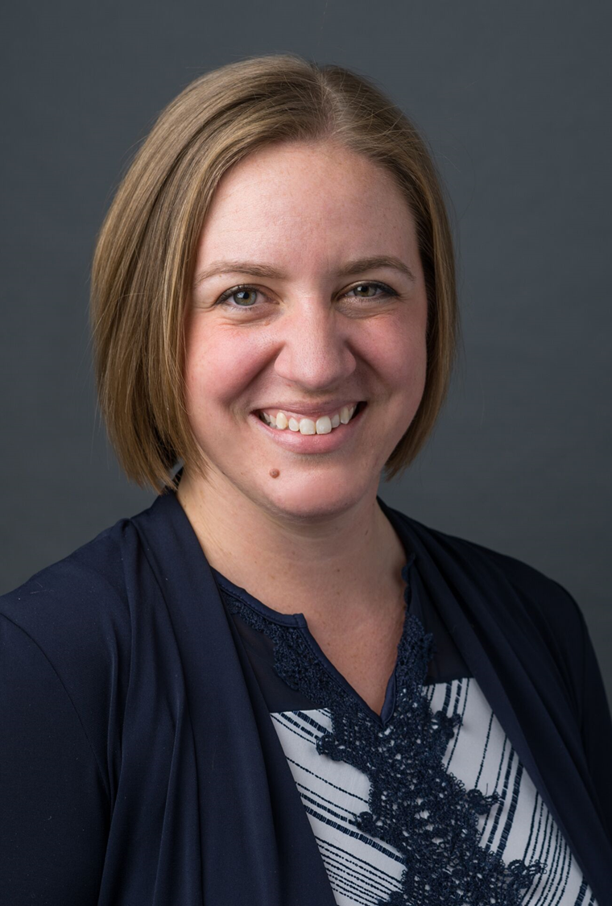
Clinical navigation for patients experiencing dual crises and travel restrictions
Jamie M. Callahan, BSN-RN, OCN, CBCN
Oncology Nurse Navigator
UCHealth
Fort Collins, CO

Slide 33
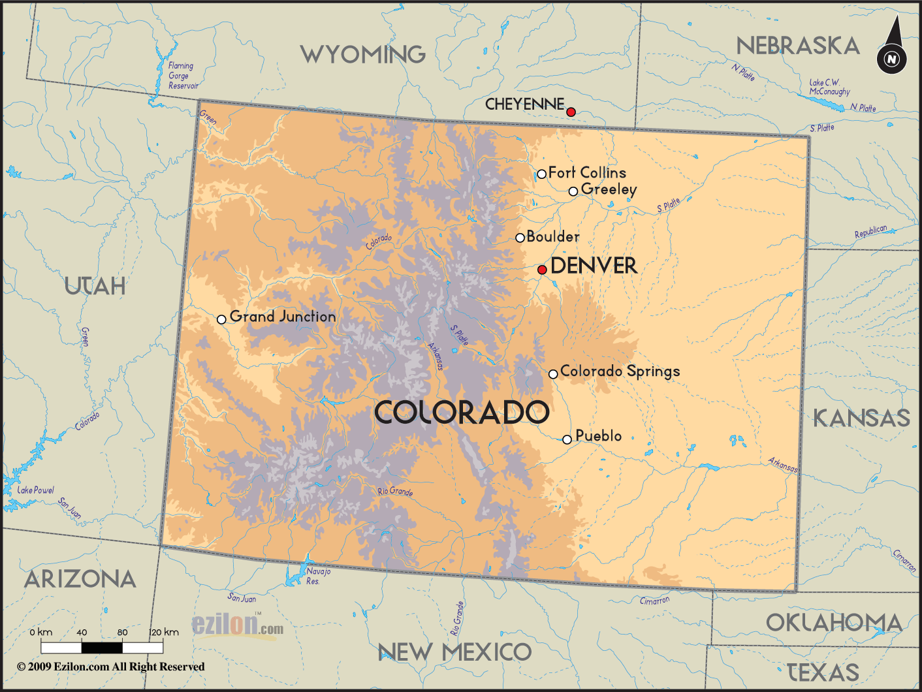

Slide 34
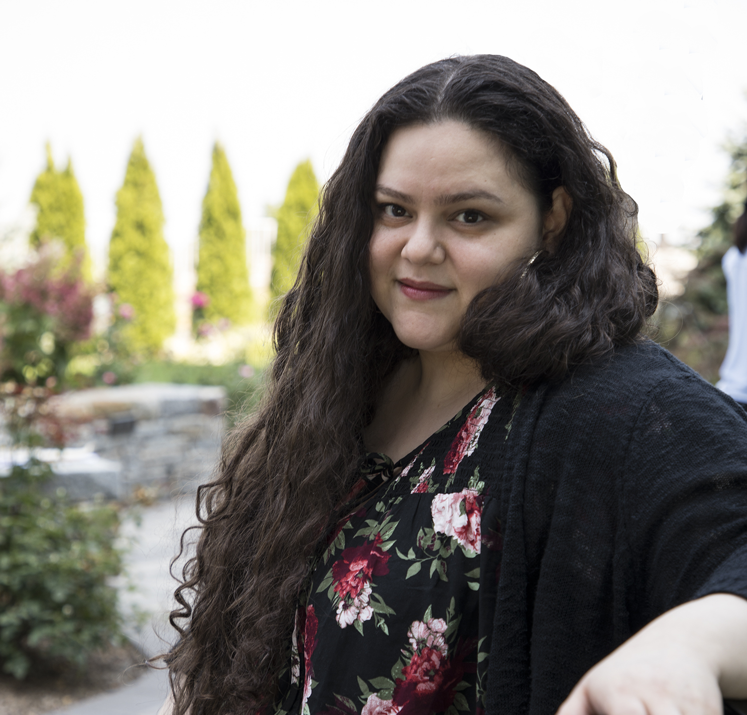
Starting a food bank and responding to social determinants of health issues
Zarek Mena, OPN-CG
Women’s Health Program Manager
Whittingham Cancer Center/MSK Physicians at Norwalk Hospital
Norwalk, CT

Slide 35
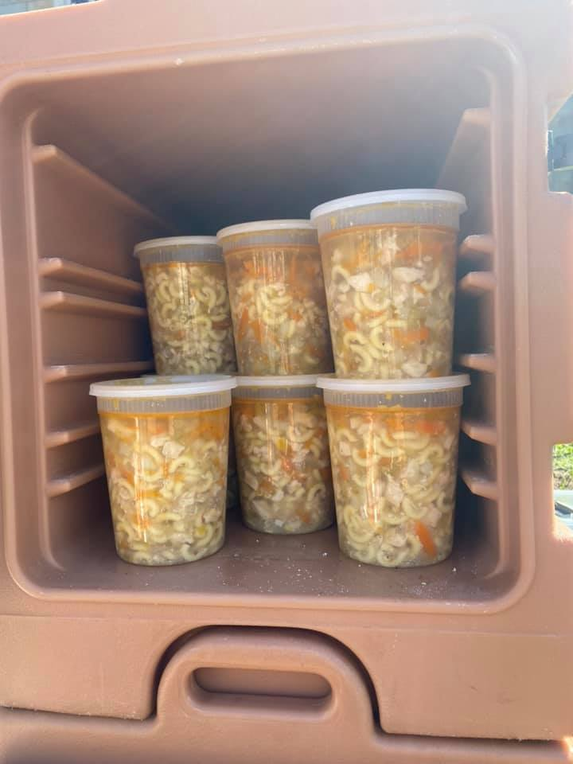
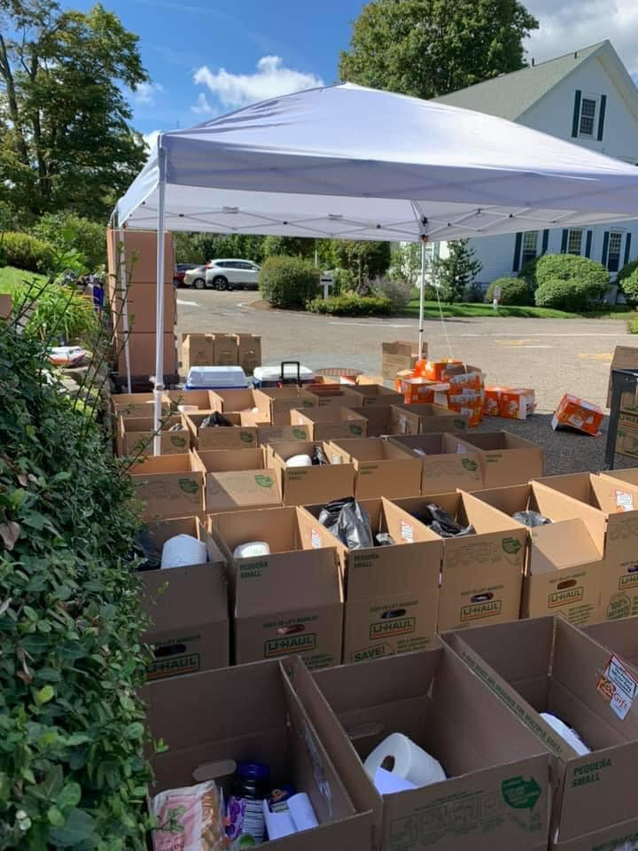
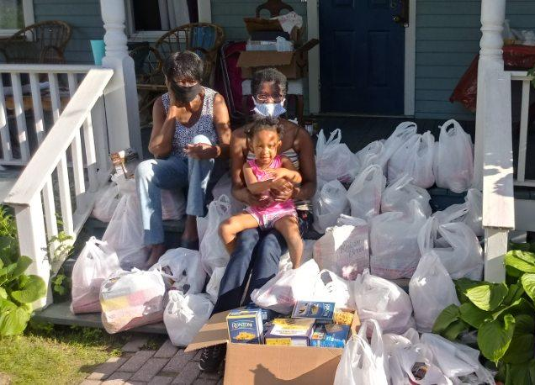
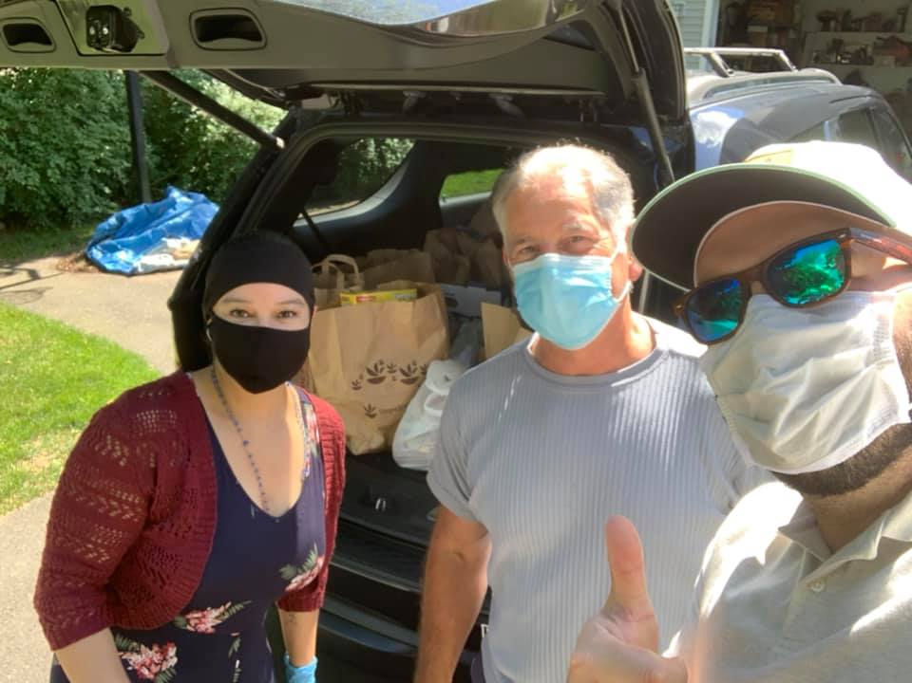
Zarek Mena, OPN-CG, Women’s Health Program Manager
The Smilow Family Breast Health Center
Whittingham Cancer Center/MSKCC Physicians
Norwalk Hospital at Nuvance Health
zarek.mena@nuvancehealth.org (203.852.2357)

Slide 36
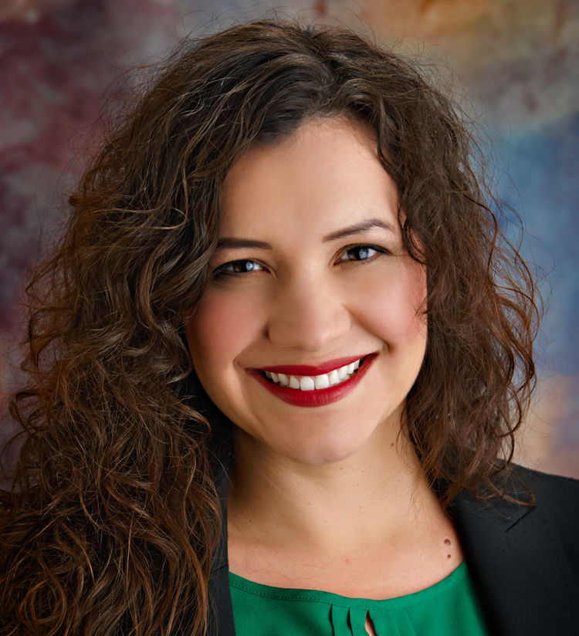
Restructuring navigation roles & responsibilities, streamlining integrative supportive services and the importance of community partnerships
Sandra E. Arellano, MA, CN-BM
Navigation Program Manager
Lovelace Women’s Hospital
Albuquerque, NM

Slide 39
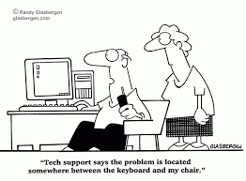

Slide 43
Breakout 2: Our 2020 Experiences
Each participant will tell a 3-minute story about a personally meaningful 2020 experience working in navigation
Situation, action, significance
When finished briefly discuss any overlapping themes
15 minutes
Identify one person to “chat” themes back after breakout

Slide 44
5 Minute Break

Slide 45
Keynote Presentation

Slide 46
Navigation & Health Equity
Natalie S. Burke
President & CEO, CommonHealth ACTION
Washington, DC
Notes:
Give Zoom control to Natalie who will run her slides

Slide 47
Breakout 3: Applications
We’ve heard from Jamie, Zarek, Sandra, Natalie and other colleagues
What inspired you? What did you learn?
What can you apply in your own work?
13 min

Slide 48
Wrap up: Membership Overview & Next Steps

Slide 49
2021 Goal: Raising our Relevance with our Membership
We currently have over 70 member organizations and over 120 individuals representing those organizations.
A primary goal for NNRT in 2021 is to engage our membership and raise our relevance! We need to hear from you.
Examples of our 2020 activities to raise relevance
COVID survey
Multi-part interactive annual meeting
Continuing to update the website with new resources
Supplement in Cancer
Infographics and case studies to make our work more relevant

Slide 50
Who we are……..
“People desperately need help to get quality, timely cancer services. Patient navigation can provide such help. Unfortunately, there are barriers to moving patient navigation forward to all populations. Action MUST be taken.
This is the role of the NNRT – leveraging the voices of many organizations in the patient navigation field to take collective action to expand and sustain navigation programs and their highly skilled navigators. Patient Navigators serve those most in need.”

Slide 51
Working Together: Next Steps
We are planning several new strategic initiatives for 2021:
Toolkit/resources to address navigation program sustainability in community health centers and safety net hospitals
ROI Calculator and case studies
Infographics on Supplement papers translating finding to practical program recommendations
We want to hear from you so please join us for:
Meeting 2 of the Annual Meeting Series: December 7 from 2:00-4:30
Topic: Applying key takeaways from Meeting 1 to the NNRT Strategic Objectives and Activities for 2021
We can only be successful if we take on the issues that are most important to our membership. Come share your ideas.

Slide 52
Orientation Wrap Up: Join Us
Become a Member or Update your membership
Complete the Membership Information Sheet you will be receiving in the next few days
Participate in one of our Task Groups:
Evidence Based Best Practices
Workforce Development
Policy
Volunteer to serve on an NNRT Standing Committee
Nomination/Membership (Currently have 5 members but need 2 more)
By-laws Committee
Run for a spot on the Steering Committee
We will be filling 4 vacant positions and the Chair role at our 2021 meeting
Stay up to date through our website: https://navigationroundtable.org/

Slide 53
Thank You
We look forward to seeing you again in December.
Visit the NNRT website for updates: https://navigationroundtable.org/
Please complete the meeting evaluation (link located in Zoom Chat)

