Slide 1
2020 Annual Meeting
Navigation in a New Era:
Crisis & Opportunity
Meeting 2 • December 7, 2020 • 2:00-4:30 PM ET

Slide 2
Zoom Best Practices
This meeting will be recorded.
You will be muted with your video turned off when you join the call. Use the buttons in the black menu bar to unmute your line and to turn on your video. *6 to unmute if joining by phone.
Please make sure your video is turned ON in breakouts.
Toggle between Gallery view and Speaker view at top-right of your Zoom window to view select participants or a single speaker.
This call takes place on the Zoom platform. To review Zoom’s privacy policy, please visit zoom.us/privacy
Questions? Type them in the chat box.
ZOOM Technical Support:
Kristen Wehling
American Cancer Society
In case of emergency: kristen.wehling@cancer.org

Slide 3
Agenda
Welcome and Meeting 1 Review/Meeting 2 Objectives
Invited Presentation 1: Applying Health Equity Principles in Navigation
NNRT 2020 Strategic Plan & Task Group Review
“Get to know your Task Groups” Breakouts
Invited Presentation 2: Applying Health Equity Principles in Navigation
Closing and call to action

Slide 4
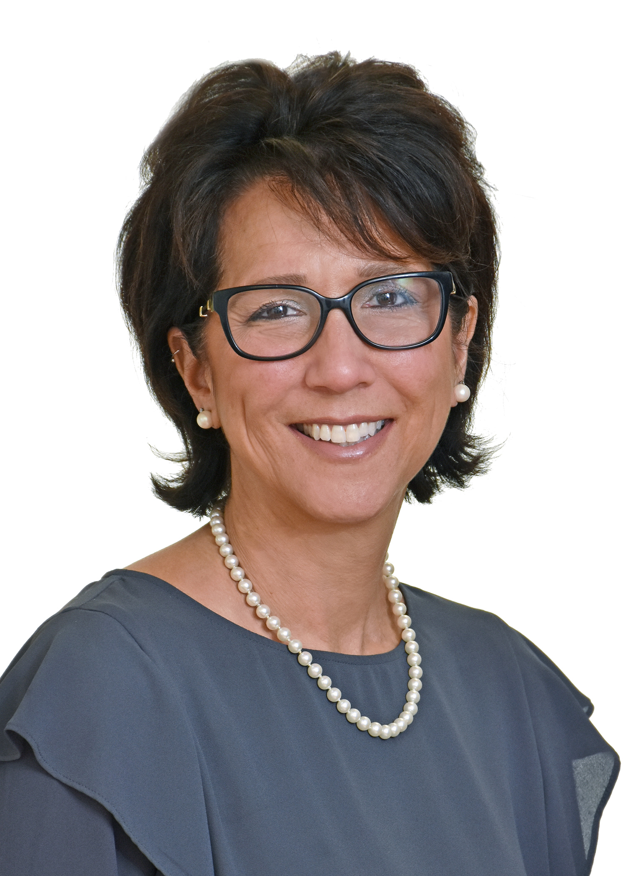
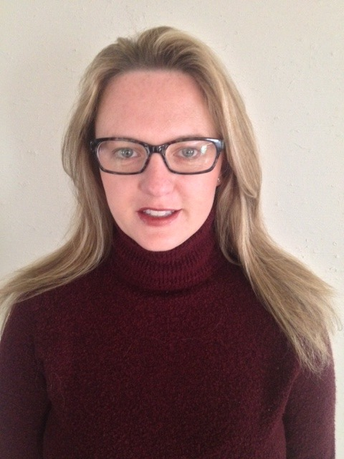
Welcome (back)!
Tracy Battaglia, MD, MPH, Chair NNRT
Boston University Schools of Medicine
& Public Health
Andrea (Andi) Dwyer, Vice-Chair NNRT
University of Colorado Cancer Center School of Public Health

Slide 5
Thank you to:
Our NNRT Sponsors
Annual Meeting Planning Committee!
NNRT Steering Committee
NNRT Task Groups and
NNRT members!

Slide 6
Meeting 1 Key Messages: Health Equity
Context
Language Matters: Common Language
Social Identities
Health Equity
Equity Lens
Intent Vs. Impact
Allyship + Anti-ist
Natalie Burke
President & CEO
CommonHealth ACTION
Washington, DC

Slide 7
Objectives
Introduce the NNRT 2020 strategic plan and work of task groups
NNRT members share how health equity is prioritized in 2 exemplar programs
Small group discussions on approaches to integrating health equity into NNRT/Task group work
Discuss ways to be more involved in NNRT/Task Group work

Slide 8
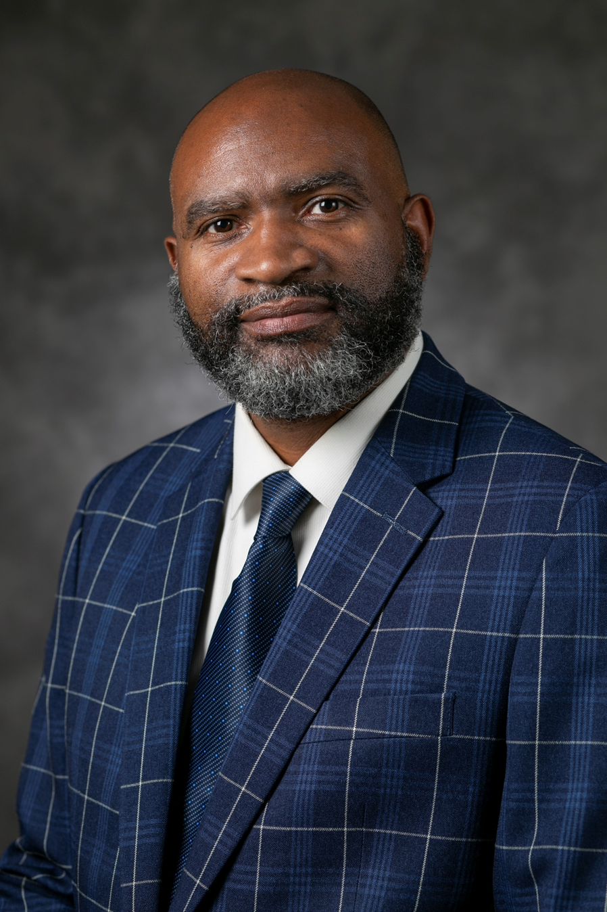
Invited Member Presentation: Angelo Moore, PhD, MSN, RN, NE-BC Program Manager Office of Health Equity Duke Cancer Institute Q&A Facilitator: Angie Patterson

Slide 9
OHE Vision and Mission
Vision:
To excel as the leader in reducing cancer disparities through authentic community engagement and partnerships, the delivery of seamless cancer care, and the provision of outstanding and innovative research and resources to achieve optimal health in a changing and diverse environment.
Mission:
To reduce cancer disparities and promote health equity within the Duke Cancer Institute’s catchment area through strategic initiatives that integrate the following core areas:
Community Outreach & Engagement
Community-Facing Patient Navigation Services
Health Disparities Education
Clinical Trials Education & Workplace Diversity
Target Populations

Slide 10
OHE Community-Facing Navigation
Duke Cancer Institute has officially adopted Patient Navigation (PN) as a system-wide program housed in the Office of Health Equity to provide education and resources to community members and patients who seek cancer screenings, diagnoses and treatment.
Patient Navigations services include, but are not limited to:
Bilingual education to community members on cancer risks and screening guidelines
Assisting patients in establishing a medical home
Assisting patients in obtaining financial help for their medical care
Helping patients complete insurance paperwork
Directing patients to healthcare services for further diagnosis and referral for Treatment Navigation
Providing navigation guidance in and through the healthcare system by
Keeping track of and helping patients get to their medical appointments
Talking to patients' medical teams

Slide 11
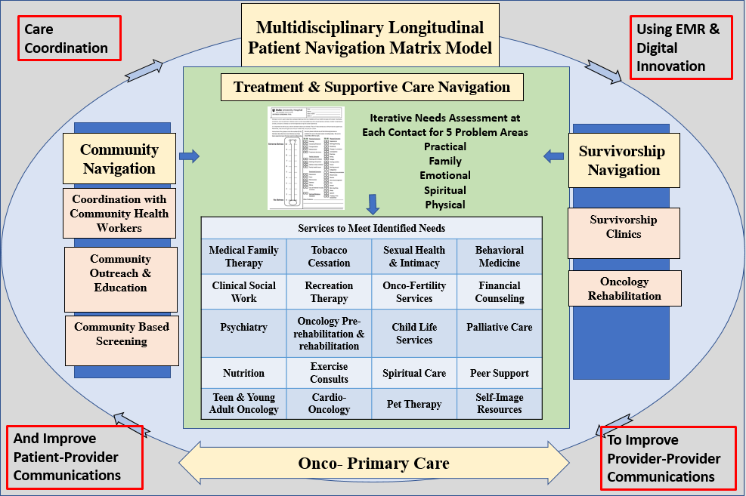
DCI Patient Navigation

Slide 12
Key Annual Community Outreach Events
Men’s Health Screening: Free community screening program between DCI, LCHC and DPC Croasdaile
NIEHS Women’s Health Awareness Day: Annual program reaching ~600-800 women, DCI leads the cancer track
Educated over 300 women in cancer risks, symptoms, and screenings.
Provided thyroid screening = 106, Lung cancer assessments = 108, Radon kit testing with follow-up = 272.
Held in April
2019 MHS = 321 Men
 | Total | Normal | F/U Needed | Range
PSA | 297 | 250 | 47 | 0.08-31.95ng/ml
DRE | 204 | 192 | 12
Skin | 100 | 93 | 7
CRC | 79 |  | 2 | 56% Return Rate
BP | 286 | 74 | 212 | 187 = Stage 1&2
DM | 193 | 112 | 81 | 4 = HbgA1C >12
HIV | 220 | 217 | 3
HEP C | 220 | 218 | 2
Radon | 91

Slide 13
Community Navigation Examples
47 y.o. AAM homeless with renal cancer
20 y.o. Latina twins with thyroid cancer
50 y.o. AAM with prostate cancer

Slide 14
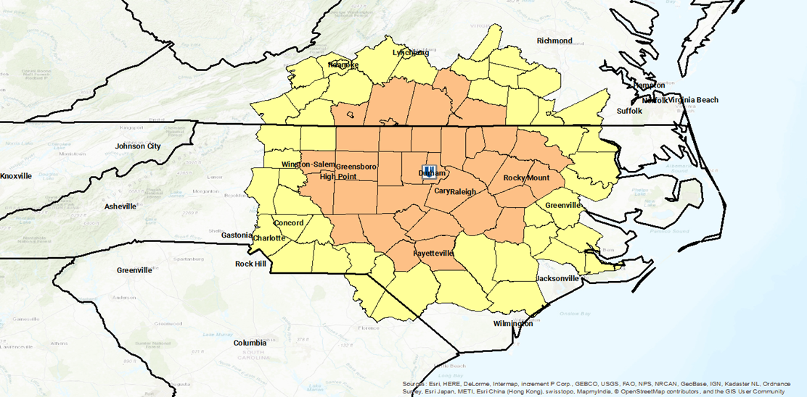
DCI Cancer Burden Catchment Area: CHA Program Reach
Wake, Alamance, Orange, Scotland, Brunswick, Pitt, Lenoir, Edgecombe, Guilford, Franklin, Robeson, Cleveland, Gaston, Nash, New Hanover, Durham, Vance, and Granville Counties
x
x
x
x
x
x
x
x
x
Greene
x
x
x
x
x
x
x
x
x
x

Slide 15
Questions? Submit them through the Chat Function in Zoom
Contact:
Email: angelo.moore137@duke.edu
Phone: (919) 668-7946

Slide 16
2020-2022 Strategic Plan Overview & Task Group Review/Alignment

Slide 17
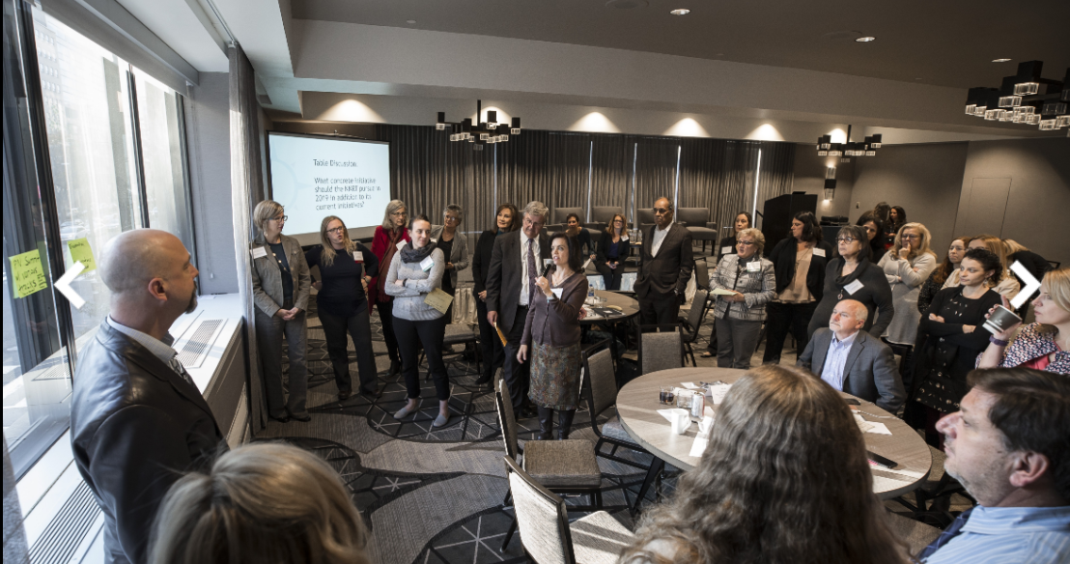
Who is the NNRT?
The NNRT is made up of members from over 80 organizations (130 individual members) representing:
health systems
cancer centers
academic institutions
cancer and health related non-profits
state and federal government organizations
health plans
private industry

Slide 18
What we do…….
Vision | High quality cancer care for all through evidence-based navigation.
Mission | A collaborative advancing navigation efforts that eliminate barriers to quality care, reduce disparities in health outcomes, and foster ongoing health equity across the cancer continuum.
People desperately need help to get quality, timely cancer services. Patient navigation can provide such help. Unfortunately, there are barriers to moving patient navigation forward to all populations. Action MUST be taken. This is the role of the NNRT – leveraging the voices of many organizations in the patient navigation field to take collective action to expand and sustain navigation programs and their highly skilled navigators.”

Slide 19
How do we do our work?
4 Primary Task Groups
Evidence Based Best Practices Task Group
Policy Task Group
Workforce Development Task Group
Public Awareness & Communications Groups
Task Groups are where “collective action” begins, by bringing members together to work toward common goals:
Navigators, Physicians, Nurses, Social Workers, Community Health Workers, Researchers, Health System Leadership/Administration, Program Directors, …………..Just to name a few

Slide 20
Strategic Goals: 3-year
 | Clarify Process & Role | Provide Tools & Training | Align to Health Equity | Influence Policy | Represent Key Stakeholders
3 Year Goals | A shared understanding of the process of Navigation and every caregiver’s role in the navigation process | Tools/TA/Training for those who want to adopt evidence-based Navigation | All NNRT activities demonstrates a clear Health Equity lens | NNRT has seat at table in key stakeholder groups that promote Policy and policy | NNRT has the right balance of members and leadership structure to advance mission
1-Year Measurable Objectives | Processes and roles defined in collaboration with our member organizations | We have disseminated findings from national survey (Cancer Supplement publication, national presentations) ROI Tool Work Beginning | Criteria are developed for activities that include health equity lens | Key stakeholders and professional organizations are aligned with NNRT mission. We have defined ‘seat at the table’ | A leadership structure that ensures balance of key stakeholder perspectives is in place
3-Year Measurable Objectives | NNRT affiliated organizations and members (i.e. CoC) have adopted shared definition of roles | A robust longitudinal TA/training dissemination strategy exists which meets needs of our membership (i.e. website, webinars, symposia) | At least half of NNRT activities include health equity lens | NNRT has a demonstrated seat at the table for 80% of these stakeholder groups | Leadership structure in place and 80% of stakeholder groups are represented

Slide 21
Definition of Health Equity Through A Cancer Lens
Everyone has a fair and just opportunity to prevent, find, treat, and survive cancer.
No one should be disadvantaged in their fight against cancer because of how much money they make; the color of their skin; their sexual orientation; their gender identity; their disability status; or where they live.
.​
Equity is not the same as equality. Equality is providing everyone with the same tools and resources.
To achieve equity, individuals and populations with the greatest needs and least resources require different, not equal, effort and resources to improve their health.

Slide 22
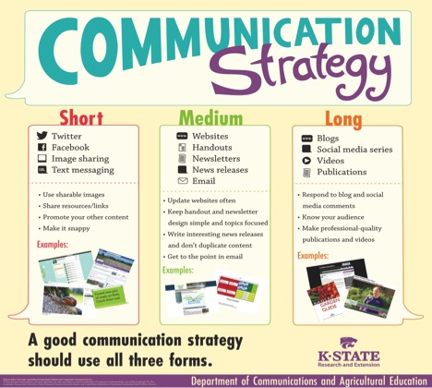
Task Groups
Evidence Based Promising Practices
Beth Calhoun, PhD, Med Electra Paskett, Ph.D.
Workforce Development
Linda Burhansstipanov, MSPH, DrPH Patti Valverde, PhD, MPH
Policy
Elizabeth Franklin, Ph.D., MSW Elizabeth Rohan, PhD, MSW
Public Awareness/Comm
Linda Fleisher, Ph.D., MSW
Linda Burhansstipanov, MSPH, DrPH

Slide 23
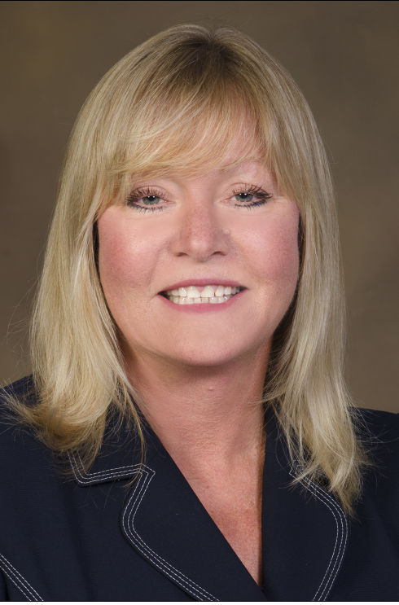
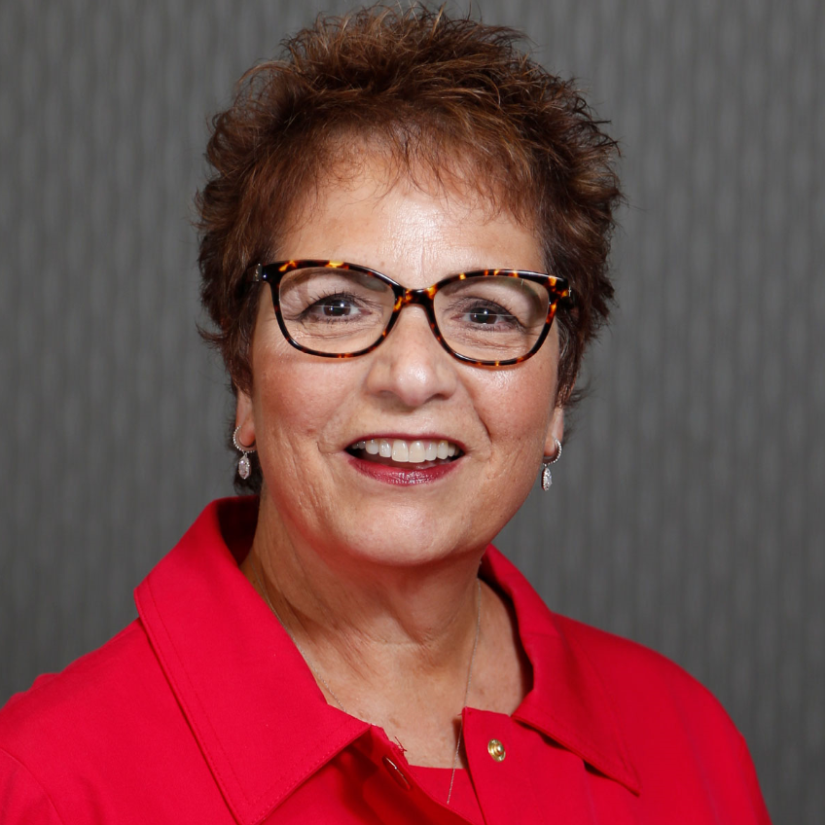
Evidence Based Promising Practices
Task Group Goal: Focus on establishing an evidence
based/outcome driven patient navigation model.
Task Group Co-Chair
Elizabeth Calhoun, PhD, MEd
University of Kansas, School of Medicine
Task Group Co-Chair
Electra D. Paskett, PhD
Ohio State University/James Cancer Center

Slide 24
Evidence Based Promising Practices
Accomplishments of the Committee:
Accomplishment #1: The Task Group created and conducted a survey to identify metrics and barriers to implementing these metrics. The survey was completed by navigators and navigation program administrators. The survey was supported by a national navigation organization. A total of 778 participants completed the survey.
Accomplishment #2: A supplement in Cancer is underway. Plans are for the supplement to published February 2021.

Slide 25
Evidence Based Promising Practices
Projects planned for 2021-2022:
Identify case studies across the cancer continuum from outreach through end of life that demonstrate financial sustainability
Potential other case studies i.e., Financial toxicity (Health Equity Focus)
Develop a multi-media approach to disseminate the case studies

Slide 26
HOW CAN TASK GROUPS ALIGN WORK TO ACHIEVE NNRT GOALS? TASK GROUP STRATEGIES WITH DELIVERABLE DATES EXAMPLES
 | Clarify Process & Role | Provide Tools & Training | Align to Health Equity | Influence Policy | Represent Key Stakeholders
Evidence TG (Date) | Analyze survey data to answer questions about overall navigation Develop case studies JANUARY 2021- December 2021 | Publish finding in Cancer Supplement (February 2021) Develop Case Studies to support sustaining navigation programs with an emphasis on making the business case but also achieving health equity JANUARY 2021-December 2021 | Survey analyses consider equity Develop Case Studies to support health equity JANUARY 2021-December 2021 | Use data to inform recommended policy initiatives Dissemination of Cancer Supplement to policy stakeholders. Engage policy stakeholders in case studies and work with them for dissemination of case studies. JANUARY 2021-December 2021 | Key stakeholders are engaged in the case studies and dissemination of the case studies. JANUARY 2021-December 2021

Slide 27
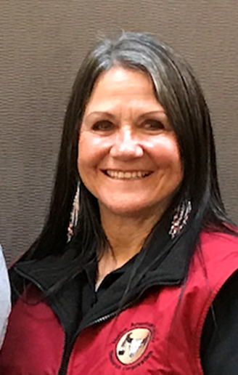
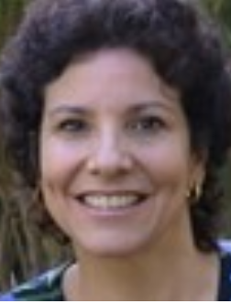
Workforce Development Task Group
Task Group Goal: ensuring that there is an activated trained
workforce-to implement the model
Task Group Co-Chair:
Linda Burhansstipanov, DrPH, MSPH
Founder, Native American Cancer Research Corporation
Task Group Co-Chair:
Patricia Valverde, PhD, MPH
University of Colorado Denver

Slide 28
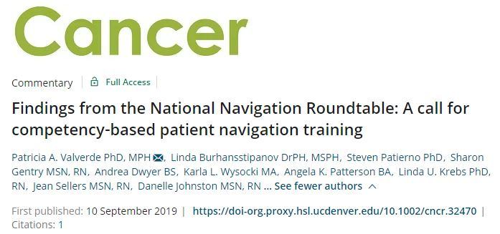
Workforce Development
Accomplishments
Published a commentary in Cancer on competency-
based PN training (Sep 2019)
Created a consensus list of PN competencies
Created a job description based on competencies
Developed one-page fact sheet
Members of Task Group almost completed 2 peer-reviewed manuscripts
Analysis and manuscript on PN supervision and training for Cancer supplement
Develop, implement, analyze and write up COVID19 and PN manuscript

Slide 29
HOW CAN TASK GROUPS ALIGN WORK TO ACHIEVE NNRT GOALS? TASK GROUP STRATEGIES WITH DELIVERABLE DATES EXAMPLES
 | Clarify Process & Role | Provide Tools & Training | Align to Health Equity | Influence Policy | Represent Key Stakeholders
Workforce Development TG (Date) | Conduct COVID-19 survey to understand impact on cancer PN workforce. OCTOBER 2020 What tools and resources do you need to improve, describe and communicate the importance of PN in clinical and non-clinical settings? (2021) | Disseminate findings from survey in Cancer supplement JANUARY 2021 What tools and resources do you need help PN throughout the continuum (starting with outreach through end-of-life) (2021) Determine criteria for tools & training (2021) | Explore role of safety net settings on COVID survey findings OCTOBER 2020 Identify resources that are appropriate to share with Patient Navigators who work with underserved populations and what tools and resources do you need to address improve diversity training for PNs? (2021) What tools and resources do you need to increase diversity on the workforce, worksite (2021) | Results inform recommendation to Policy Task Group DECEMBER 2020 | Policy partners lead survey and analyses OCTOBER 2020

Slide 30
Workforce Development
Projects planned for 2021-2022
Navigation in Clinical & Non-clinical settings & importance of PNs
What tools and resources do you need to improve, describe and communicate the importance of PN in clinical and non-clinical settings?
Health Equity (Building or linking equity tools to help others)
What tools and resources do you need to increase diversity on the workforce, worksite
Resources & Deliverables (to help achieve cancer navigation throughout the continuum)
What tools and resources do you need help PN throughout the continuum (starting with outreach through end-of-life) working with underserved populations and identify criteria for posting resources and tools to the NNRT website.
Training (Resources & Tools)
Identify resources that is appropriate to share with Patient Navigators who work with underserved populations and what tools and resources do you need to address improve diversity training for PNs?

Slide 31
Policy Task Group
The Policy Task Group uses evidence and engages stakeholders to support initiatives related to the sustainability the work of patient navigation, including, defining roles, establishing the business case, and championing reimbursement.

Slide 32
Policy Task Group
Task Group Goal: establishing policies to support paying for implementation of the model
Task Group Co-Chair
Elizabeth Franklin, MSW, Ph.D.
Cancer Support Communities
Task Group Co-Chair
Elizabeth Rohan, Ph.D., MSW, LCSW
Centers for Disease Control & Prevention

Slide 33
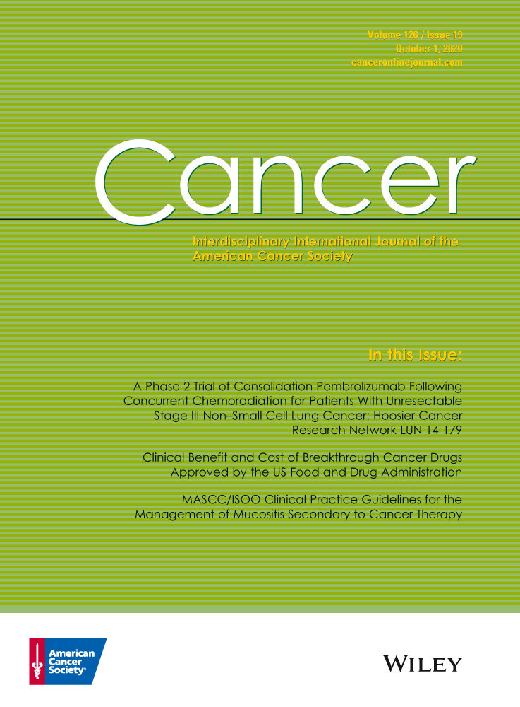
Policy Task Group

Slide 34
Policy Task Group 2021 Projects/Activities
HOW CAN TASK GROUPS ALIGN WORK TO ACHIEVE NNRT GOALS? TASK GROUP STRATEGIES WITH DELIVERABLE DATES
 | Clarify Process & Role | Provide Tools & Training | Align to Health Equity | Influence Policy | Represent Key Stakeholders
Policy TG (Date) | Develop Return on Investment (ROI) model for diverse PN programs that address all processes and roles DECEMBER 2020 | Create Return on Investment (ROI) model as Electronic Tool fpr different settings JANUARY 2021 | Tool accounts for safety net settings JANUARY 2021 | ROI tool findings inform policy partners initiatives JANUARY 2021 | Policy partners endorse RO1 findings JANUARY 2022

Slide 35
Policy Task Group 2021 Projects/Activities
Science
Partnerships
Opportunity

Slide 36
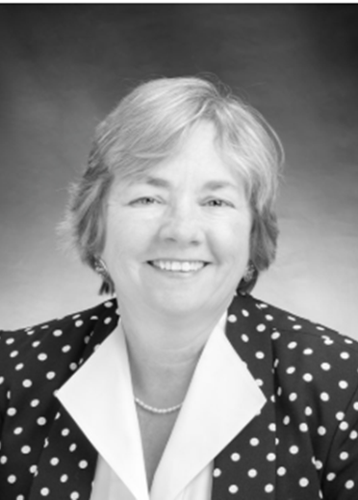
Public Awareness/Communications
Task Group Goal: Supports public awareness of the evidence-based model through multiple communication channels to members, partner organizations, and other interested parties
We are just getting started. If you have an interest in the following, please join us:
Establishing an NNRT Communication Plan/Calenda and social media plan (when do we post, what do we post, who posts)
Enhancing/updating the NNRT website
Dissemination of all NNRT resources, publications etc.
Other communication strategies (blogs, videos, pod-casts, newsletters, infographics)
Working closely with the Membership Committee on promoting the NNRT
Task Group Co-Chair:
Linda Burhansstipanov, DrPH, MSPH
Founder, Native American Cancer Research Corporation
Task Group Co-Chair
Linda Fleisher, PhD, MPH
Fox Chase Cancer Center

Slide 37
Public Awareness/Communications
Major accomplishments to date:
Review and recommendations to the NNRT website – the goal is to have the NNRT website one of the most visited websites for patient navigation resources
Initiated a SOP (including form to be completed) for what to post on NNRT website
Inventory of NNRT products and materials to include in the redesigned NNRT website
Initiated the concept for NNRT elevator speech; Ryan Soisson coordinated and refined the process; Soisson facilitated the process for refinements by the NNRT SC
Developed infographic concepts that will be produced by ACS’s third-party communications firm
Cultural humility, health disparities, health inequities and what is the PN's role (what are the steps to reaching the 3-year role (January 2021)

Slide 38
HOW CAN TASK GROUPS ALIGN WORK TO ACHIEVE NNRT GOALS? TASK GROUP STRATEGIES WITH DELIVERABLE DATES EXAMPLES
 | Clarify Process & Role | Provide Tools & Training | Align to Health Equity | Influence Policy | Represent Key Stakeholders
Public Awareness TG (Date) | Disseminate processes and procedures for posting and updates NNRT website for dissemination. Communication Plan DECEMBER 2020 | Develop summaries and infographs of key findings from Cancer Supplement articles Launch social media plan MARCH 2021 | Materials on cultural humility & health disparities and inequities and the role of PN and multi-lingual materials JANUARY 2021 | Develop a database of key stakeholders and disseminate policy related NNRT materials JUNE 2021 | Engage NNRT members and key organizations in the developing Work Group MARCH 2021

Slide 39
Public Awareness/Communications
Projects planned for 2021-2022
Develop summaries and infographics of key findings from Cancer Supplement and COVID survey articles – focus on the impact on health disparities and health equity
Launch social media plan – focus on both professional and public – explore social media outlets used by underrepresented populations.
Review & disseminate materials on cultural humility, health
disparities and health equities and the role of PN
Identify, recommend & disseminate multi-lingual materials for PN
Develop a database of key stakeholders and disseminate policy
related NNRT materials
Engage NNRT members and key organizations in the expanding Work Group membership

Slide 40
Break

Slide 41
Task Group Breakouts

Slide 42
Break Out Instructions
You will be automatically moved into 1 of 7 Task Group breakouts. Breakout is 30 minutes.
Current Task Group members are assigned to a breakouts with their Task Group. Participants who are not current members of a Task Group will be randomly assigned.
Task group chairs will facilitate.
The purpose of this breakout gain clarity regarding the task group and to discuss how this group might better address health equity.
Question 1: From the work you do, what health equity related issues/needs do you have that might be addressed by the ________________________Task Group?
Question 2: Based on your experience, what could this task group do to address these health equity needs?

Slide 43
Invited Member Presentation Linda Burhansstipanov, DrPH, MSPH Cherokee Nation Founder, Native American Cancer Research Corporation, President, Native American Cancer Initiatives, Incorporated Q&A Facilitator: Sharon Gentry

Slide 44
Native American Cancer Research Corporation, & PN (Native Sisters) & Health Equity
Staff started 1994 via RWJF (NAWWA)
Founded NACI 1998; NACR 1999
Native Sisters programs expanded via foundation,
state, then NIH funding
Cultural focus throughout continuum (outreach -> EOL)
Issues of trust, spirituality, logistics specific to AI/ANs (IHS / PRC; tribal laws and wills)
Characteristics of effective & efficient Native Sisters
Native (preferred, but Non-NDN too! [Walking Forward]), respected by the community (credibility in the community), model healthy behaviors, Passion for helping community members, education varies (service vs. research grant; nurses=needed as much training as “some college”)

Slide 45
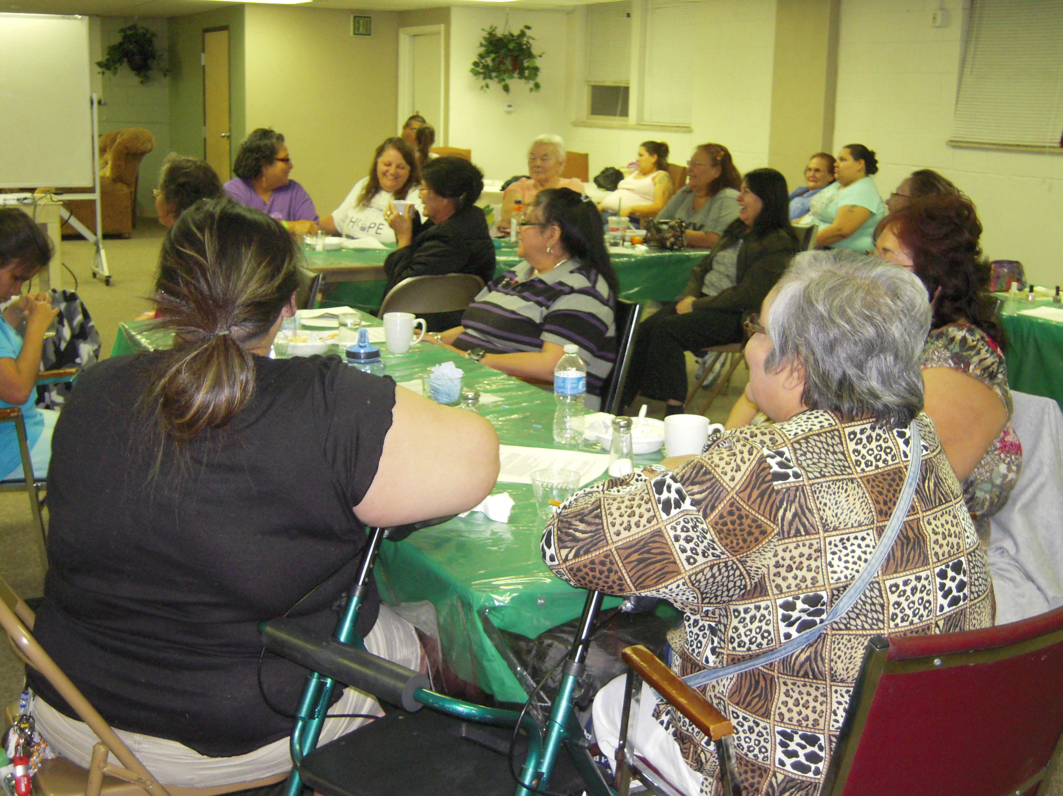
NPN / Native Sisters Address Disparities well due to Training
Outreach (public, culturally tailored workshops,
exhibits [PowWows], in-home visits)
Unique communication patterns, working with
HC Team (SW, clinical staff), resources
Logistics learning how to cross clinical threshold
Outreach -> Recruitment ->Prevention -> Early Detection -> Diagnosis -> Treatment -> Recovery and QOL -> Survivorship -> Palliative care (comfort care, managing side effects) -> end-of-life
Basic skills (Meet Ms. Mouse), basic cancer and screening content to addressing side effects of cancer or cancer treatments

Slide 46
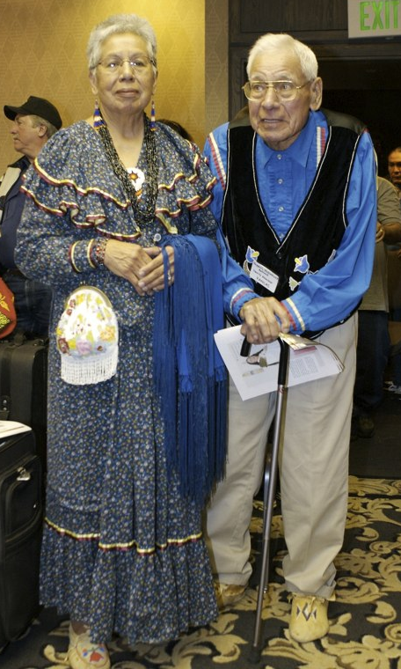
NPN / Native Sisters Address Disparities well due to Training
Expanded from screenable cancers to cancer sites of
interest to tribal programs (stomach, ALL) and long /
-late effects of cancer or cancer treatments
Survivorship issues among AI/ANs (logistical
regression to identify excessive problems in
comparison to City of Hope QOL issues)
Refresher sessions (e.g., 3X for CT)
In-person trainings throughout NDN Country -> Webinars
ARS -> GoToTraining or Zoom (Avg increase in knowledge >25%)
NACI Care© (not limited to Indigenous programs)

Slide 47
Overall NPN Workshop Evaluation (ARS, online, webinar)
Average % of participants that rated NPN training content as "understandable” = 94.5%
Average % of participants that responded "I agree" that the NPN trainings sessions providing useful information = 98.7%
Average % of participants that answered "yes" they would recommend the training to other PNs = 98.7%
https://natamcancer.org/Training
https://natamcancer.org/Overview
People don’t care how much you know until they know how much you care

Slide 48
Meeting Review & Close

Slide 49
Reflections from Meeting 2
Introduce the NNRT 2020 strategic plan and work of task groups
NNRT members share how health equity is prioritized in 2 exemplar programs
Small group discussions on approaches to integrating health equity into NNRT/Task group work
Discuss ways to be more involved in NNRT/Task Group work

Slide 50
Next steps
To accomplish NNRT strategic plan, we need your help-collective action
Call to action:
BECOME A MEMBER or UPDATE YOUR MEMBERSHIP INFORMATION!! https://navigationroundtable.org/membership-application/
JOIN A TASK GROUP: Please enter your name, e-mail address and the group you are interested in joining into the Chat now.
STAY TUNED for more information on Meeting III coming in Spring 2021.
Topics for upcoming meetings will include:
Technology in navigation (Tele-navigation, Digital resources in navigation, EHRs
Clarifying roles and responsibilities in navigation

Slide 51
Thank You
We look forward to seeing you again in December.
Visit the NNRT website for updates: https://navigationroundtable.org/
Please complete the meeting evaluation (link located in Zoom Chat)

