Slide 1
2022 Call to Action Series
October 25, 2022
4:00 – 5:00 ET
Meeting 1 October 25, 2022 • 4-5 PM ET

Slide 2
Zoom Best Practices
This meeting will be recorded.
Have your smartphone to interact with polling questions.
For social media, please tag posts with our meeting hashtag #NNRT22
You will be muted with your video turned off when you join the call.
This call takes place on the Zoom platform. To review Zoom’s privacy policy, please visit zoom.us/privacy
Questions? Type them in the Question and Answer box at the bottom of your screen.

Slide 3
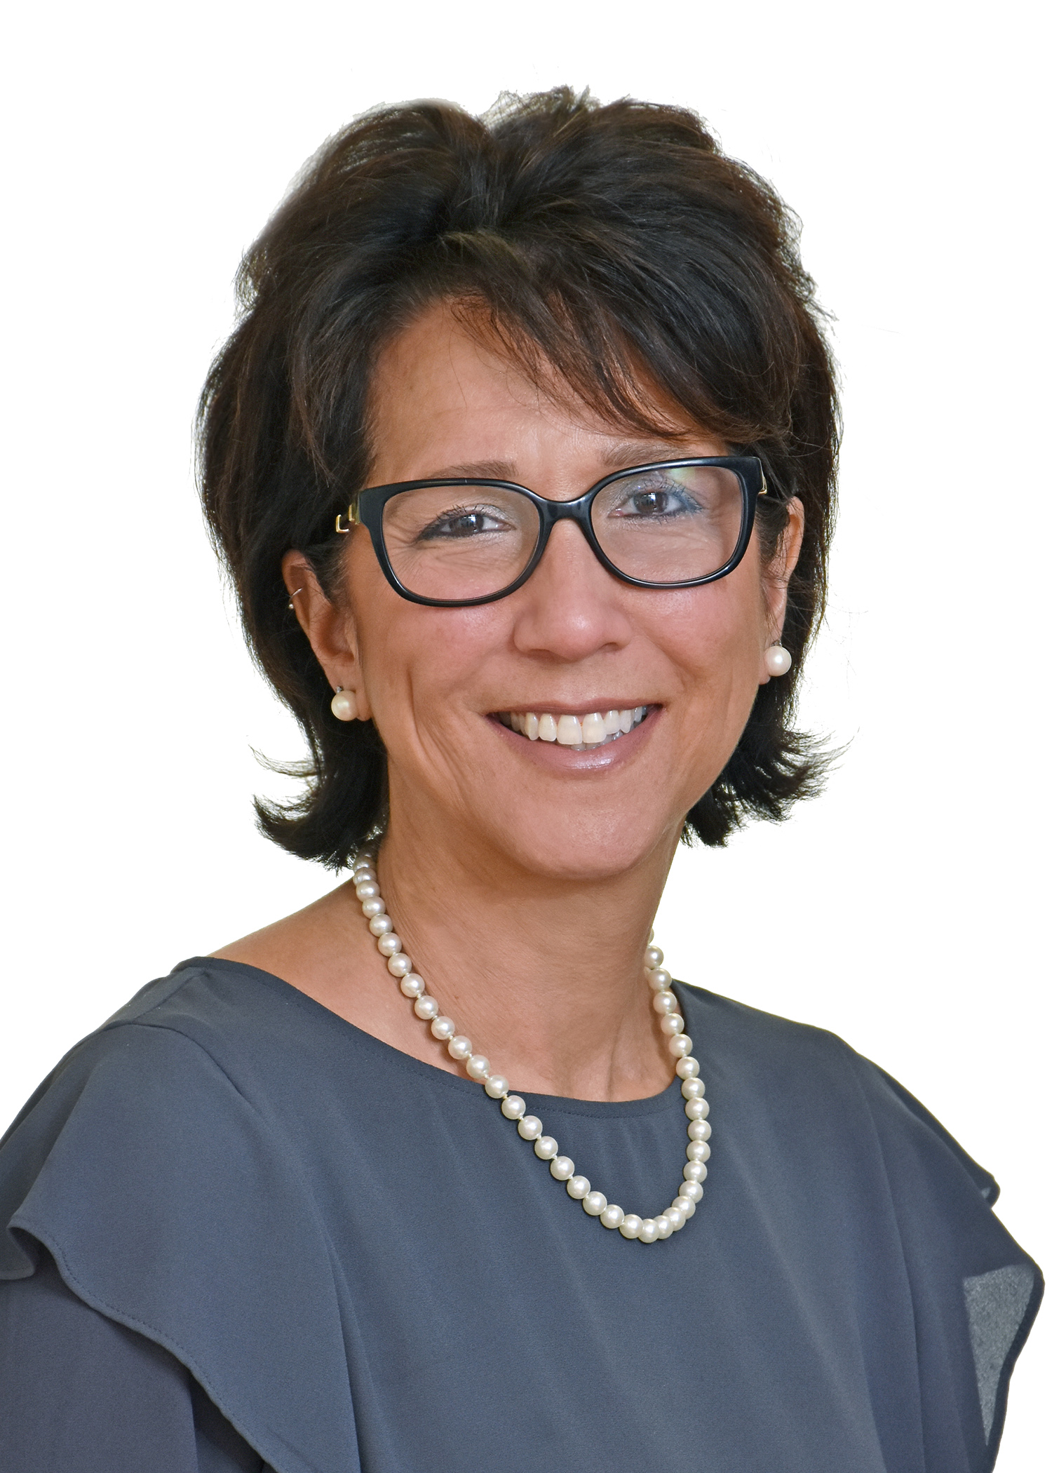
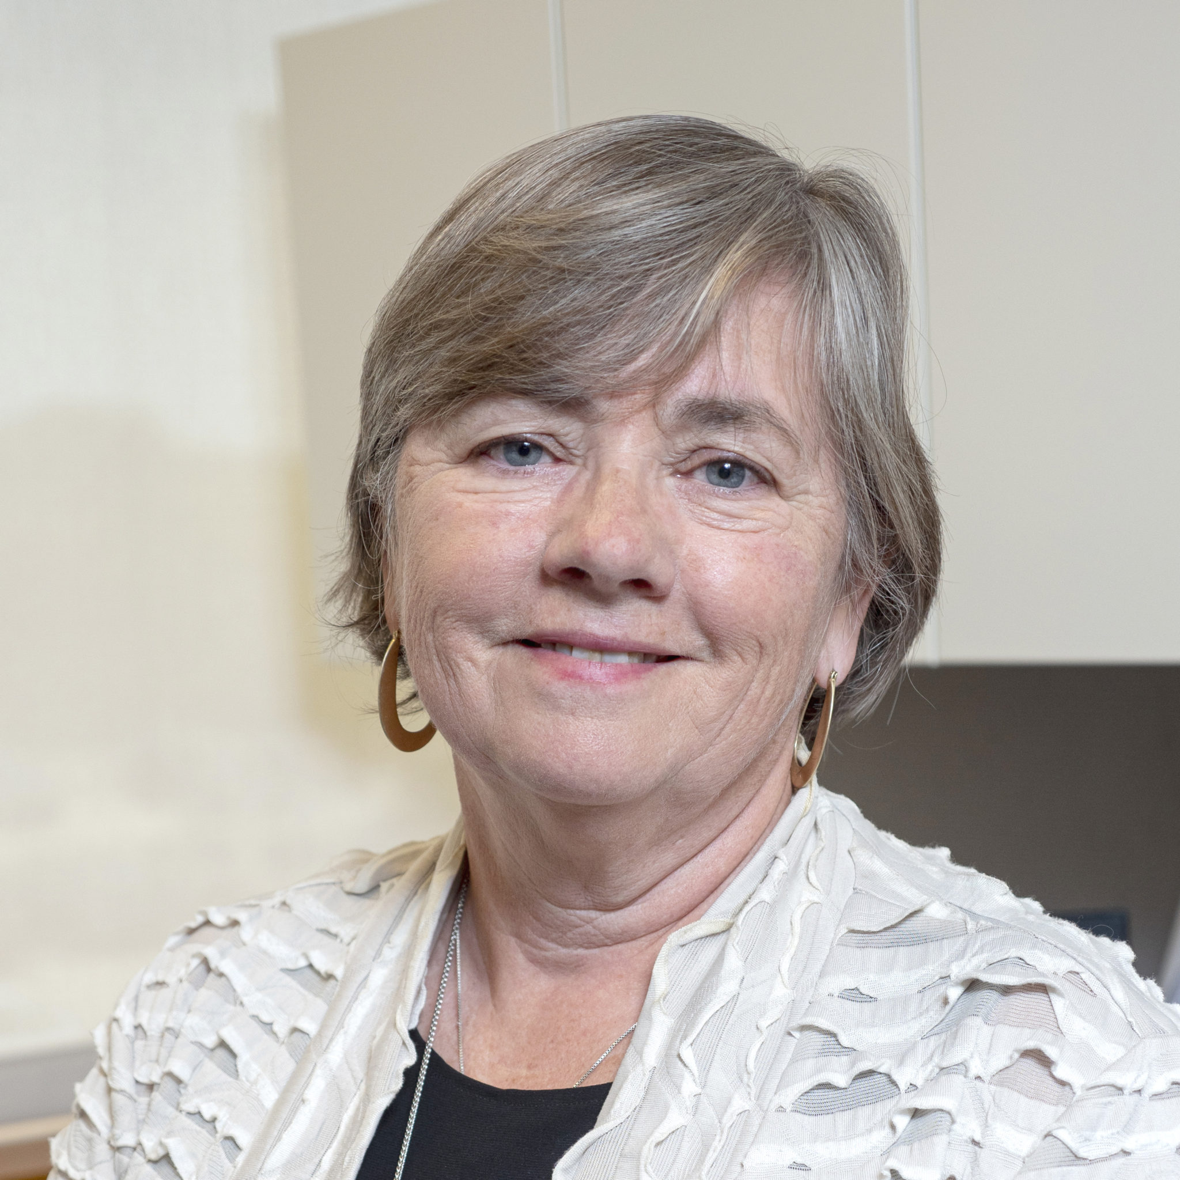
Welcome!
Linda Fleisher, PhD, MPH, Vice-Chair NNRT
Fox Chase Cancer Center
Tracy Battaglia, MD, MPH, Advisor to Chair NNRT
Boston University Schools of Medicine & Public Health

Slide 4
Agenda
Introduction to NNRT
Summary of NNRT Survey Findings
Panelist Introductions
Panel Discussion: Q & A
Closing and call to action

Slide 5
Tell us about you! Which describes your role best......
ⓘ Start presenting to display the poll results on this slide.

Slide 6
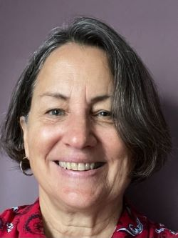
NNRT Steering Committee
Kristina Thomson, LCSW
Director, NNRT
Michelle Chappell, MS
Program Manager, NNRT

Slide 7
A Decade Later: The State of Patient Navigation in Cancer
https://acsjournals.onlinelibrary.wiley.com/toc/10970142/2022/128/S13
Notes:
published in the Cancer journal on June 14, 2022.

Slide 8
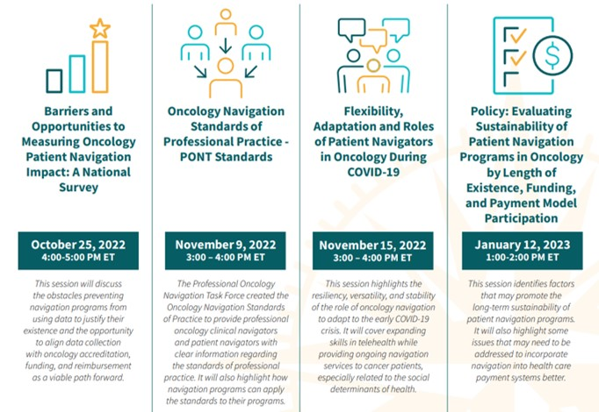

Slide 9
Barriers and opportunities to measuring oncology patient navigation impact: Results from the National Navigation Roundtable survey Battaglia, TA, Fleisher, L, Dwyer, AJ, Wiatrek, DE, Wells, KJ, Wightman, P, Strusowski, T, Calhoun, E. Cancer. 2022.

Slide 10
Background
Evaluation data is critical to sustaining navigation programs
demonstrate value and impact
identify best practices, equity
support funding models
Stakeholder driven metrics have been developed, but the extent to which programs utilize these metrics is unknown
NNRT conducted national survey of navigation programs to understand:
Which types of programs/organizations use data
How metrics are being collected and used
What barriers exist in collecting and using data

Slide 11
Survey Respondents
750 oncology navigation programs from across the country
76% navigators/supervisor; 24% program administrators
75% community hospital/practices; 25% academic institutions
80% participate in cancer accreditation programs (ie: CoC, NAPBC)
70% fund navigation through operational budgets
18% participate in alternative payment models (ie: OMC, MIPS)
Almost all navigate across the continuum of care
Notes:
ªQuality Oncology Practice Initiative (QOPI), Commission on Cancer (COC), National Accreditation Programs (NAPBC & NAPRC), National Committee for Quality Assurance (NCQA)
^{b}Merit-Based Incentive Payment System (MIPS), Oncology Care Model (OCM), and other Alternative Payment Models (APM),

Slide 12
Insights: Collecting Data
72% participate in routine data collection
Data collection reported more often by programs;
funded by grants (vs Operational budget)
NCI-designated or academic medical centers
participating in alternative payment models.
Only 50% actually use data to create reports
Data reporting reported more often by programs:
NCI-designated or academic medical centers
participating in accreditation programs
Notes:
ªQuality Oncology Practice Initiative (QOPI), Commission on Cancer (COC), National Accreditation Programs (NAPBC & NAPRC), National Committee for Quality Assurance (NCQA)
^{b}Merit-Based Incentive Payment System (MIPS), Oncology Care Model (OCM), and other Alternative Payment Models (APM),

Slide 13
Insights: Data tools
Most used ≥2 databases to collect and/or manage data.
70% used the EMR for data collection
only 40% had discrete, reportable data fields
only 25% had an identifier flag for navigated patients
Most used REDCap, Microsoft Excel files or EMR
only 30% used custom navigation software

Slide 14
Insights: Which metrics?
Wide variation in what programs report collecting
Range from 22-66% specific metrics across the care continuum
Highest reported metrics were those required for accreditation
66% survivorship care plans
64% barriers identified, addressed or resolved
Lowest reported metrics were those relate to utilization metrics
22% emergency department visits
22% readmissions

Slide 15
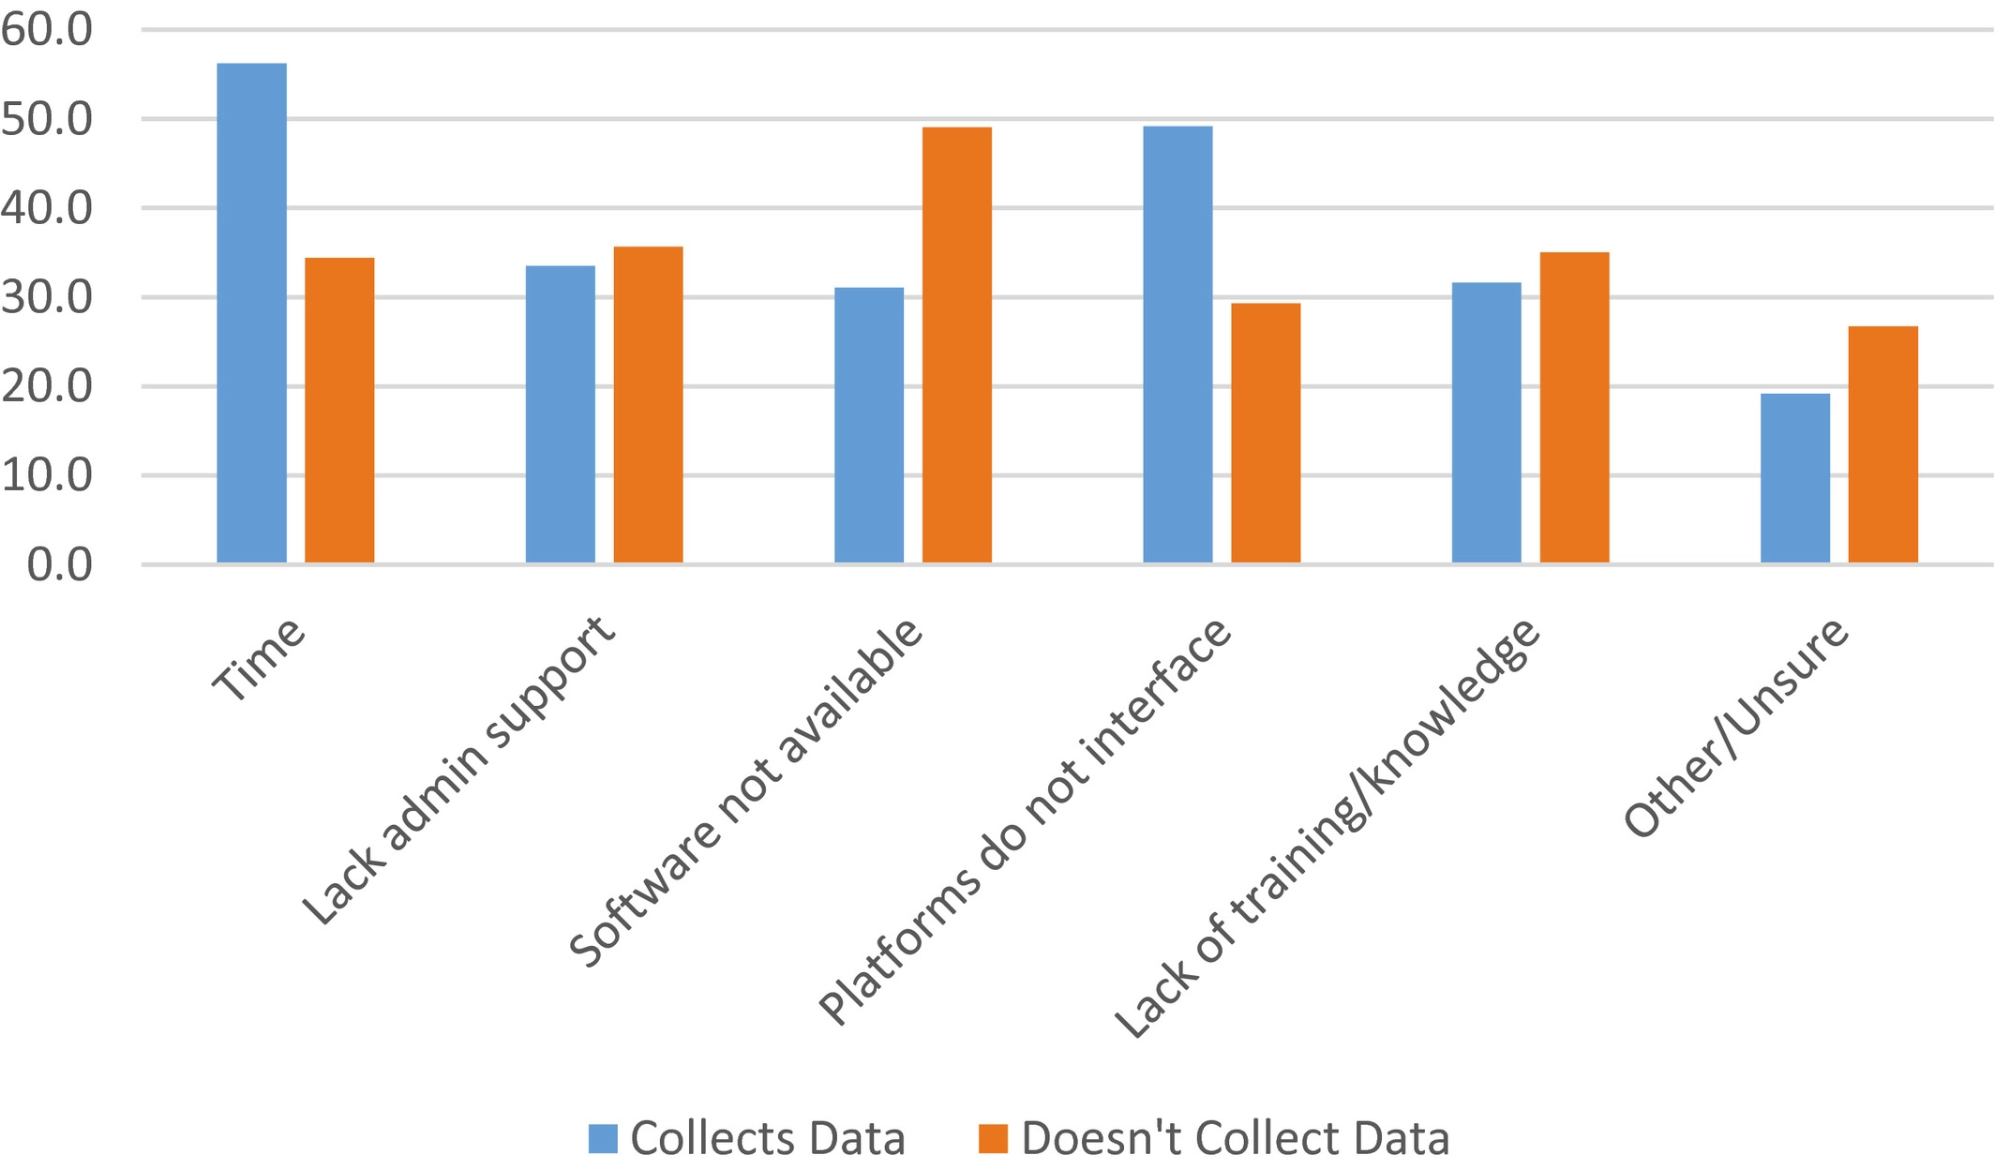
Barriers to data collection according to whether respondents actually collect data (N = 750).

Slide 16
Summary
While most oncology navigation programs routinely collect data, there remains wide variability in data metrics and only half use the data for reporting
NCI, academic cancer programs & and those who participate in accreditation programs are more likely to collect and use the data
Time, training and complex data systems are major barriers
Opportunies:
for funders and accreditation bodies to incentivize organizations to invest in the infrastructure needed for robust program evaluation
for EMR stakeholders help overcome ongoing barriers

Slide 17
Panel Discussion

Slide 18
Collecting and using evaluation data is an essential building block for sustainability of navigation programs…so what actions can we take to address these barriers to collecting and using metrics in our navigation programs?

Slide 19
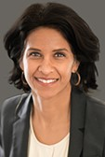
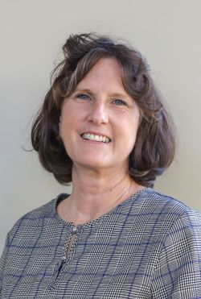
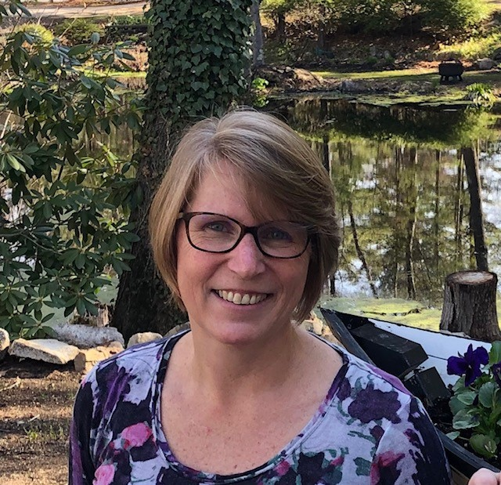
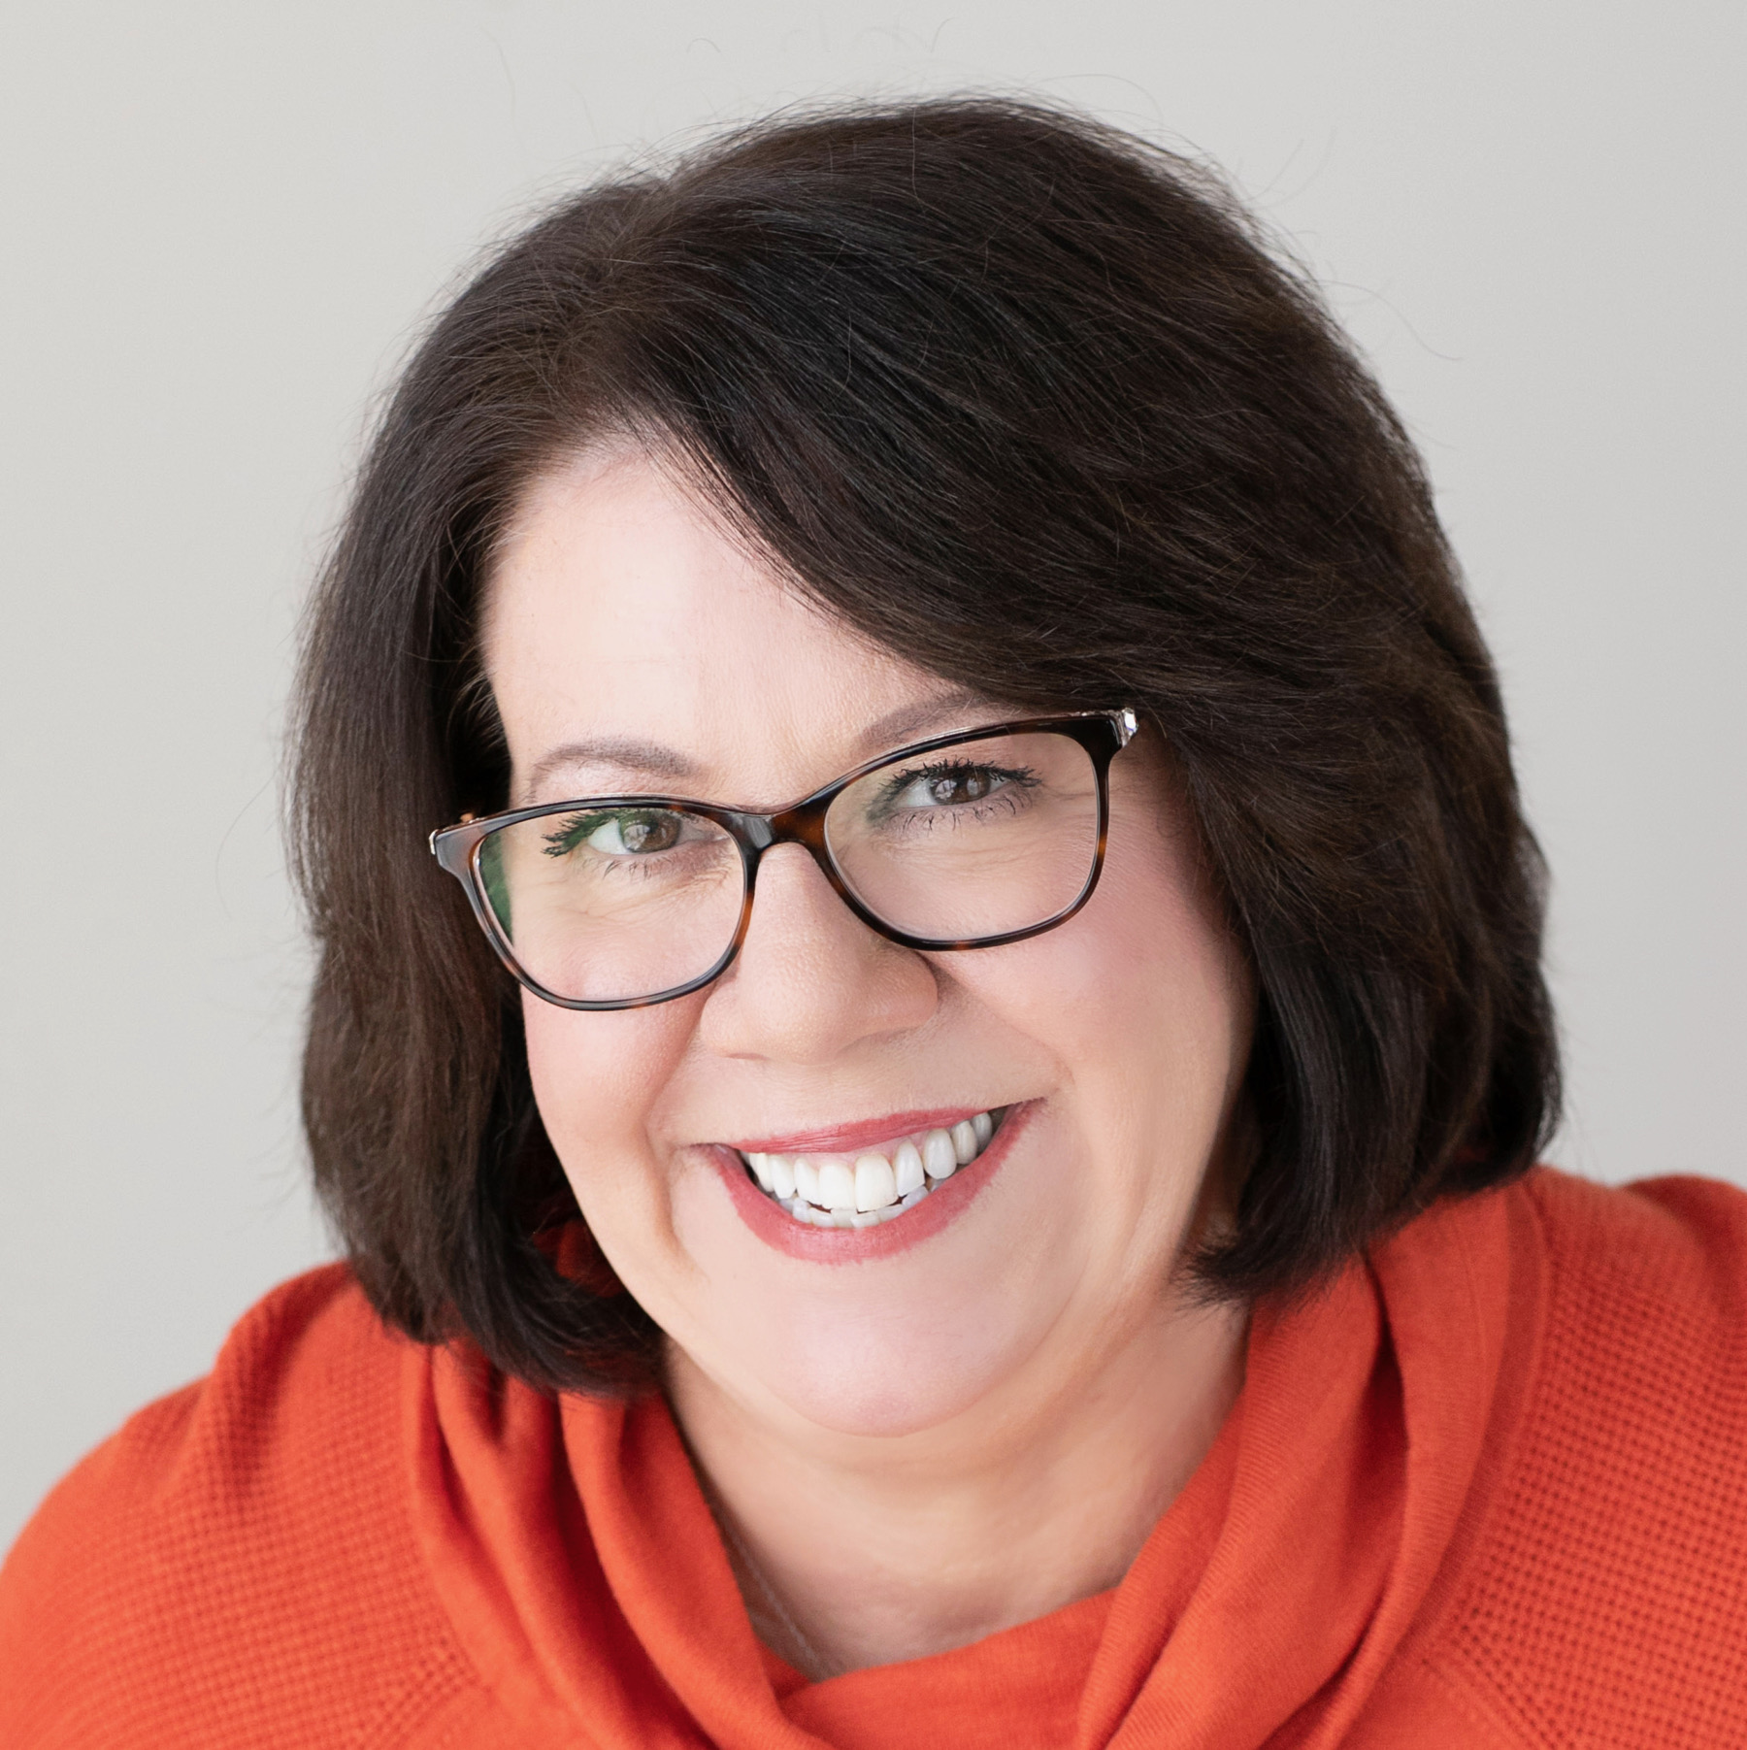
Sharon Gentry, MSN, RN, HON-ONN-CG,AOCN, CBCN
Program Director, AONN+
Heather Ciccarelli, MA, MSW
Director, Patient Navigation
Initiative,
American Cancer Society
Jo-Ann Lovins, MS, RN, NEA-BC
Senior Director, Oncology Service Line, University of Colorado Health
Sandhya Rao, M.D.
Chief Medical Officer and Senior Vice President, Blue Cross Blue Shield of Massachusetts
Notes:
Jo-Ann L. Lovins, MS, RN, NEA-BC is the Senior Director of the Oncology Service Line at University of Colorado Health, Poudre Valley Hospital and Medical Center of the Rockies, and Greeley Hospital. At these sites in northern Colorado, she works on strategic planning, budgeting, and operations for ambulatory and inpatient oncology services, including breast diagnostic services, treatment and support services, clinical research, ambulatory palliative care, and Integrative Medicine.
Dr. Sandhya Rao is chief medical officer and senior vice president for Blue Cross Blue Shield of Massachusetts, the largest private health plan in Massachusetts and one of the largest independent, not-for-profit Blue Cross Blue Shield plans in the country.
Sharon Gentry is the Program Director, for Academy of Oncology Nurse and Patient Navigators (AONN+), The Lynx Group. She serves as a leader for the AONN+ organization, guiding and directing the organization based on agreed-upon strategic plans, goals and objectives that the organization, with administrative support from The Lynx Group, intends to achieve both short-term as well as long-term. She oversees the AONN+ Leadership Council and Local Navigation Networks.
Heather Ciccarelli, MSW, is the Director of the ACS Patient Navigation Initiatives. Heather joined ACS in 2008 as a patient navigator. In her career at ACS she has managed a large team of patient navigators in diverse settings, supported large and small hospitals in improving patient outcomes and delivering patient support programs and now has her dream job. Heather is passionate about the impact patient navigation can have in reducing health care disparities and will be facilitating the multi-year navigation capacity-building initiative.

Slide 20
From your perspective, why or how are
evaluation data important to sustaining
oncology patient navigation?

Slide 21
Which of the following actions can you take to improve the use of standard metrics to evaluate and sustain navigation? Please check all that you can act on within your organization:
ⓘ Start presenting to display the poll results on this slide.

Slide 22
Meeting Review & Close

Slide 23
Thank You
We look forward to seeing you again for: Oncology Navigation Standards of Professional Practice - PONT Standards:
November 9, 2022
3:00 – 4:00 pm ET
Visit the NNRT website: https://navigationroundtable.org/
Questions about NNRT: National.Navigation.Roundtable@cancer.org
Please complete the meeting evaluation

