Slide 1

Leveraging Technology to Benefit Patient Navigation Capitol
November 19, 2024

Slide 2




This webinar will be recorded and will be archived on the ACS NNRT website
You will be muted with your video turned off when you join the webinar.
This webinar takes place on the Zoom platform. To review Zoom’s privacy policy, please visit https://www.zoom.com/en/trust/terms/
Questions? Type them in the Question-and-Answer box at the bottom of your screen.
Zoom Best Practices
Notes:
Michelle
Zoom best practice
Please note that this webinar will be recorded.
When you join the call, you will automatically be muted, and your video will be turned off.
This webinar is hosted on Zoom. For more information on Zoom’s privacy policy, please visit zoom.us/privacy.
If you have any questions during the webinar, please type them in the Question-and-Answer box located at the bottom of your screen.

Slide 3





2024 Sponsors
Notes:
thank sponsors – lead sponsors Novocure, Sanofi, and Eisai

Slide 4
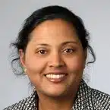
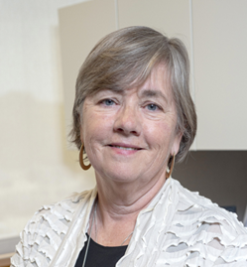
Facilitators
The objectives of this session are to:
Arti Patel Varanasi, PhD, MPH, CPH
President & CEO
Advancing Synergy, LLC
1
Maximize automation to increase identification of patients needing service in order to support resource optimization.
2
Enabling data to impact practice and process
3
Enable standardized protocols and data collection
4
Support alignment with Oncology Navigation Professional Standards of Practice.
Linda Fleisher, PhD MPH
Fox Chase Cancer Center

Slide 5

Five-Year AIM (2021-2026)
MISSION
VISION
To support the creation of a sustainable model for oncology patient navigation to achieve health equity across the continuum of cancer care.
High quality cancer care for all through evidence-based patient navigation
NNRT is a collaboration that advances patient navigation efforts to eliminate barriers for quality care, reduce disparities in health outcomes and foster ongoing health equity across the cancer continuum.
https://navigationroundtable.org/
Notes:
Leverage the ACS NNRT as the leader in addressing the creation of a sustainable model for oncology patient navigation to achieve health equity across the continuum of cancer care.
Provide resources and a framework for accelerating the work of the ACS NNRT members and leadership to develop a blueprint to lead to the creation of a stable funding environment for patient navigation at all levels.

Slide 6
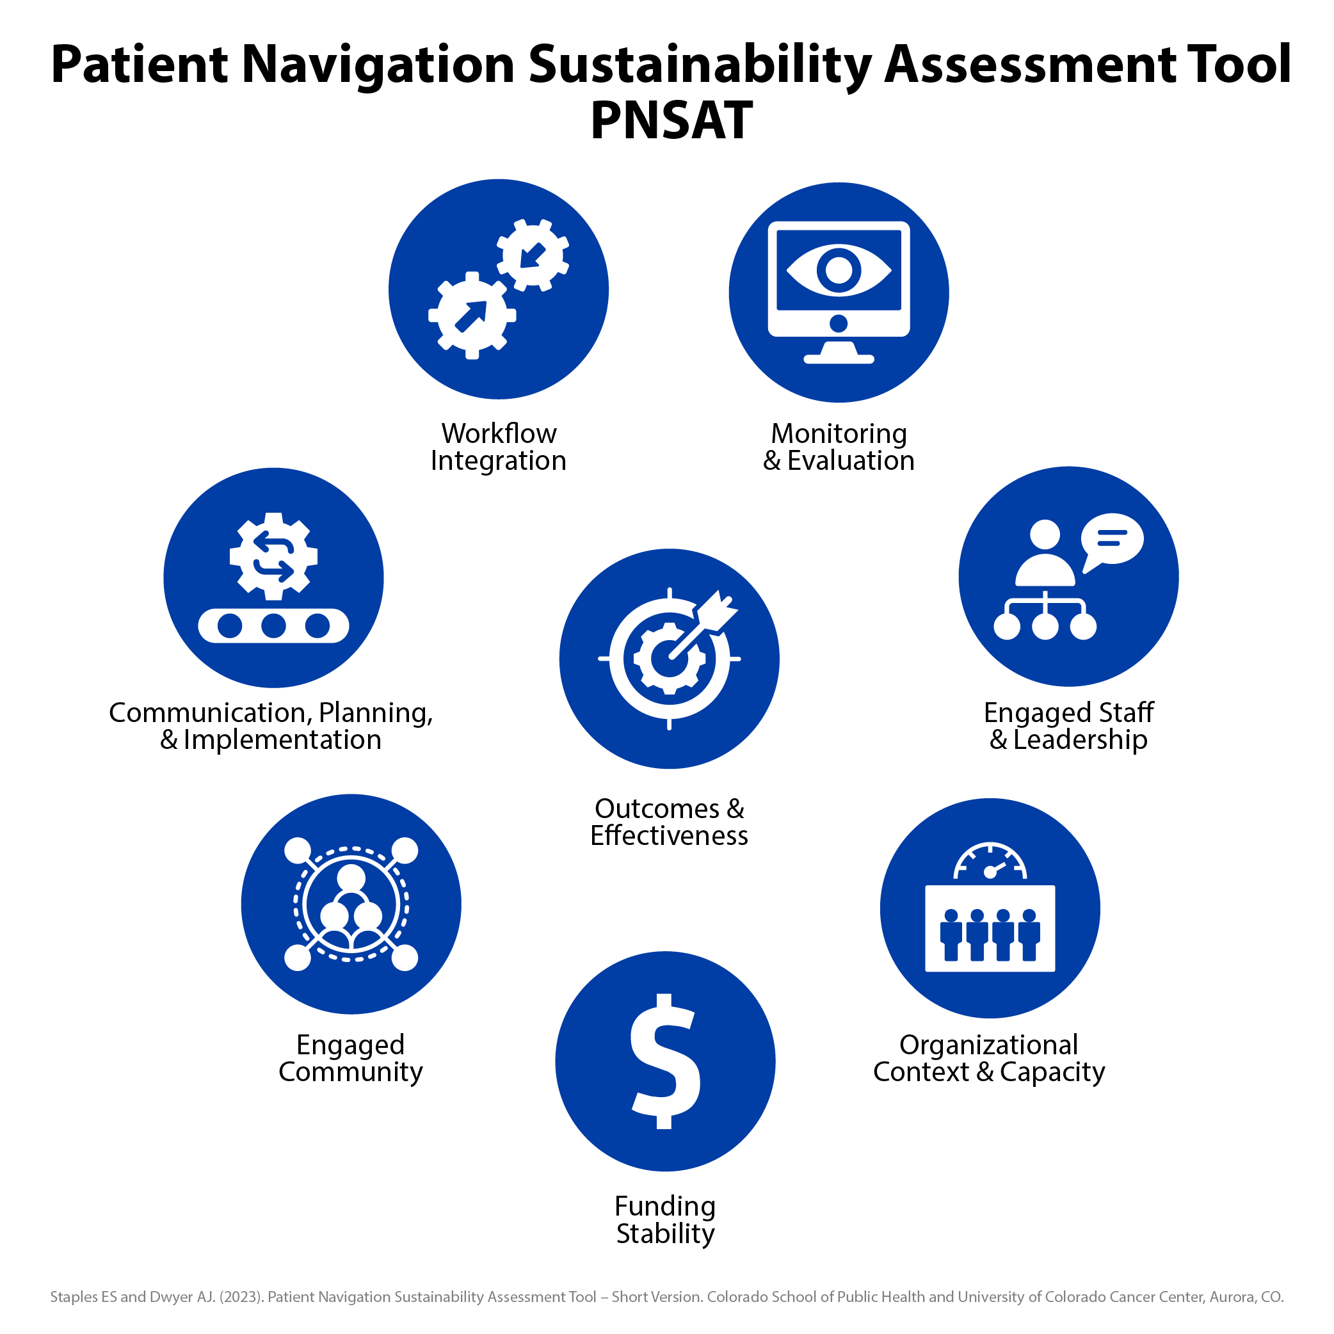
The Foundational Building Blocks
PNSAT Domains | Definition
Engaged Staff & Leadership | Having frontline staff & management within the organization who are supportive of the PN practice
Organizational Context & Capacity | The PN practice has the internal support & resources needed to effectively navigate patients/clients
Funding Stability | The PN practice has established a consistent financial base
Engaged Community | The PN practice has external support & engagement (beyond the clinical navigation team)
Communication, Planning, & Implementation | Using processes that guide the direction, goals, & strategies of the PN practice
Workflow Integration | Designing the PN practice to fit into existing processes, policies, & technologies
Monitoring & Evaluation | Assessing the PN practice to inform planning & document results
Outcomes & Effectiveness | Understanding & measuring practice outcomes and impact of the practice

Slide 7

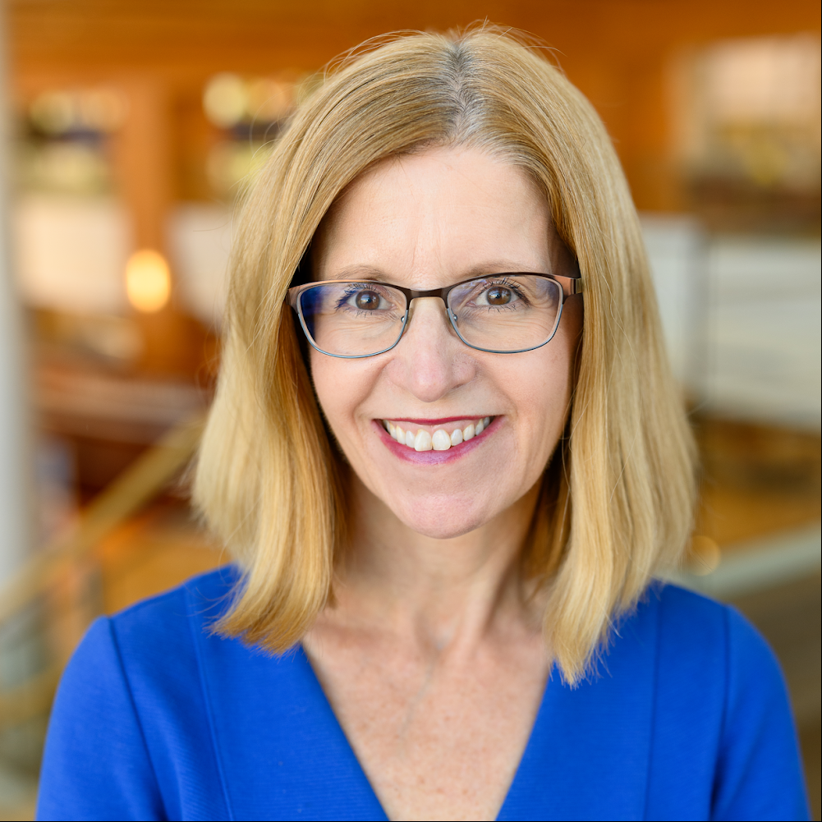
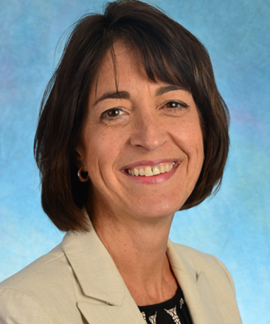
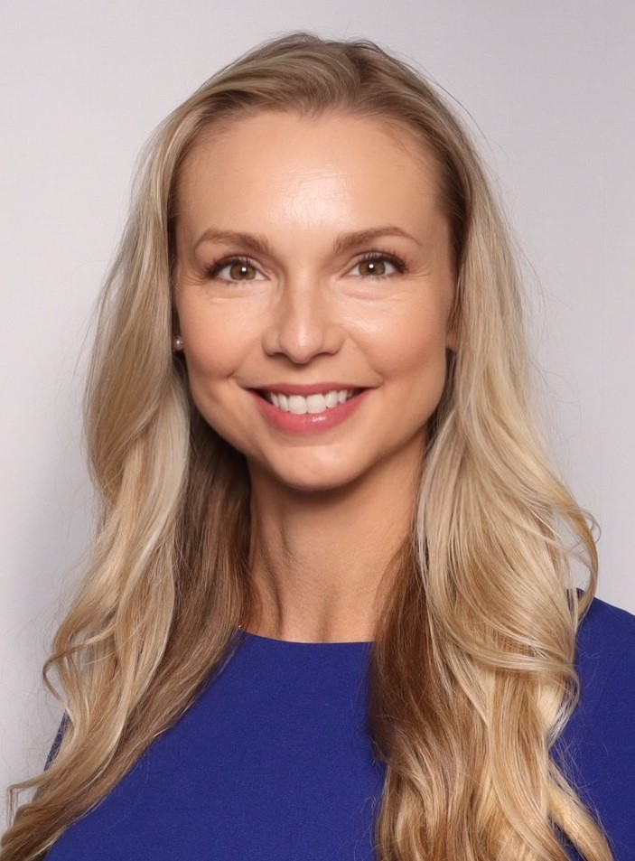
Speakers (aka Story Tellers)
Joan Scales, MSSW, LCSW, OSW-C
Markey Cancer Center
Univ of Kentucky
Jennifer Elston Lafata, PhD
UNC Cancer Care Quality Initiative
Bonny Morris, PhD, MSPH, RN
Vice President of Navigation
American Cancer Society

Slide 8

Evolution of Navigation documentation at Markey Cancer Center.
2012 –began to keep data on a word document with general categories of work we completed.
2013 – moved our tracking to excel document
2019 – moved to sharepoint/Teams
2022 – received ACS grant and built a flowsheet in Epic
2024 – IT was able to create report in Epic and tableau containing flowsheet data and other metrics
Notes:
2012 – tallied our services and began to share with leadership
2013 – created a shared excel doc with more specifics and added drop downs. IT was one shared document which would get locked as someone would use.
We created separate documents as team grew which staff would invariably change making difficult to streamline data to present to leadership.
2019 – Moved to creating a “List” in teams/sharepoint. This allowed for multiple people to use at same time, and not be allowed to modify data that was going in.
had to remind occasionally to not forget to click which then made some information hard stops.
2022 – received ACS grant which helped us to establish a flowsheet in Epic – no more double documentation.
2024 - Currently can pull up detailed report within Epic
Top barriers addressed: finances, transportation and lodging

Slide 9
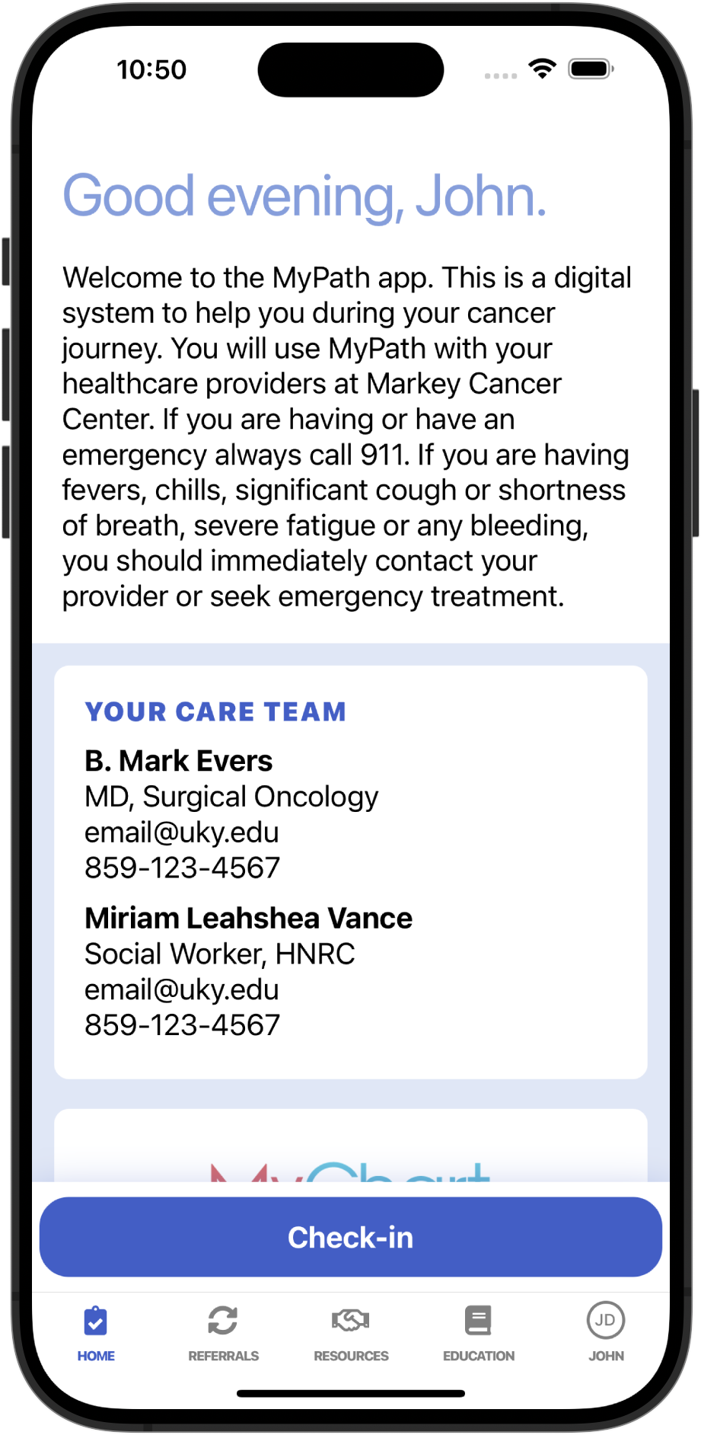
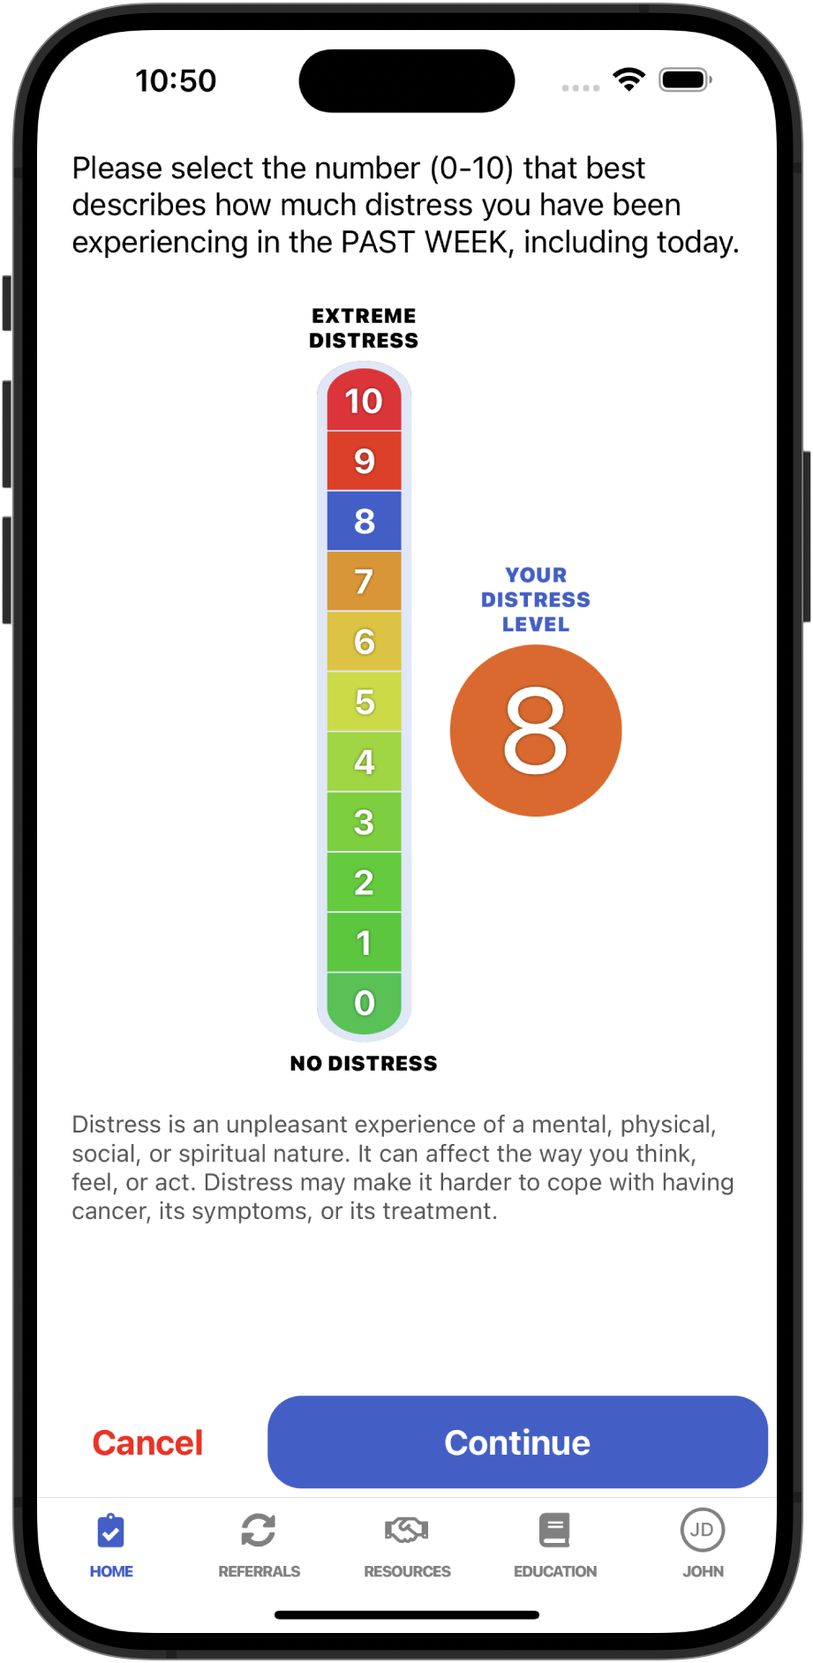
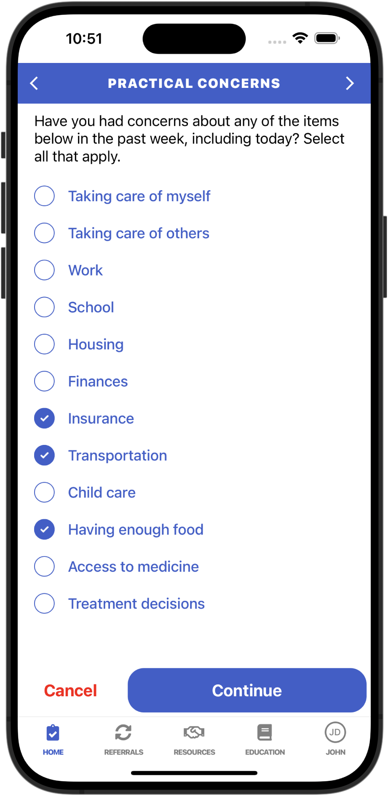
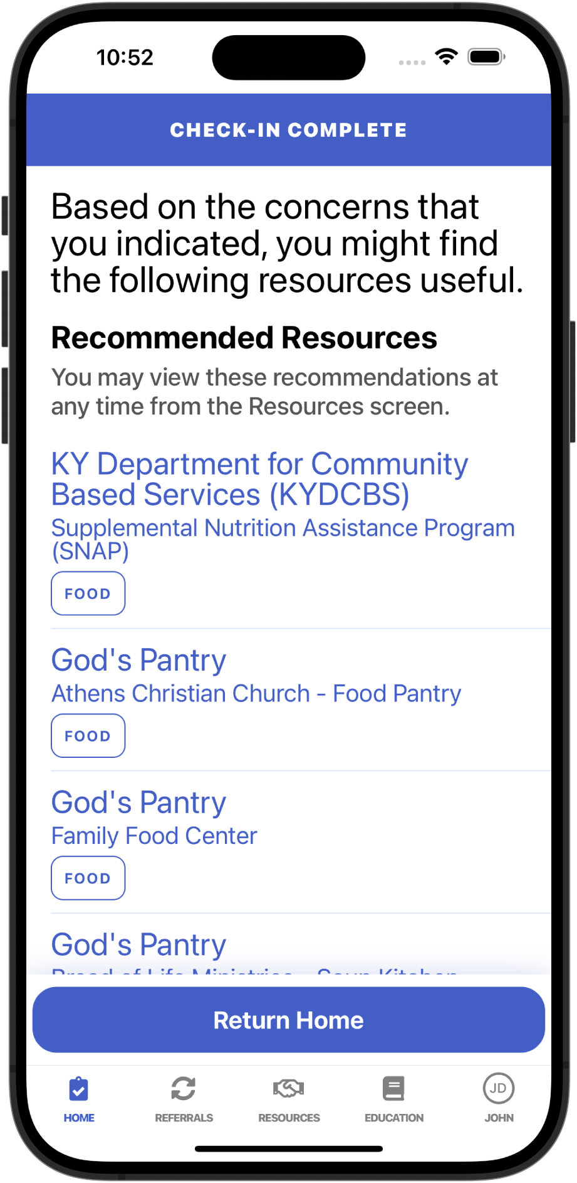
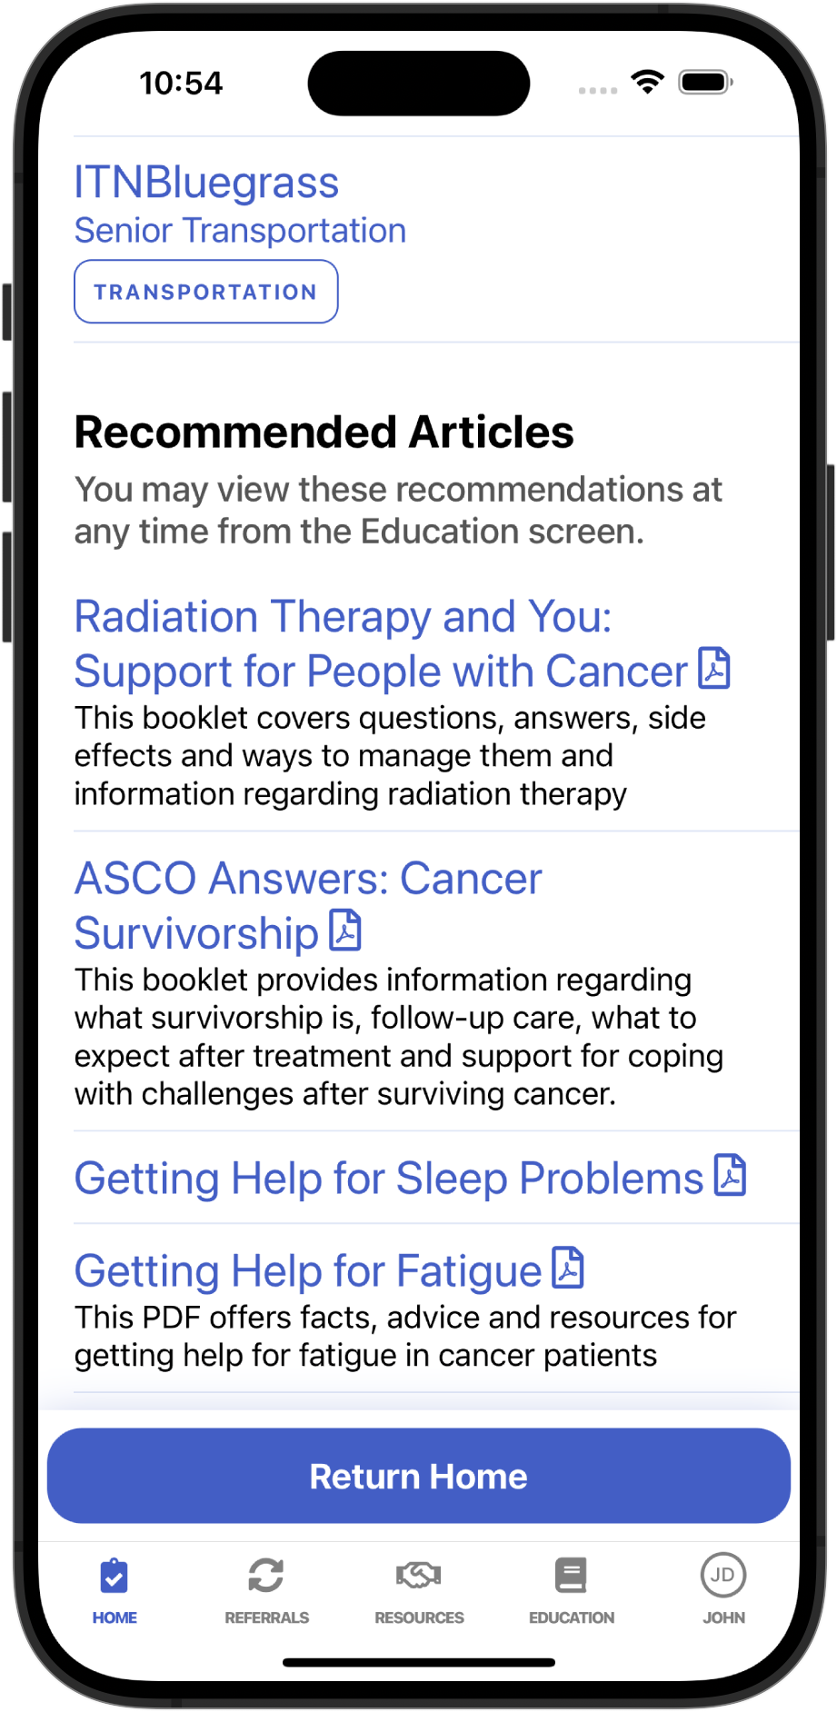
Quick Start Guide |
SAMPLE SCREENSHOTS FOR PATIENTS TO COMPLETE A CHECK-IN
From the MyPath Home screen:
Tap the blue Check-in button at the bottom of the screen.
Tap on the number that indicates your level distress.
Indicate any concerns in each category.
Progress through each category by tapping Continue at the bottom of the screen.
When you are finished:
MyPath recommends resources near you based on the concerns you indicated.
MyPath also recommends:
Articles that may be relevant to your concerns.
Notes:
Patients can complete – see recommendations for local resources as well as articles. - this a check in or ps screening. Can see care team. Based on algorithm will pull on relevant services by zip code, state, and national –
Plus pt education materials.
Expand access to resources with digital tools. Empowering to pt – has more control,
Support CLOSING THE LOOP – did they get the services they needed? Built in functionality that pt can self report outcomes. Most apps do not show this…
Variations within the app – highlight acuity specific to the need, bypass the need to restate the problems, digital connectivity concerns (state of KY is working to address low-cost high-speed internet for all Kentuckians. – for study, if they don’t have device, we will provide a tablet.
Navigators will have a dashboard view – can see what distress, concerns, and PT self referrals and what other barriers remain - can share other views.
Navigation dashboard – live view of caseload, pt concerns, notification problems and if previously addressed etc.
EX Shirley’s way – is over utilized.
If they try to self refer and access the resources can indicate it helpful which allows for us to better identify what was the problem with access/reliability
EX: was resource of funding, did their disease not qualify etc
At MCC, with this app we are also looking to capture more of 4-6 distress, using this app to help keep team informed of distress concerns.

Slide 10



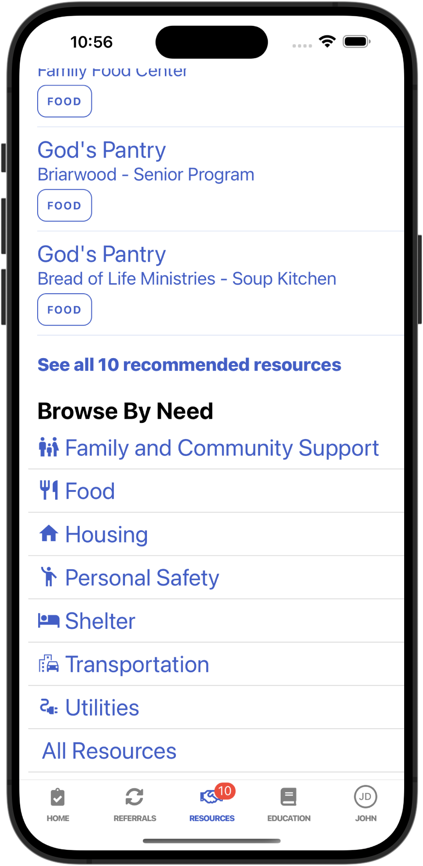
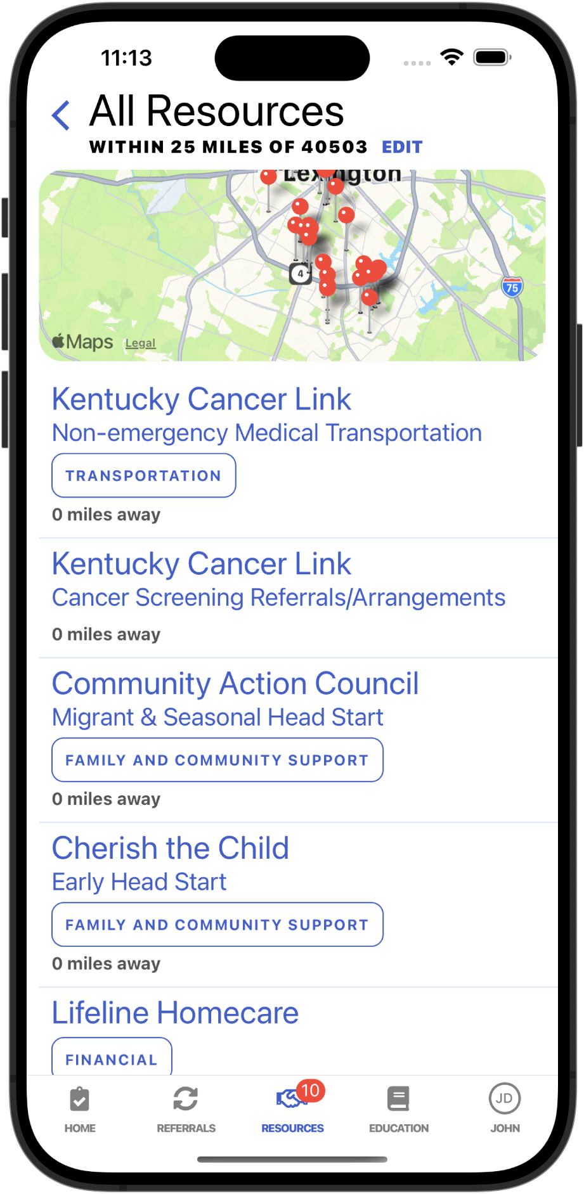
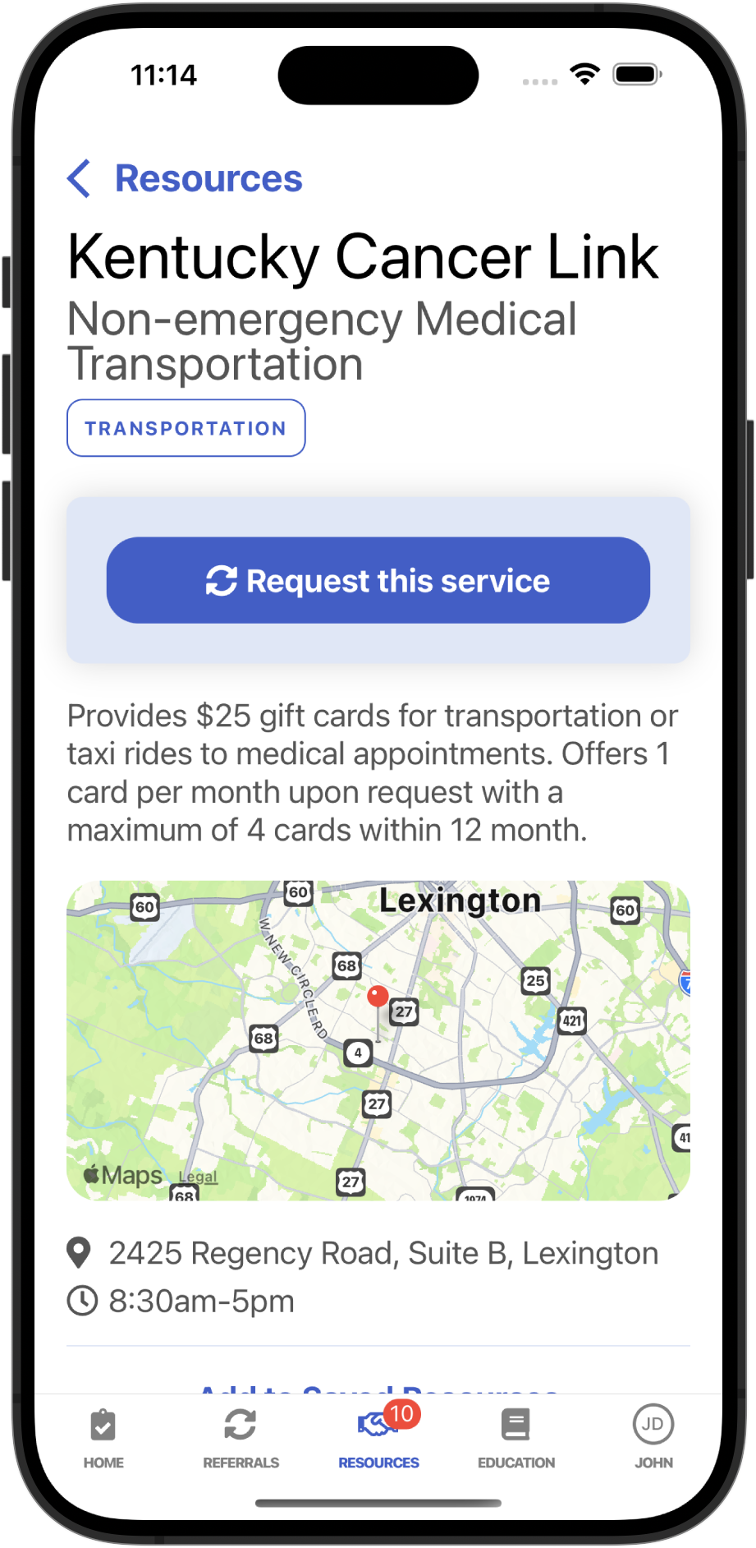
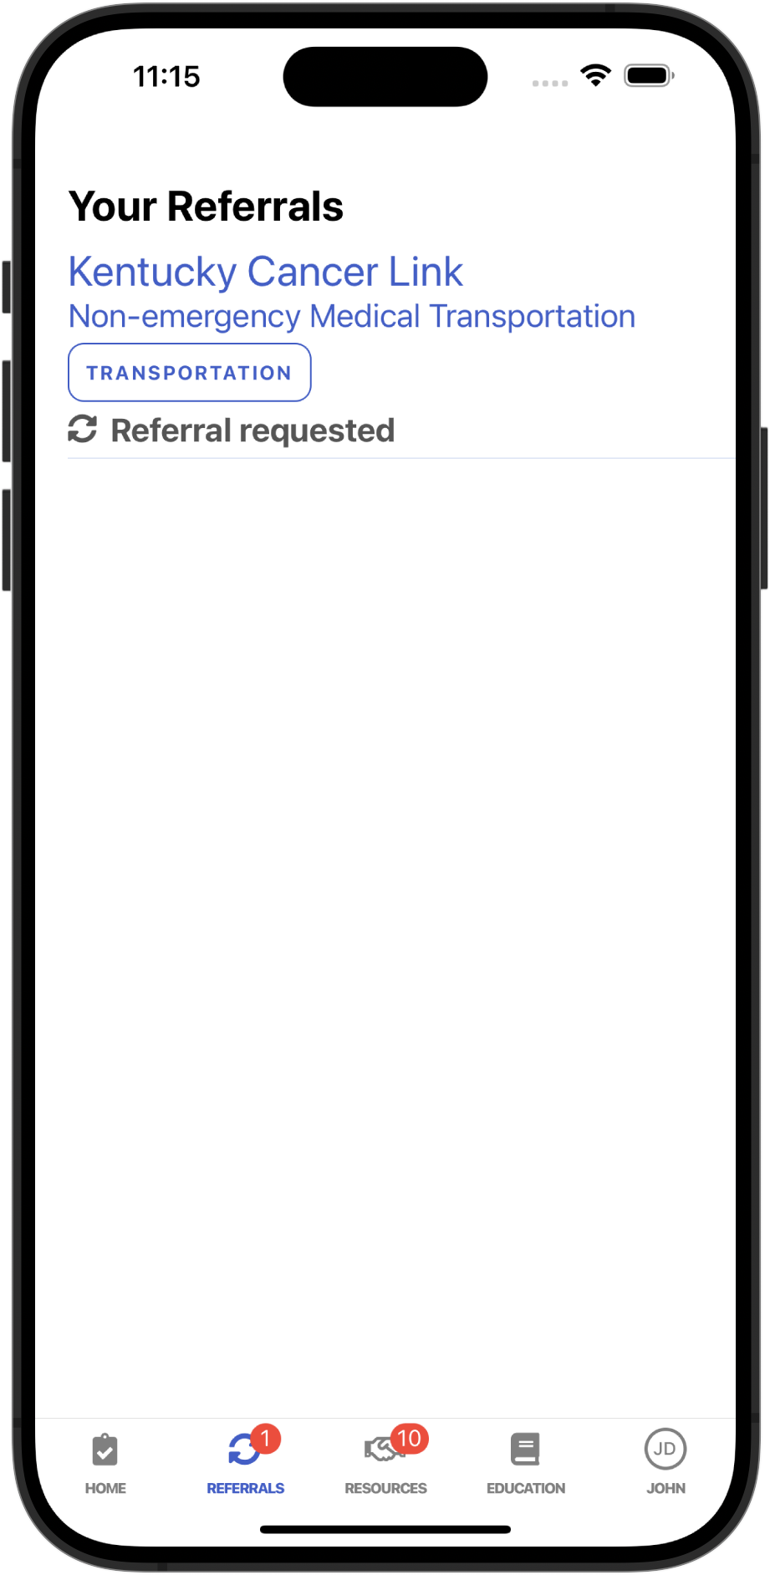
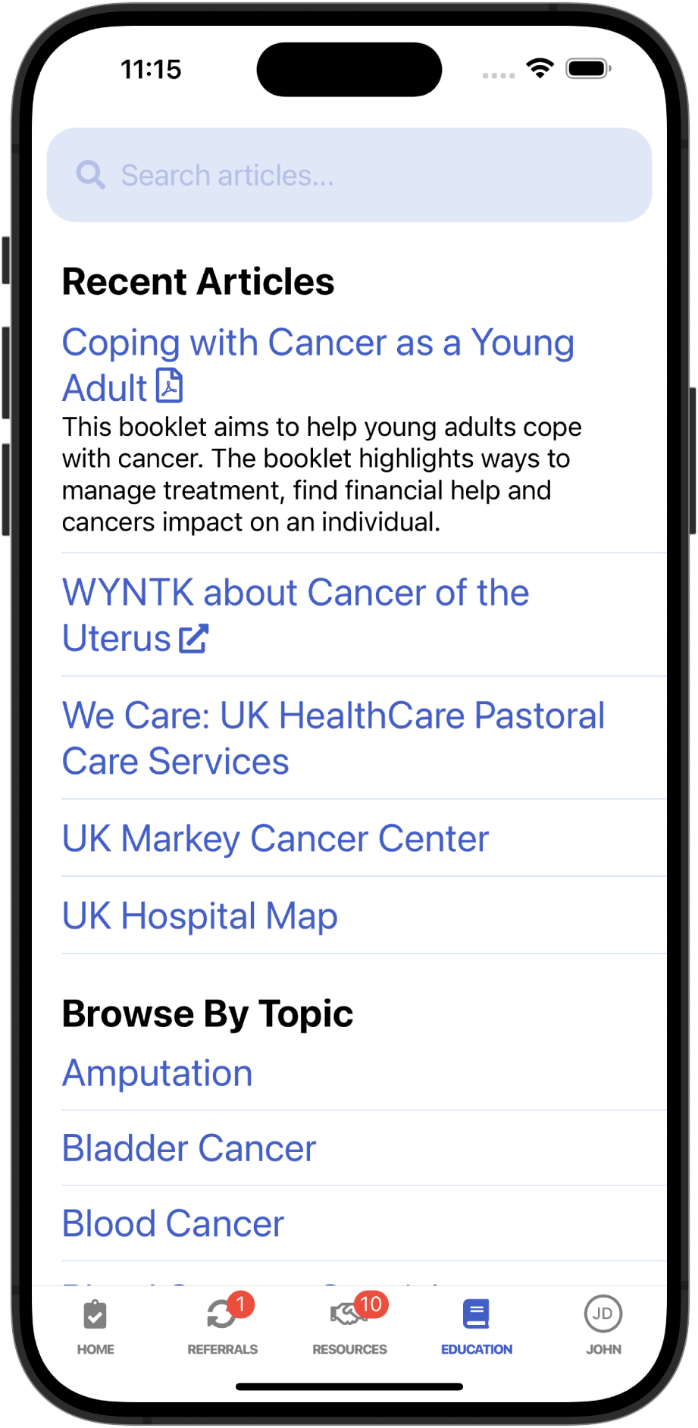
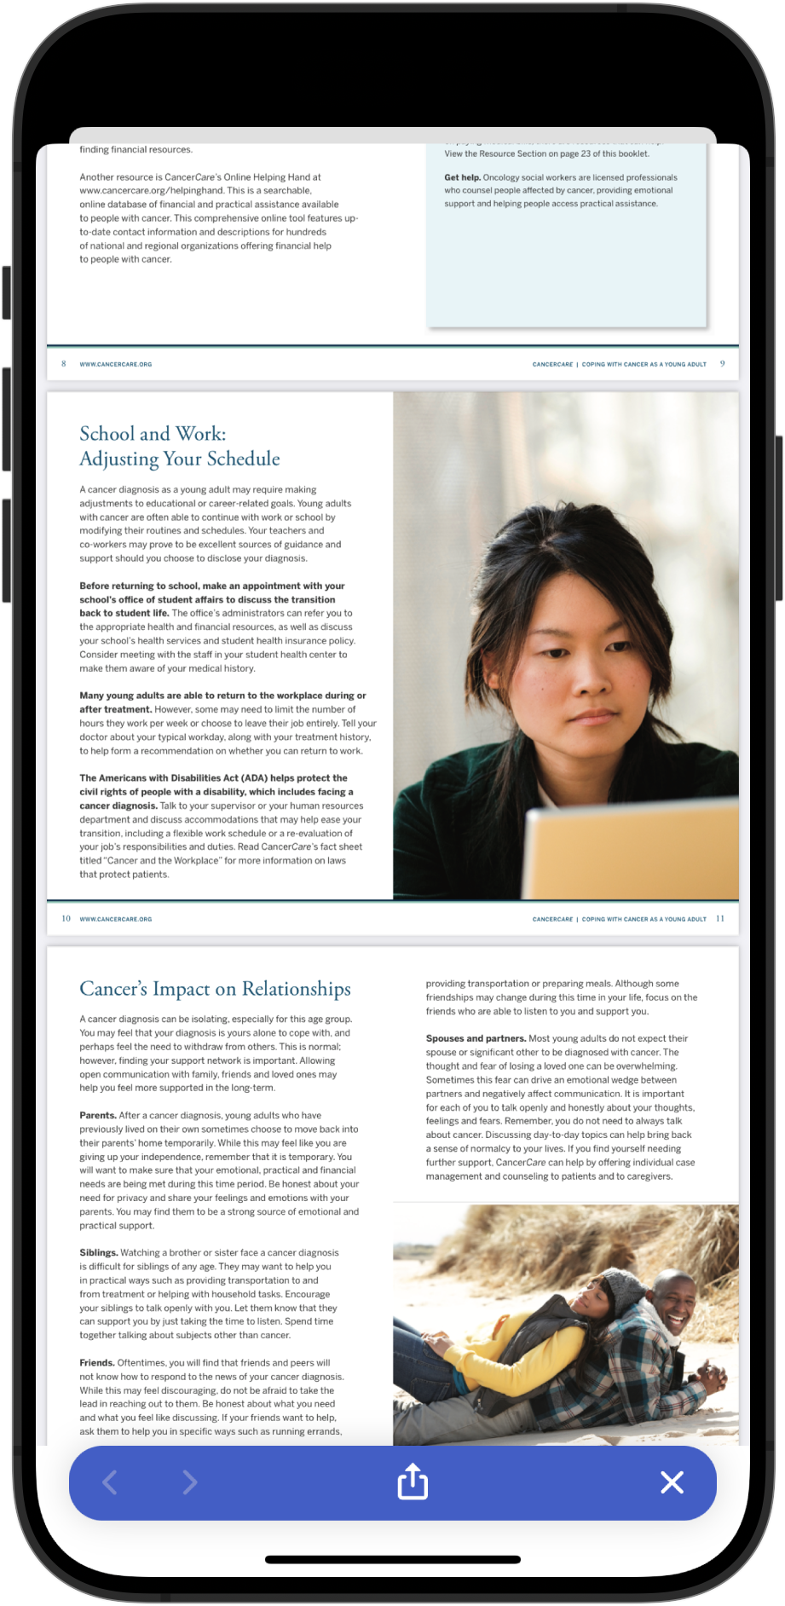
Quick Start Guide |
SAMPLE SCREENSHOTS OF OTHER C4 APP FUNCTIONS
Explore nearby service options
Refer yourself to a resource
Browse education materials
Notes:
Other functions within the app.
Patients can look up possible resources – sample screenshots of what a pt might see if patients are looking for services/resources on their own. They can browse -
base disease, location (home county) – loc services in phone or add zip code – flexibility based on comfort abd request referral from this organization.
We partner with KCP – they are the boots on the ground, working/collaborating with to keep db current. They know first if something changes. We have a built in process for maintaining th e com services db/
Identification of resources – list of resources from pop health, pathfinder resource guide
Can look, save, and send education materials as well. This app also provides patient education materials that patients can browse these contents by different "concerns” or cancer type
After requesting the referral, the resource will be added to this patient's referral list. This page shows the detailed referral page for this organization. It has a bottom for patient to report if he or she receives the service from this organization.
Pts can also report on the referral status and whether their concerns were addressed so the navigator is aware
Future direction – logarithm of resources and pdfs of what patients want to see – outside of clinic, photo option to verify assistance eligibility
Working out proxy access – so caregiver can support as well (similar to my chart)

Slide 11
Sustainability
Designing for sustainability from the beginning​
EHR integration and interoperability
  Assessing feasibility​
  Where we are now​
    Identifying internal and external resources
    Preparing to map data to common language (SMART on FHIR)
  Coordination/collaboration with UKHC enterprise​
Workforce development: Collaboration on experiential learning course to address SDOH screening and referral
Notes:
Based on focus groups – (not part of the grant)
Work to integrate within Epic exploring integration and interoperability with other health systems/EHRs.
App integrates with Epic – and then also KHIE (interoperability) so Epic can talk to other EHRs. Want both – Epic and interoperability. We want it all integrated,, so not double entry etc – seamless.
SMART on FHIR is a protocol for interoperability across Electronic Health Records (EHR) systems (such as Epic and Cerner) healthcare applications, and IT environments.
Building for the long term –
Internal and external resources
KHIE – building a common language across different EHRs.
API (application Programming interface) – thought of as a contract of service between two applications. This contract defines how the two communicate with each other using requests and responses
Recognize the need for workforce development - Working with Population Health team regarding SDOH and working together, collaborating together to remove barriers – training for navingation, CHWs etc. – Non clinical

Slide 12
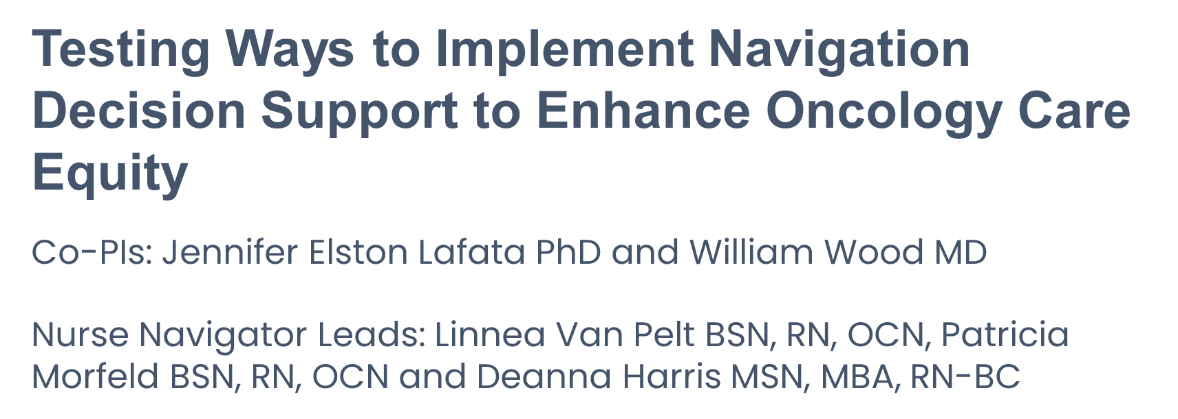


Slide 13
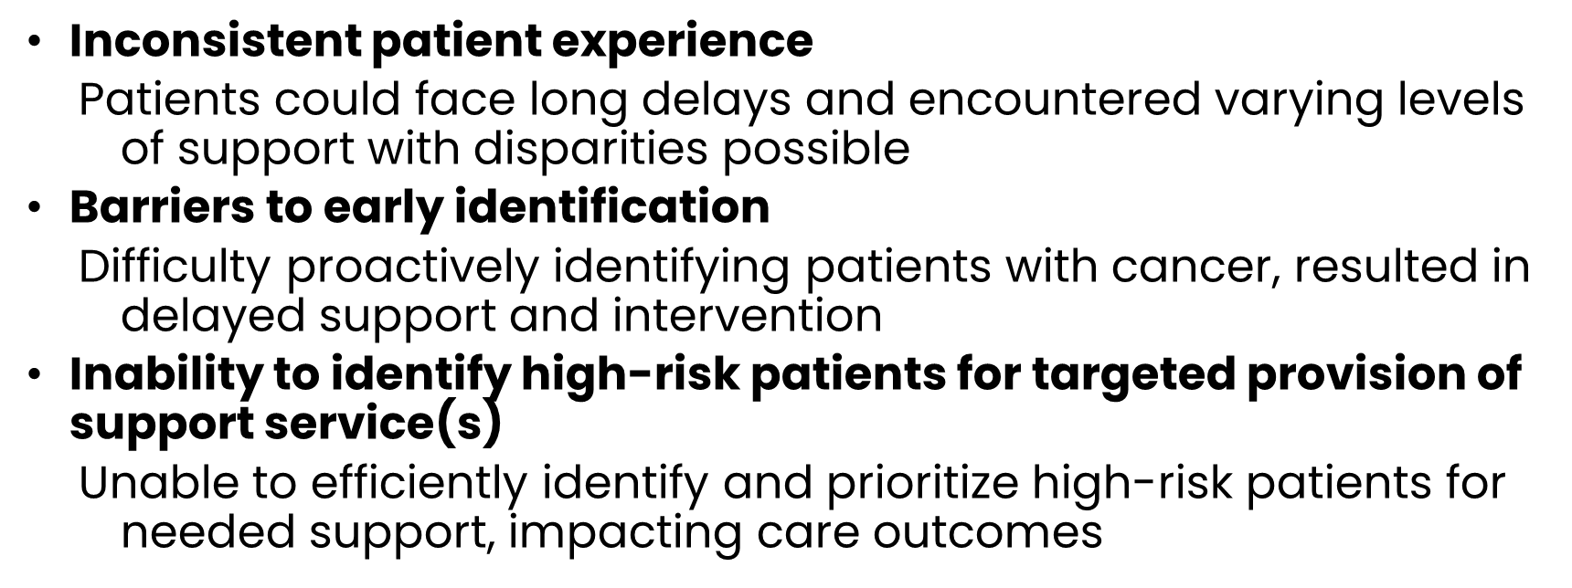

Addressing Common Challenges

Slide 14
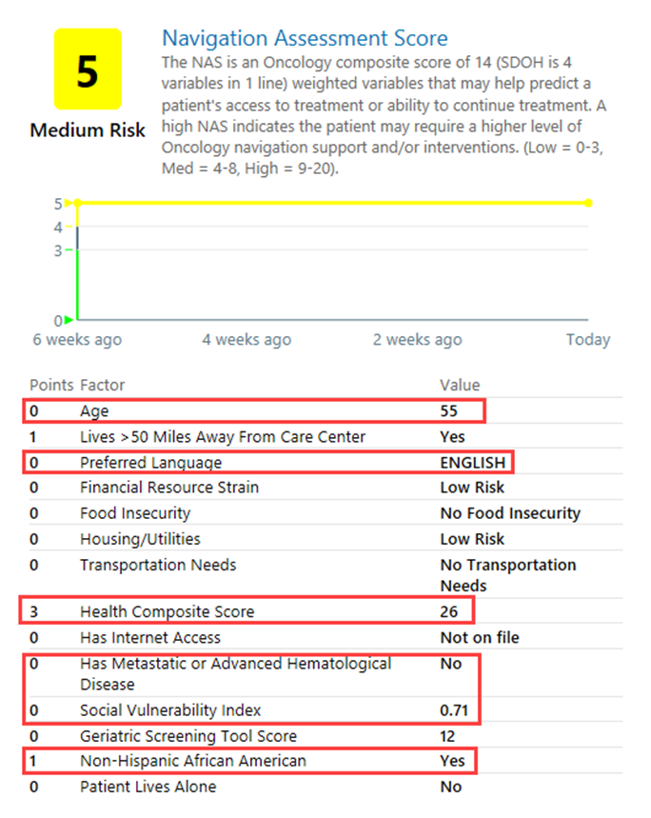
Who: Central Navigation Team member
What: SDOH risk stratification for navigation outreach cadence; located in EHR on Oncology Snapshot
Where: Patient in the comfort of own home, away from stressors of first clinic visit
When: Assessed during a pre-consult outreach call and periodically thereafter based on plan of care
Why: Immediate needs mitigated (i.e., transportation to consult appointment), appropriate early interventions initiated (i.e., early social work referral, financial assistance application), ongoing support planned (weekly check in calls to assess for treatment support needs, unreported symptoms, emotional support, etc), all leading to better access and ability to continue treatment

Slide 15
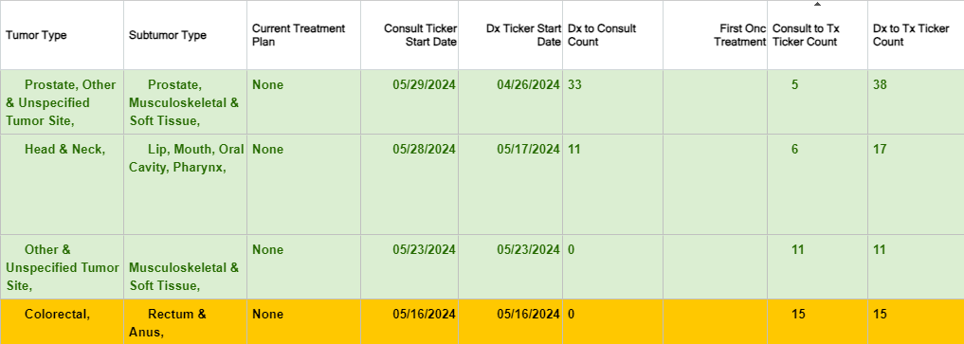
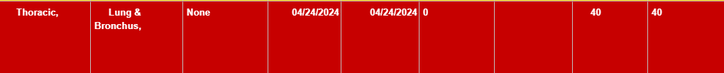
Time-to-Treatment Report
  What: Population health report that navigators and others use to identify patients who at risk of a harmful delay in treatment initiation
  Time-to-Treatment Report
    Identifies first encounter with cancer diagnosis and counts each day that passes without indication of treatment
Key Features
Users can filter reports
Color-codes reflect days since presentations
Users can remove patients form the report

Slide 16
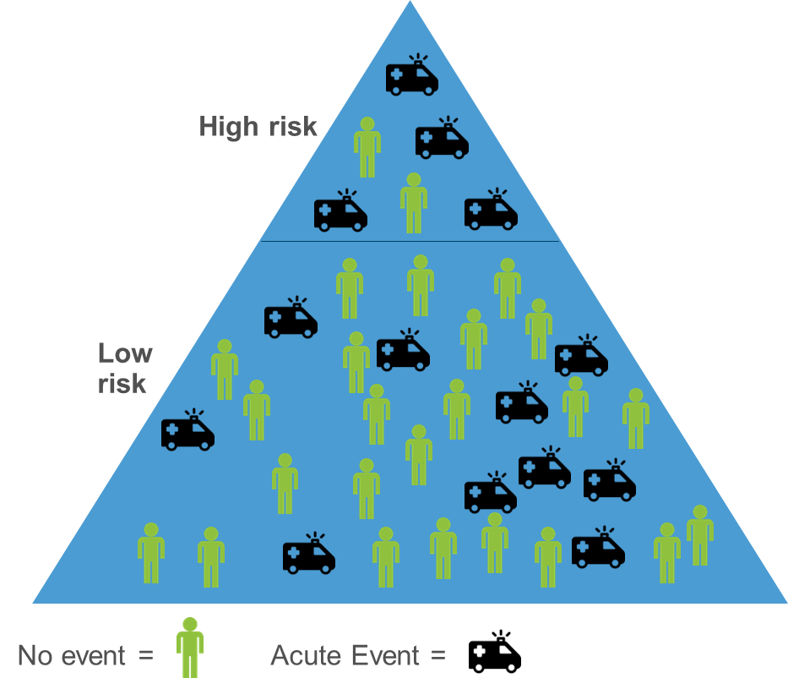
Clinical Risk: Remote Symptom Monitoring
Who: Nurse-Driven Integrated ePRO Model
Central Navigators, Clinical Navigators & Triage Nurses
What: Risk of unplanned hospital stay and/or ED visit (acute care event) during systemic treatment
When: Automated prognostic score calculation based on treatment planned; those in top 10th percentile of risk pushed to navigation team for program enrollment
Why: Targeting high-risk patients prioritized those most likely to benefit from remote symptom monitoring without overburdening oncology clinicians.
Adapted previously published PROACCT model
  (Grant et al 2019)
Four patient characteristics used to predict ACE risk
  Age
  Prior ED/Hospital use
  Cancer Diagnosis
  Treatment type (Stein et al 2023)

Slide 17
Process (and Progress) Critical Steps
  Executive Committee Sponsorship provided critical resources
    Provided essential resources and strategic direction
  Integration with Care Quality Infrastructure
    Enhanced support through alignment with new initiative infused support
  Support from ACS award
    Facilitated development and implementation
  Pen and Paper Prototyping
    Ensured data accuracy, identified workflow issues, and integrated teams
  Collaboration with Population Health Team
    Leveraged population health informatic tools contained within EHR
  Metrics and Monitoring
    Maintained focus and tracked progress
Text
Text
TEXT
* Text

Slide 18

Next Steps
  Increased attention to business case and measurable outcomes
  Continuing PDSAs to optimize workflow integration at Medical Center and large community cancer program
    Ongoing training and education
    Adaptations for spreading to other community facilities

Slide 19



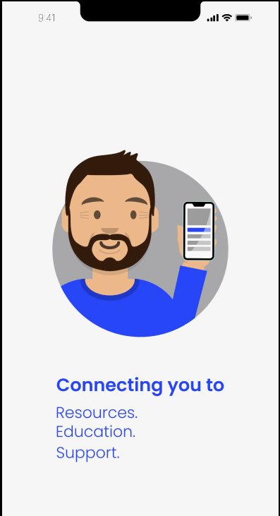
Community Access to Resources, Education, and Support
“Start Here” for cancer information and resources based on each person’s unique situation, for personalized cancer support
Bonny Morris, PhD, MSPH, RN
Vice President, Navigation, ACS

Slide 20
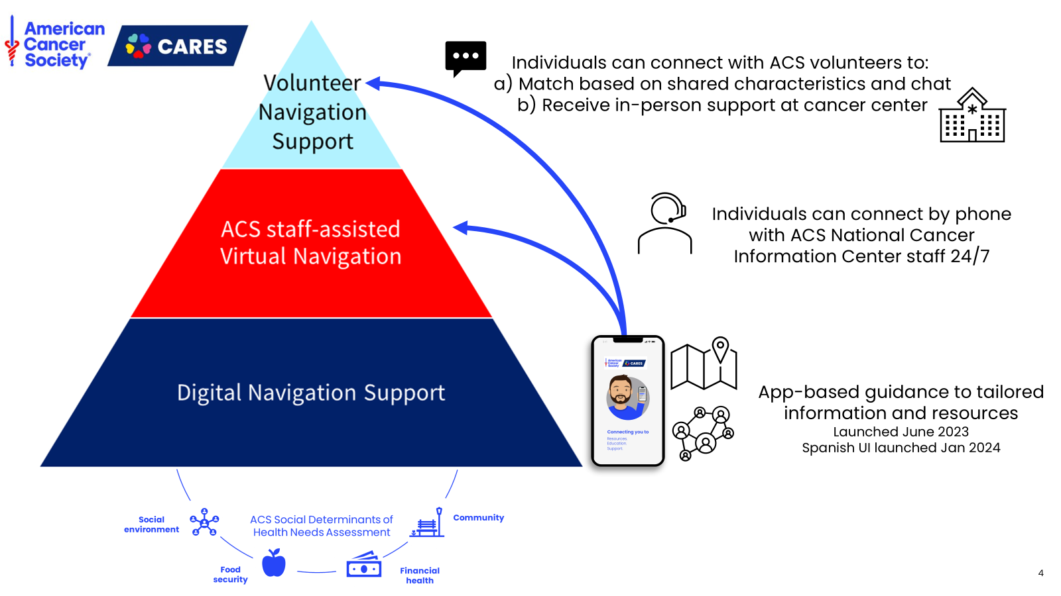

Slide 21
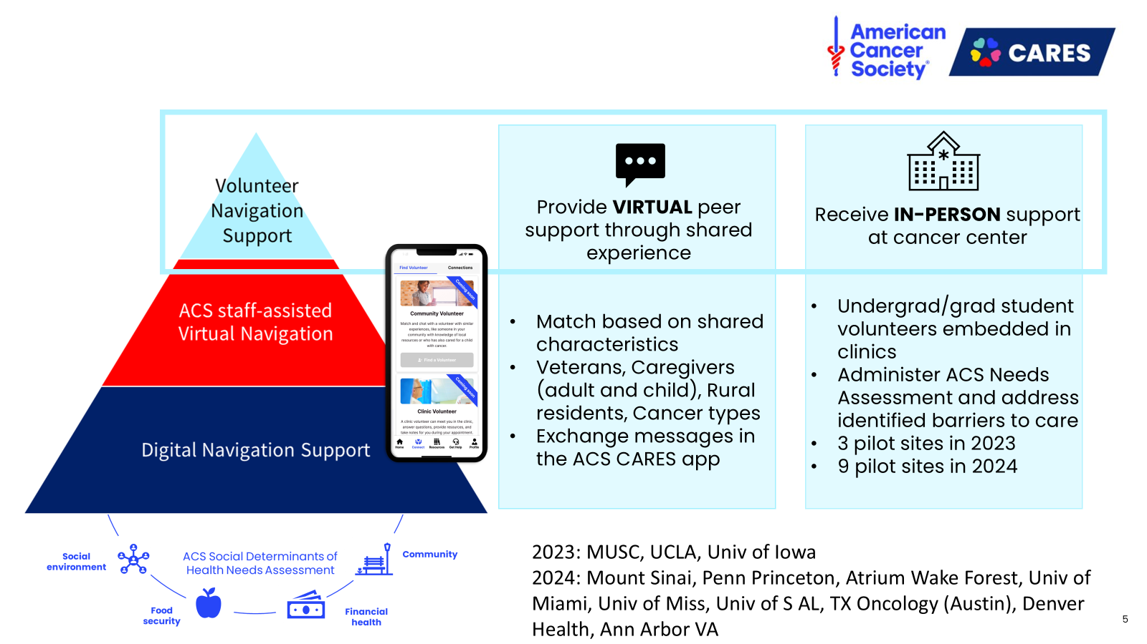

Slide 22

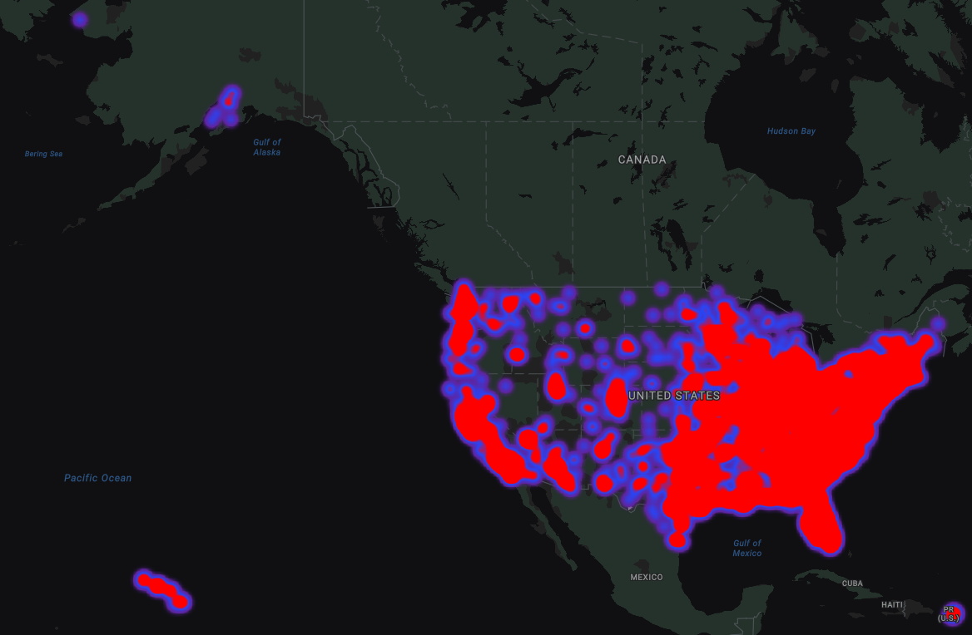
2024 ACS CARES app and volunteer updates
7,654* individuals digitally navigated since launch in Jun 2023 (54.8% patients, 29.3% caregivers for adult)
67 cancer types represented
11,126 resources accessed via app
220 community volunteers, 100% request completion rate
Average 11 messages per connection over 35 days
launched 12 sites and trained 395 student volunteers to provide in-person navigation support
Students spent avg. 115.8 minutes per patient encounter plus 75.7 minutes obtaining patient resources
2 abstracts (ASCO, ASCO Quality), 1 manuscript (under review)
Figure 1. App user reach across the US and US territories.
*current as of 11/13/24

Slide 23
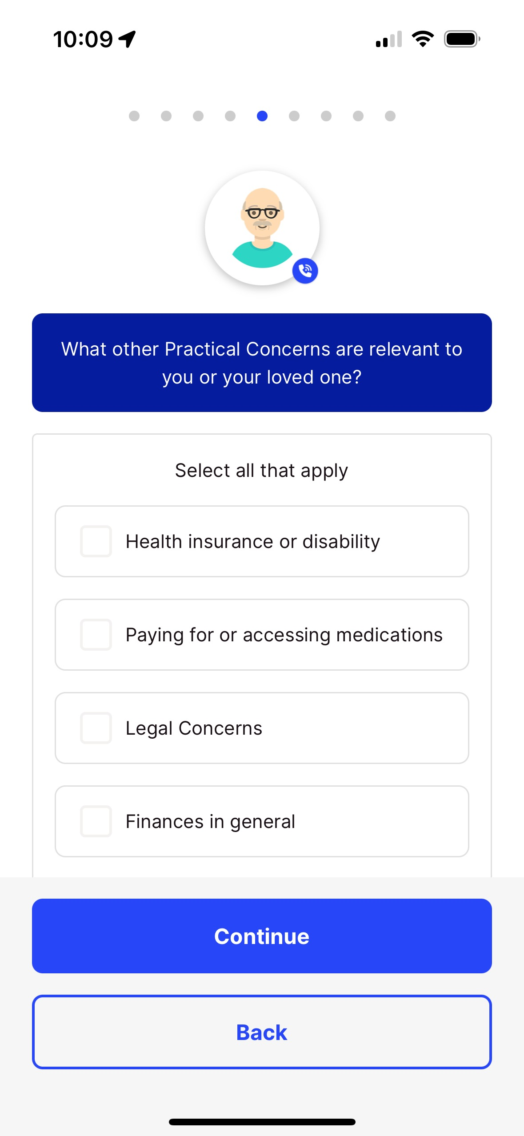
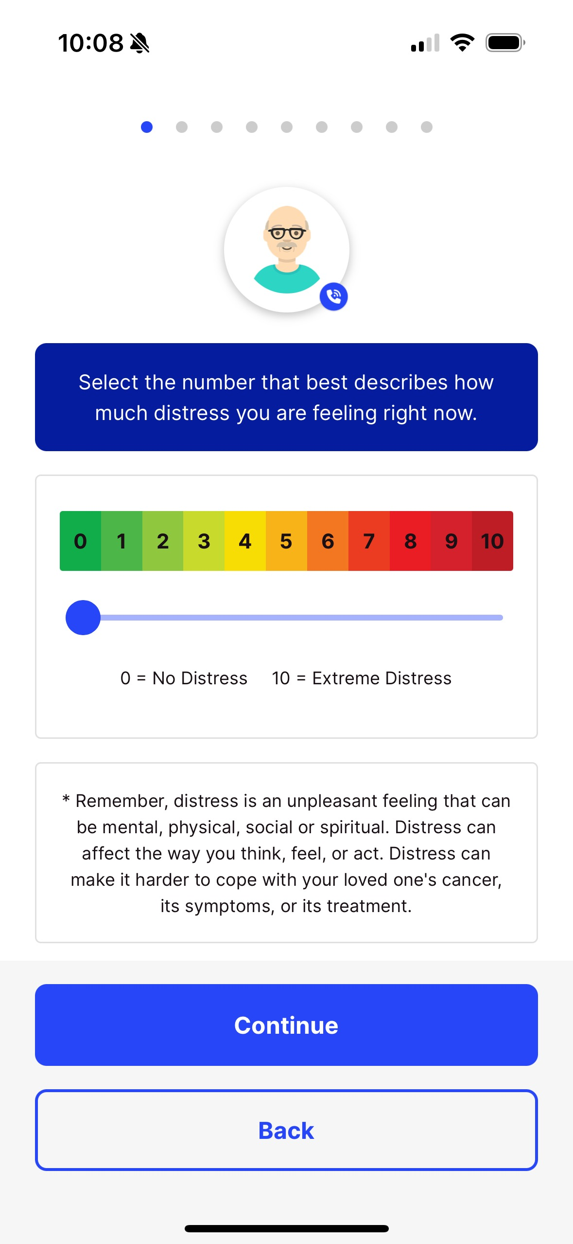
Key Features – Personalized Support
Cancer Information
Cancer type
Diagnosis date
Stage
Healthcare location
Treatment phase
Concerns Based on NCCN Distress Thermometer and Problem List
Practical
Social
Emotional
Physical
Spiritual

Slide 24
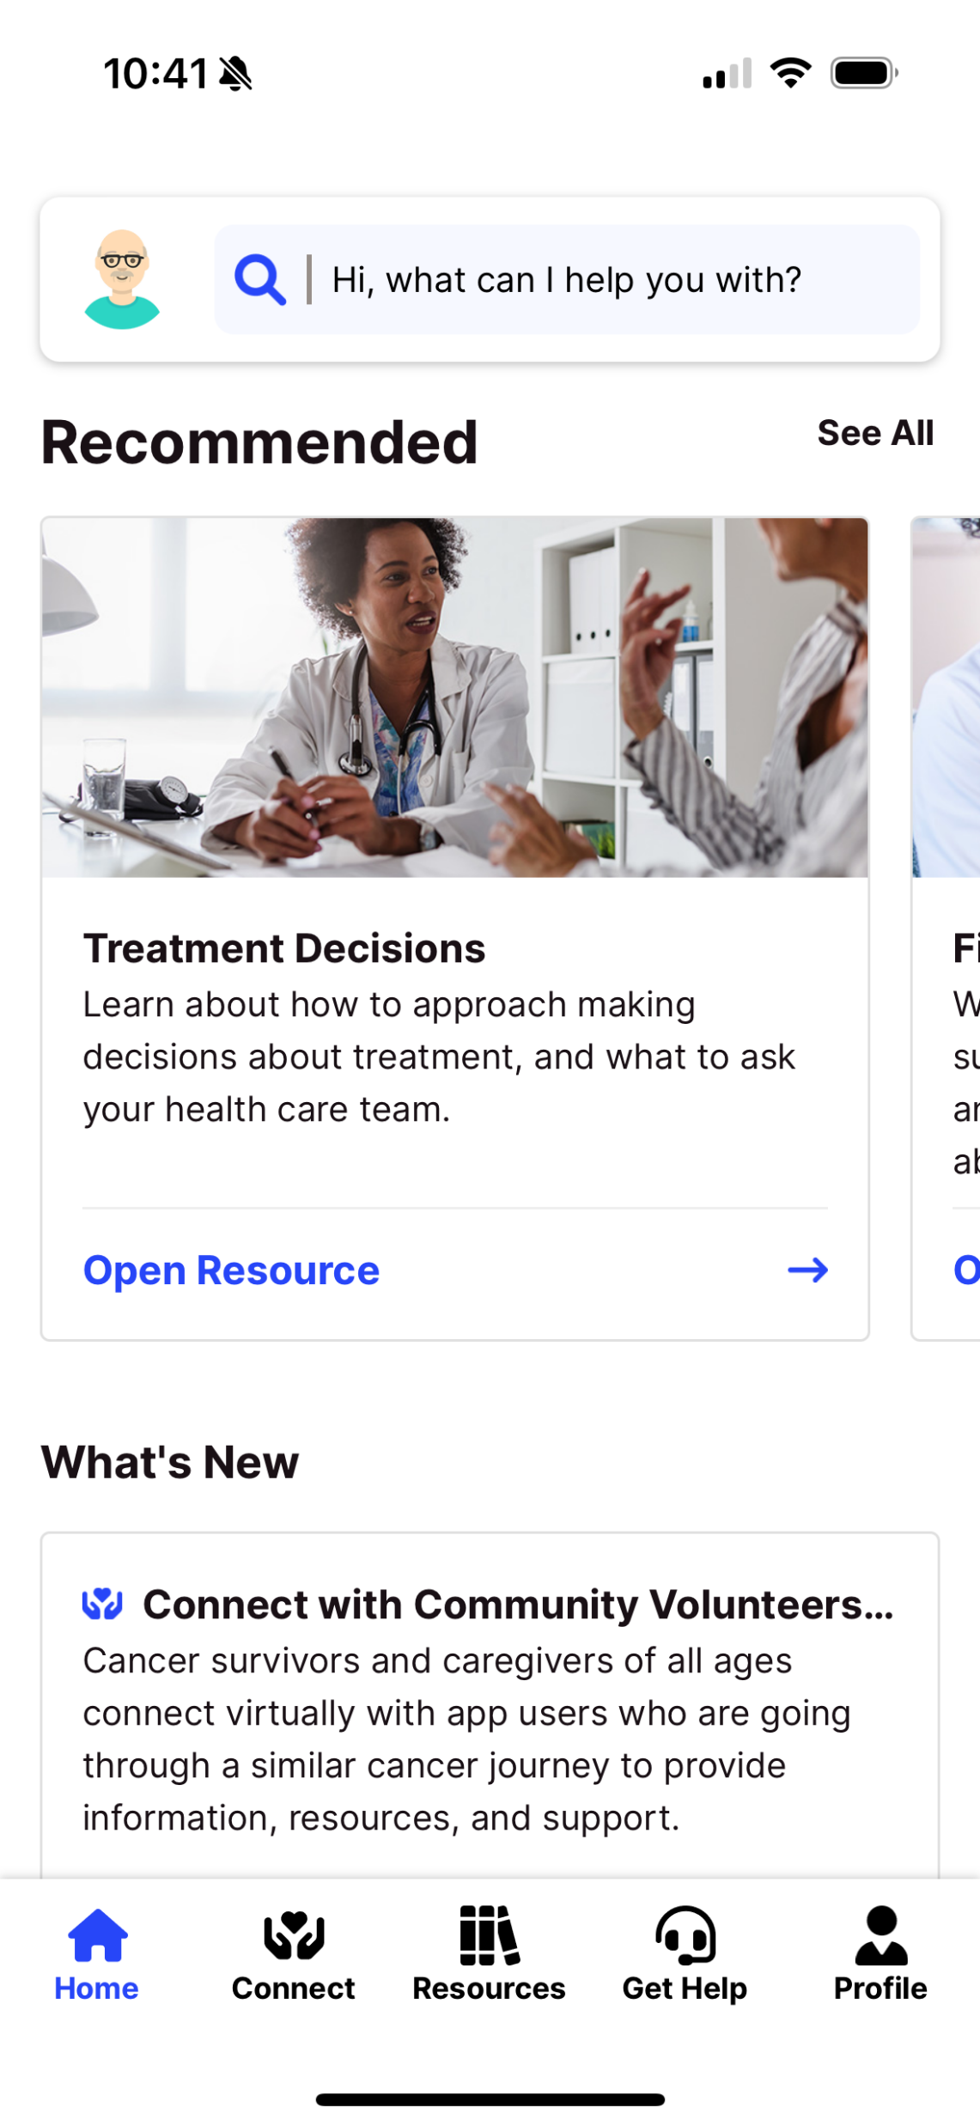
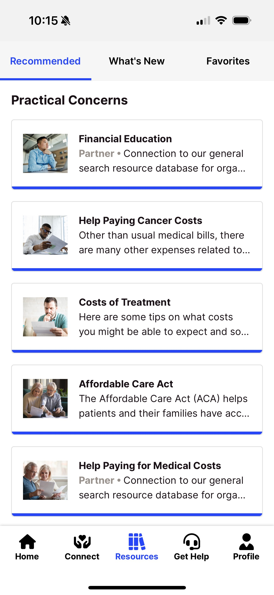
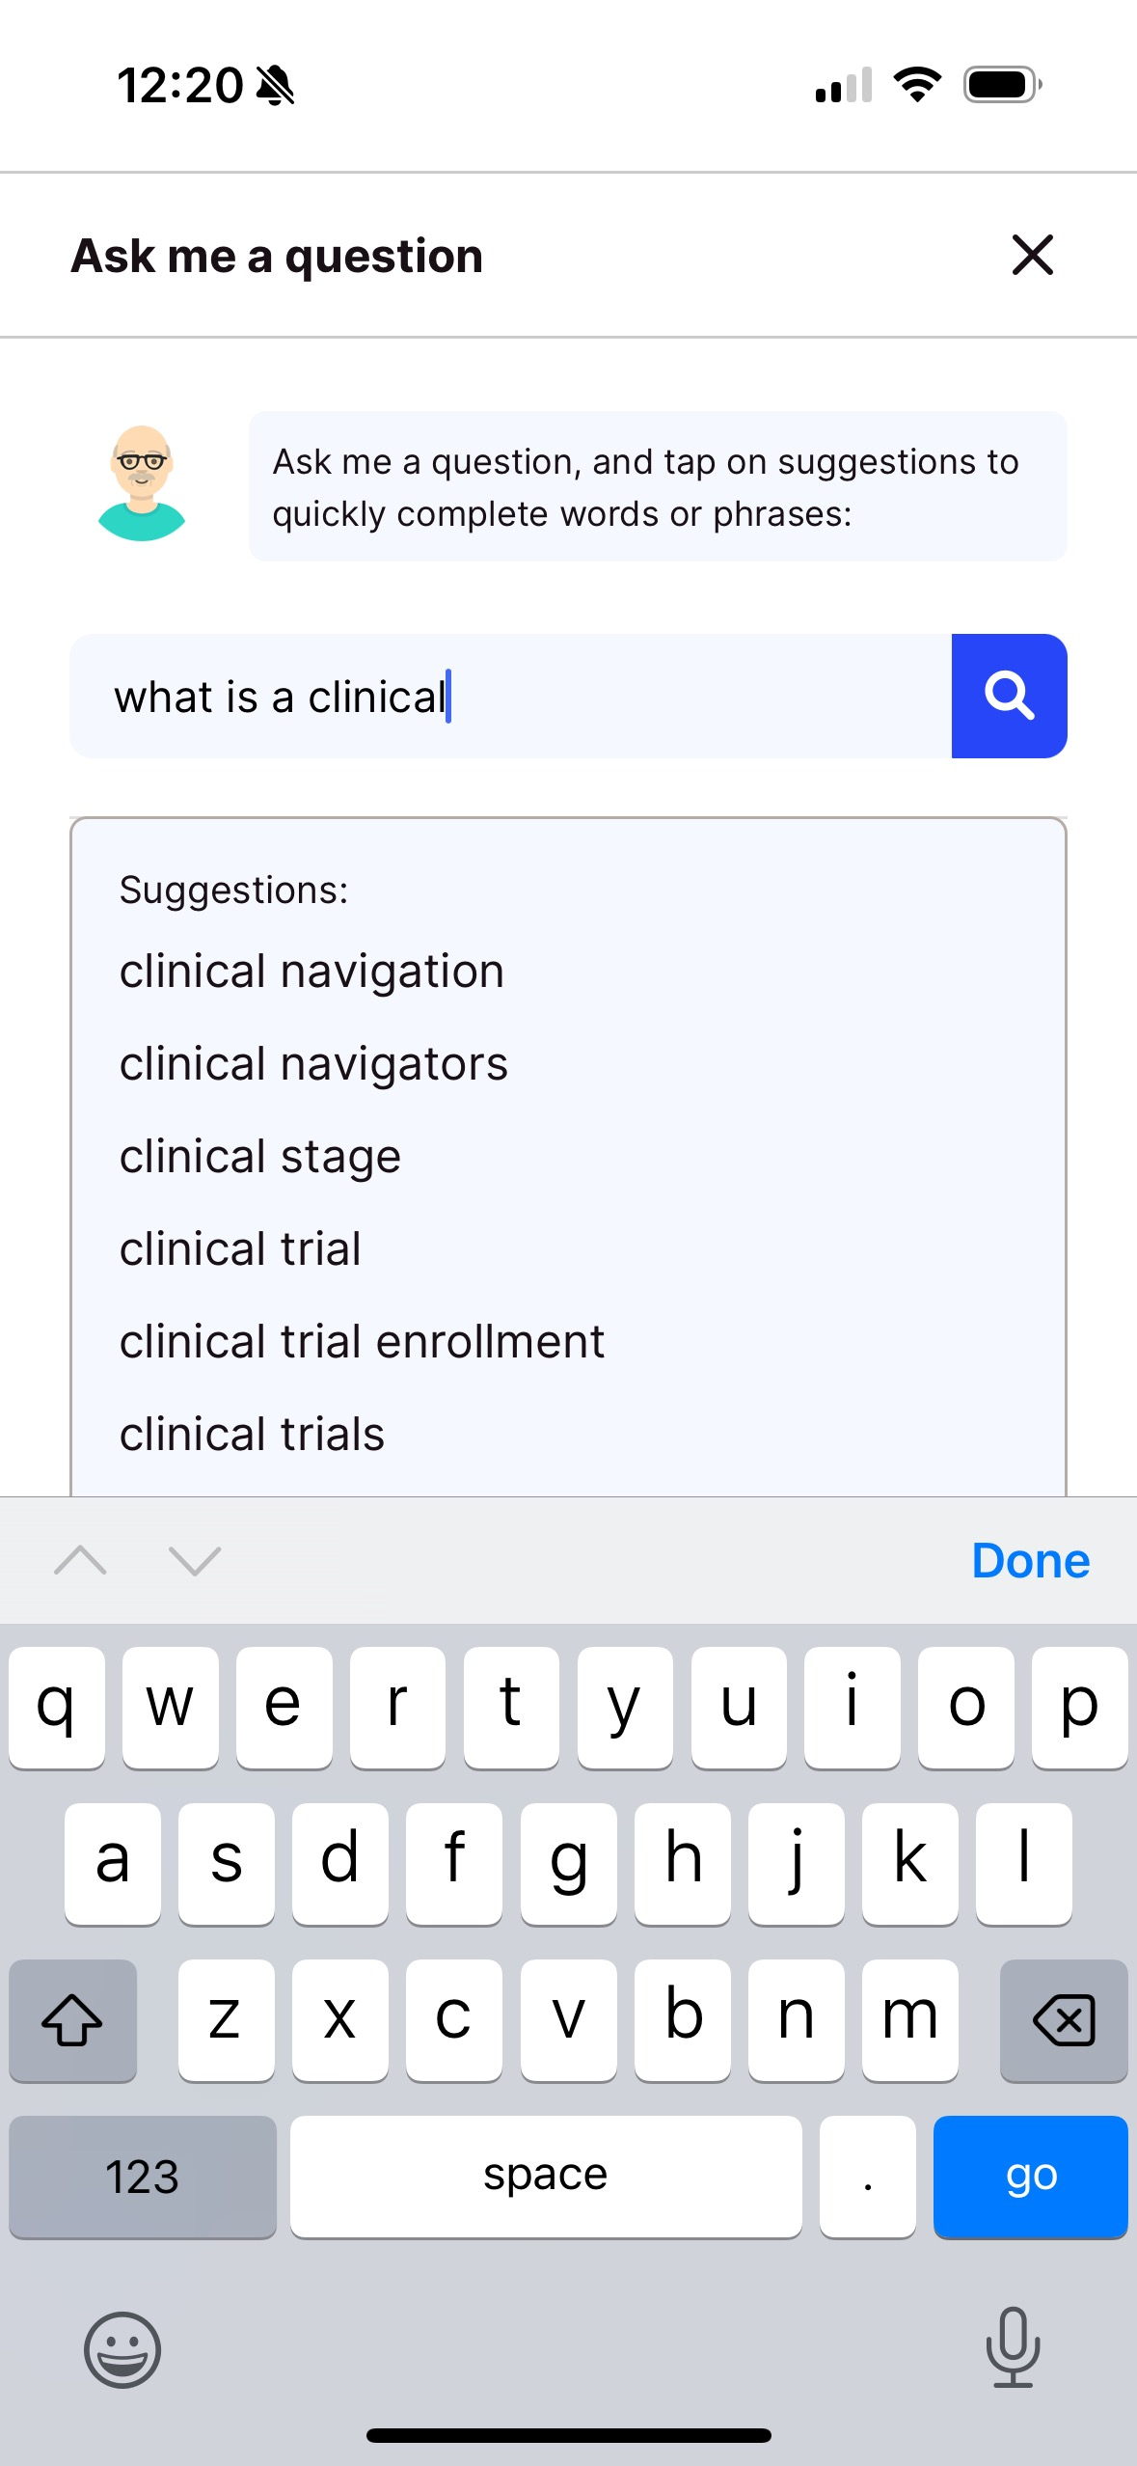
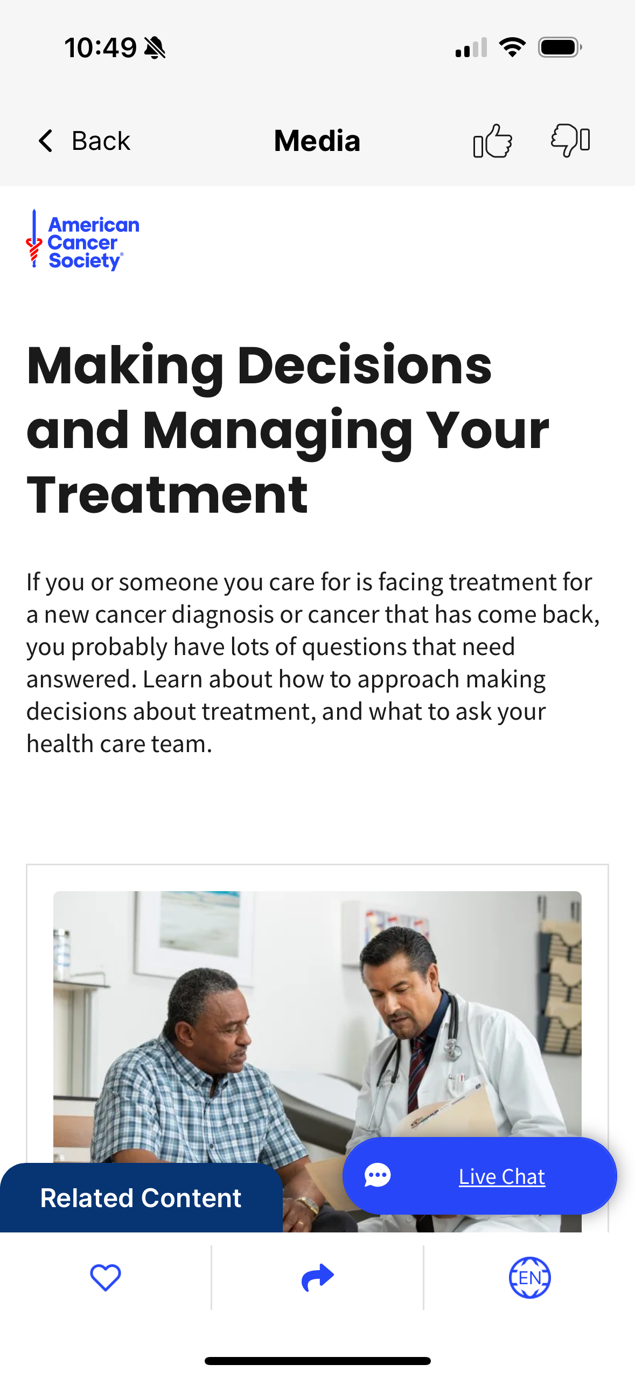
Personalized Dashboard
Algorithm populates dashboard recommendations based on user’s cancer information and concerns
Access additional resources and articles
Search feature with natural language processing
Dynamically generated related links

Slide 25
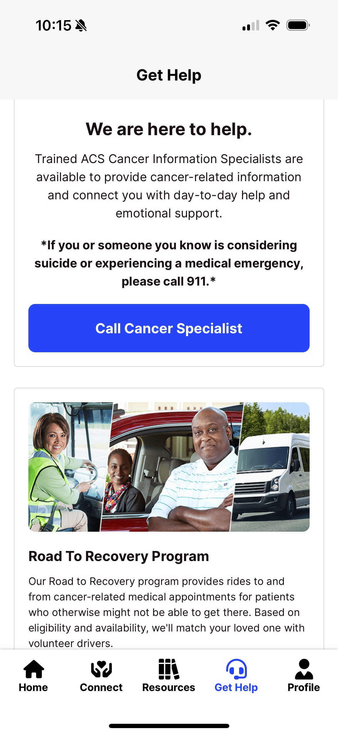
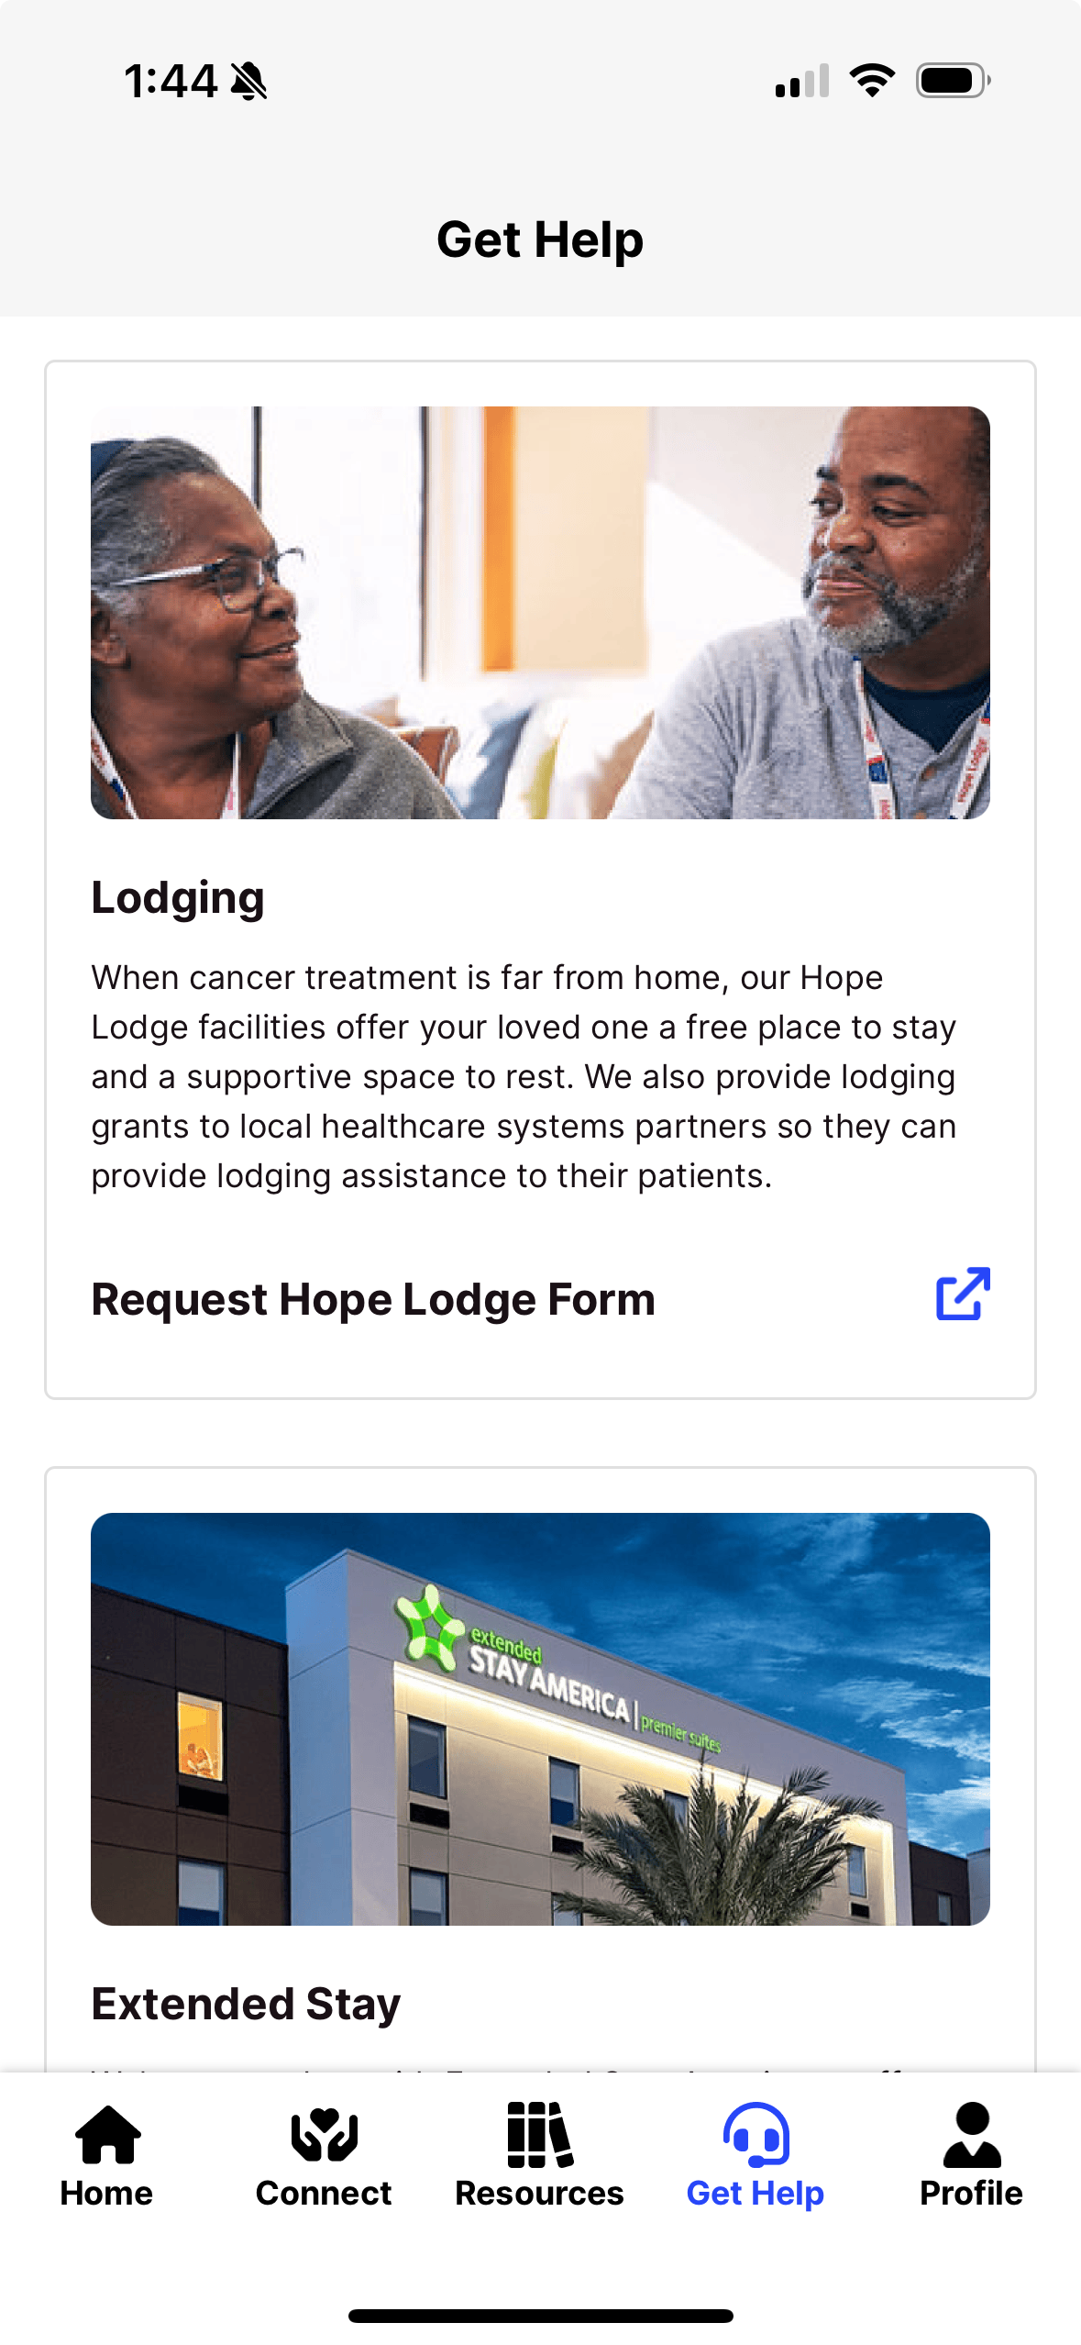
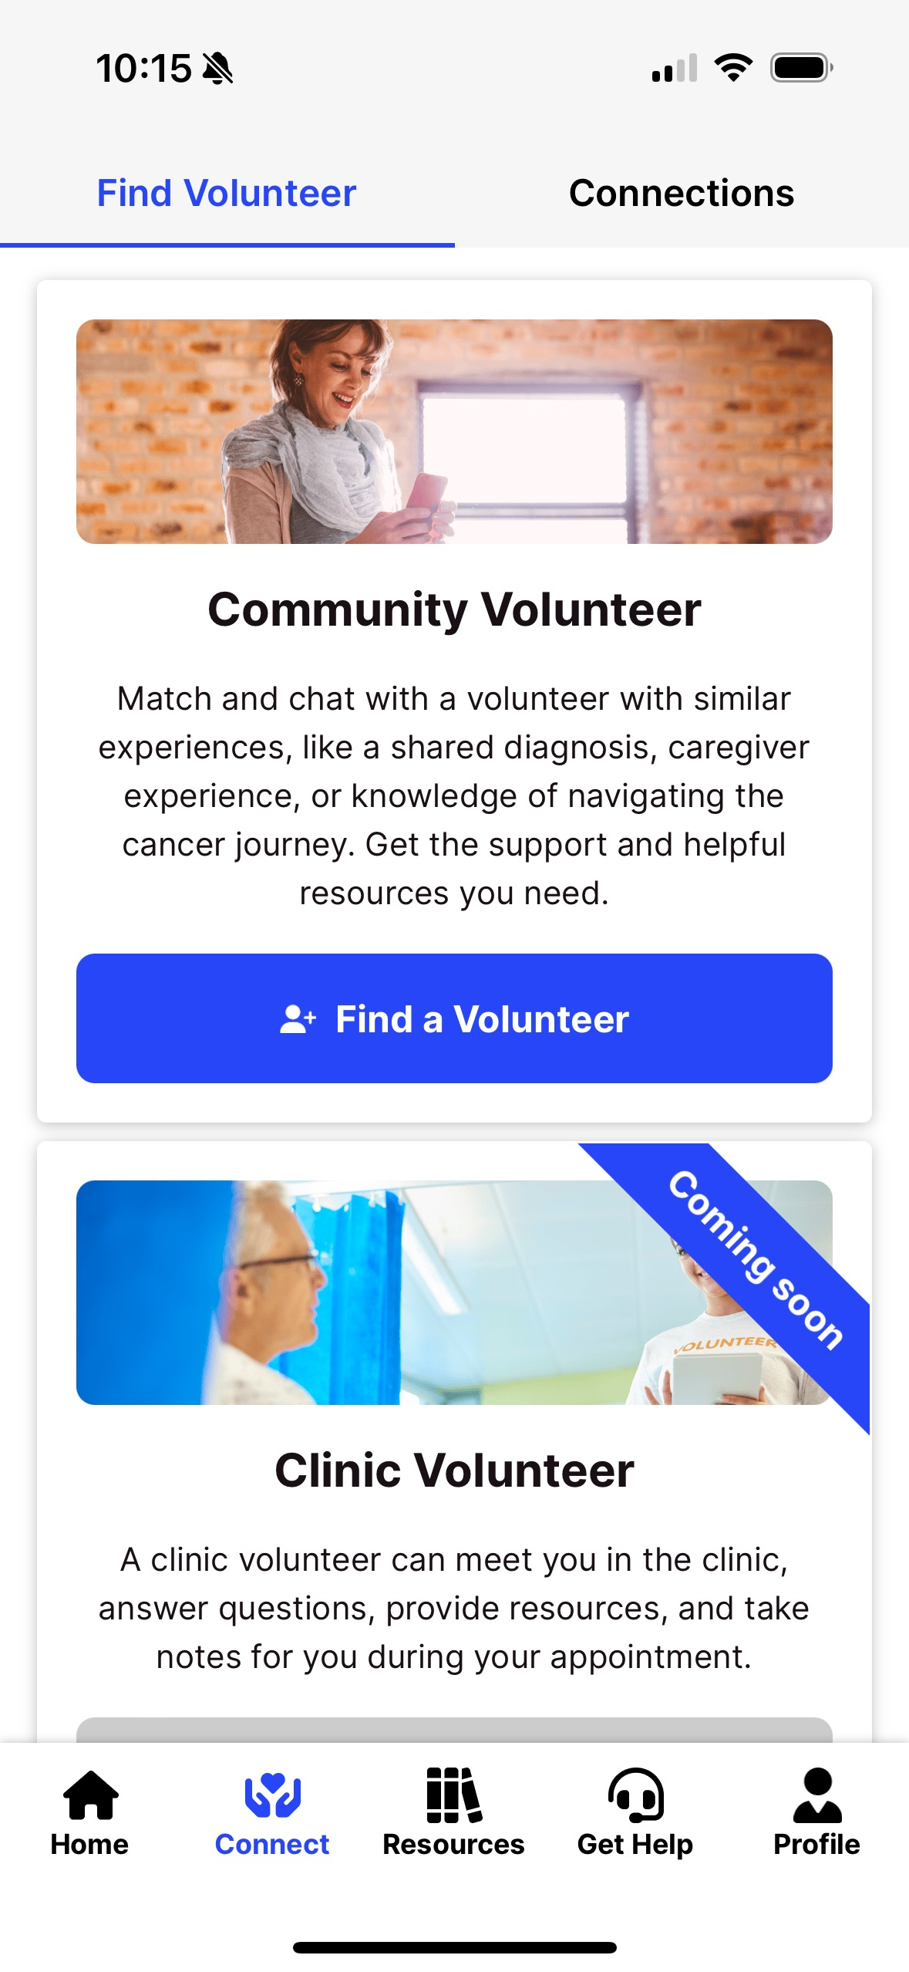
Powerful Resources
ACS CARES volunteers: Virtual community volunteers and in-person student volunteers
ACS Cancer Helpline: 24/7 telephonic support for cancer information and resources
Leveraging AI for smarter resource search for both national and local resources

Slide 26
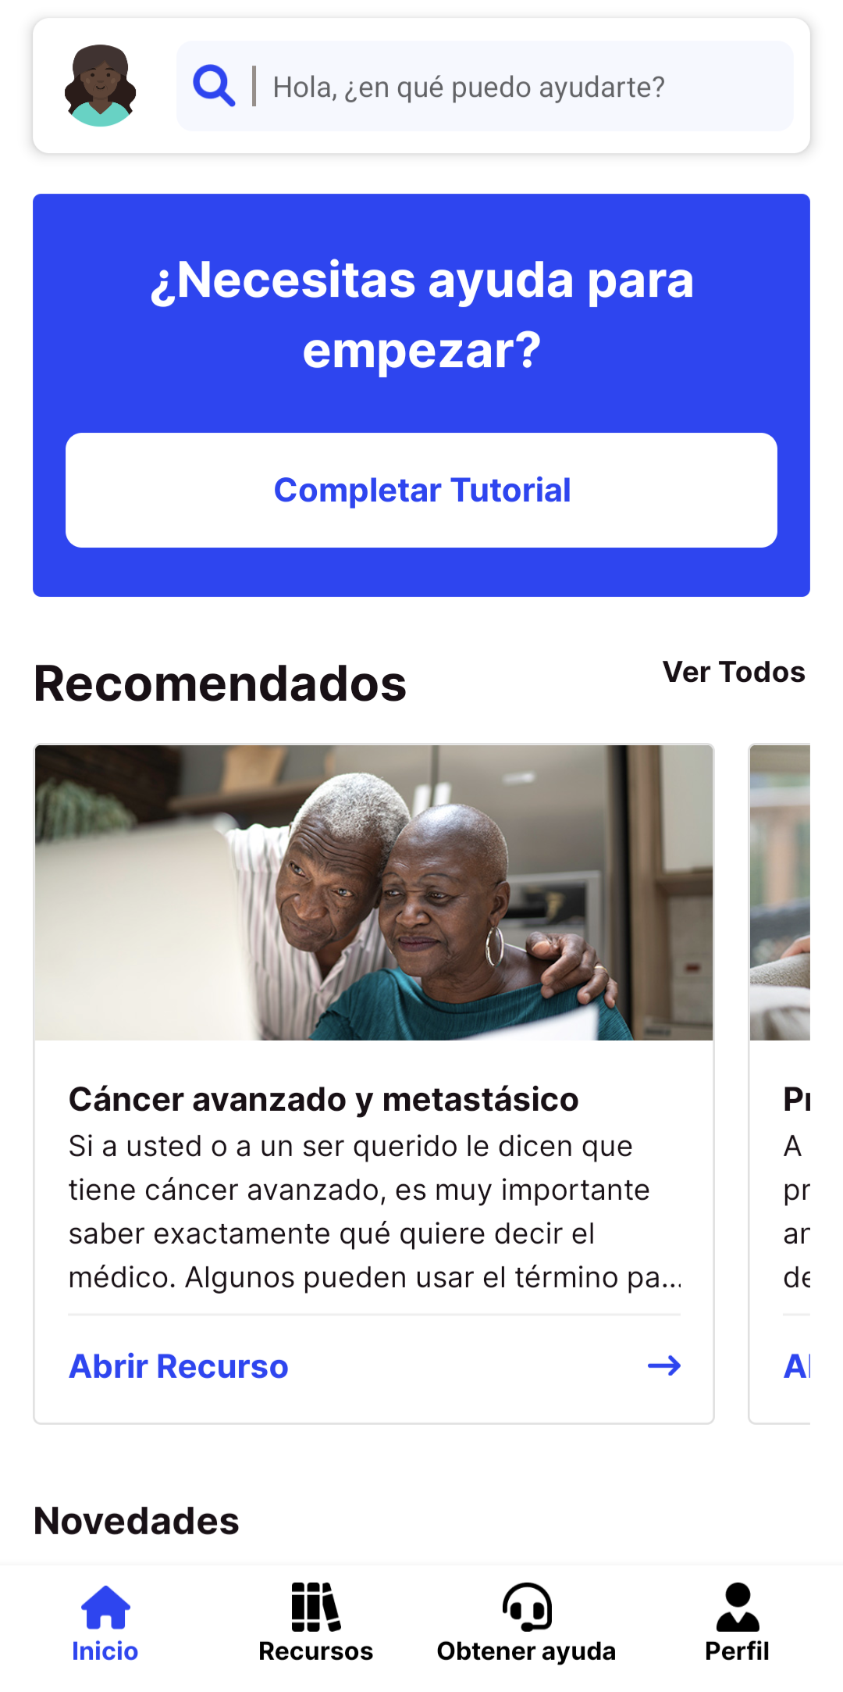
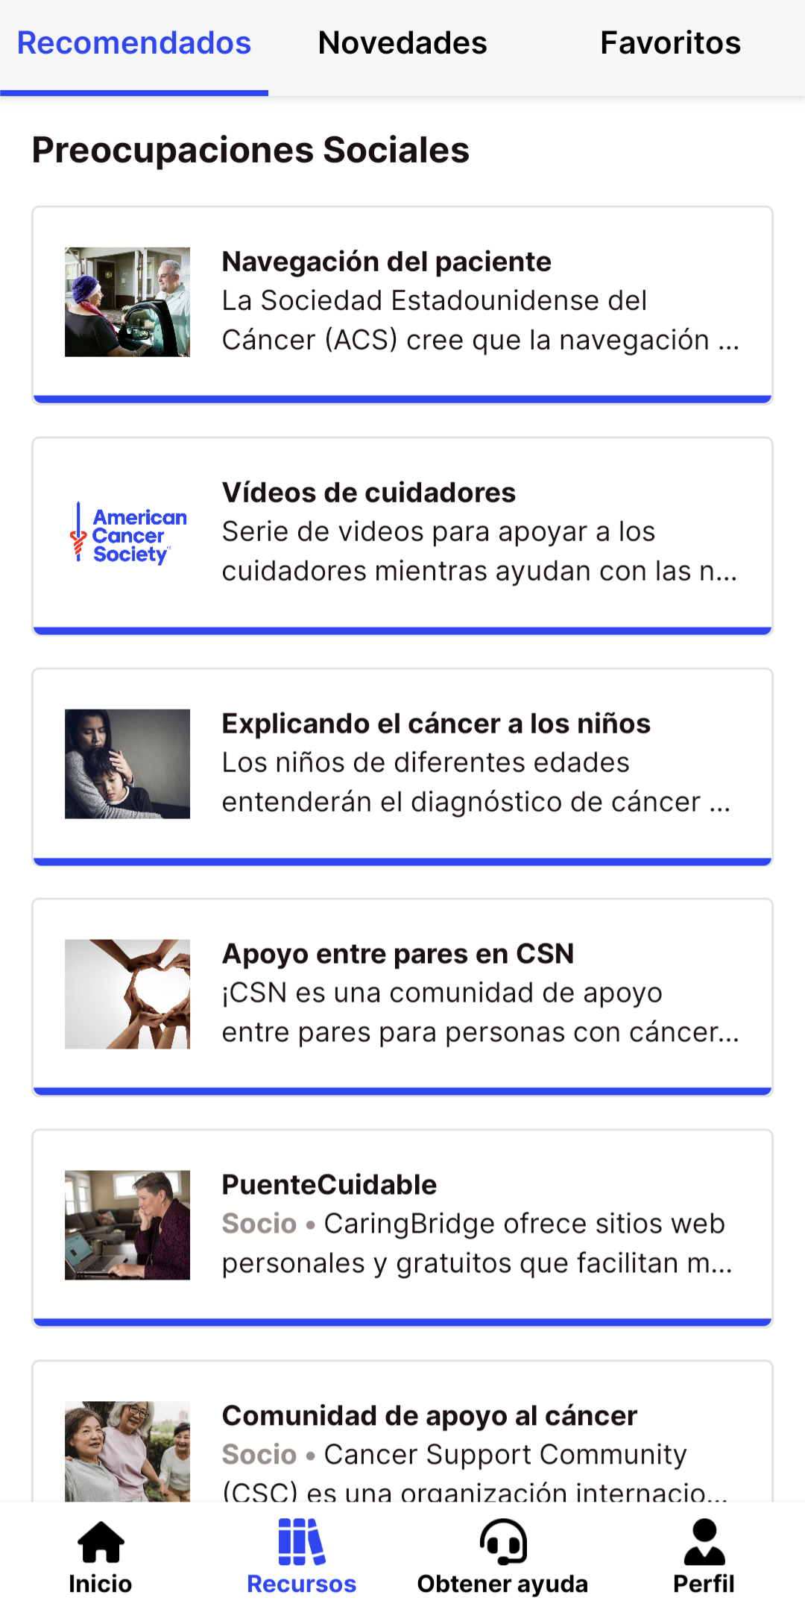
ACS CARES APP IN SPANISH
( ¡ACS CARES en Español!)
App displays in Spanish for users with their native phone setting language selected as Spanish
Hispanic and Latinx individuals disproportionately affected by cancer
Addresses a critical need for culturally-sensitive and linguistically-appropriate cancer support

Slide 27
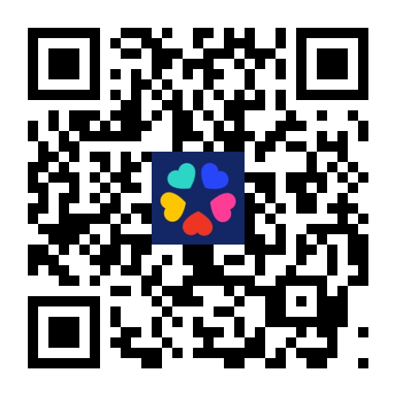
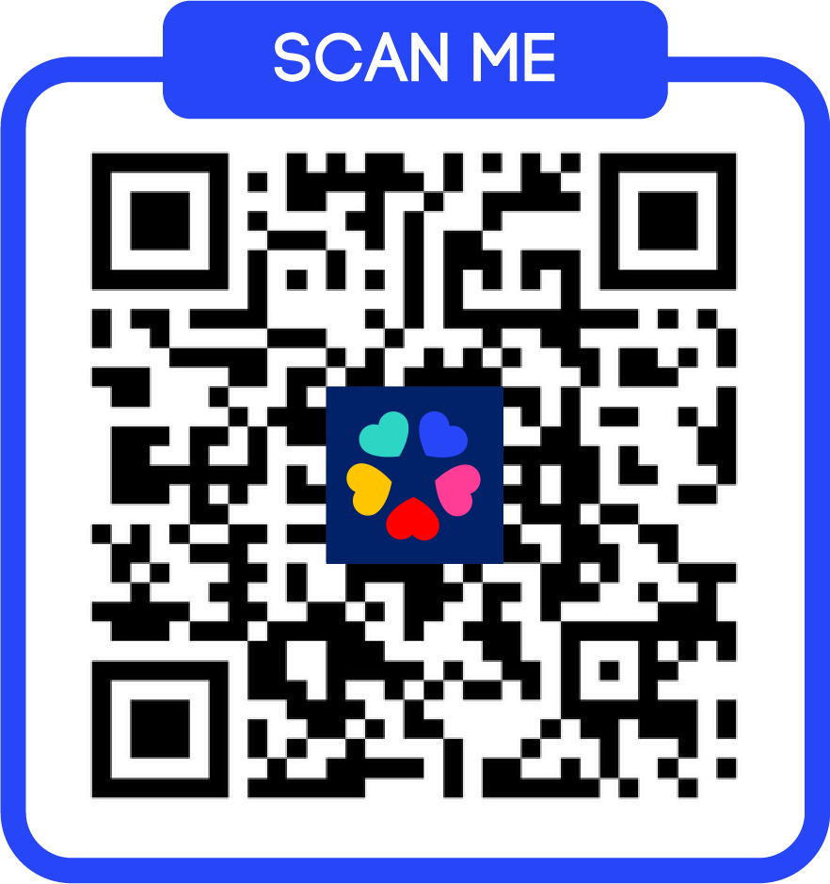
Share ACS CARES with friends, family, and community to increase access to impactful navigation support and help people with cancer and their caregivers navigate the cancer journey with confidence!
Download the ACS CARES app
Register to be an ACS CARES virtual volunteer
Visit cancer.org/acscares
Contact ACS CARES team for more information at ACSCARES@cancer.org

Slide 28

LIGHTENING
ROUND
Lessons Learned

Slide 29

Please post any questions in the Question box located in the ZOOM panel at the bottom of your screen.
Question and Answer

Slide 30
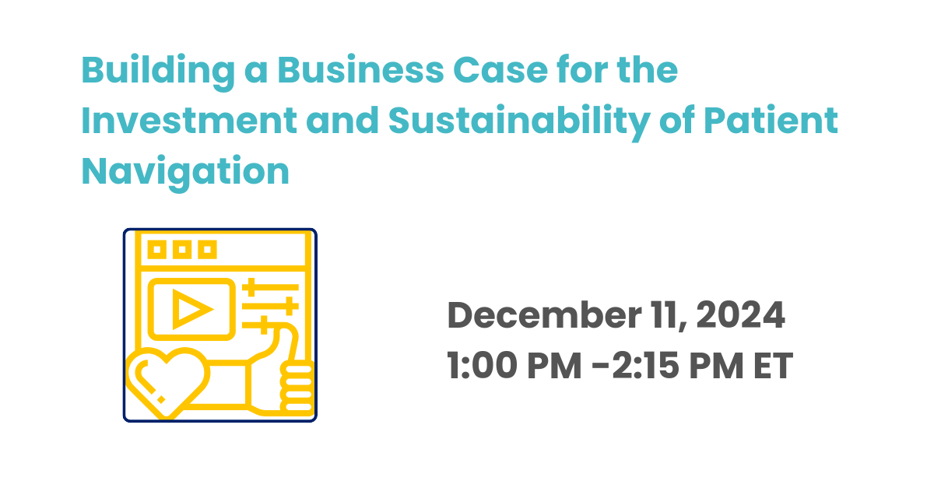

ACS NNRT
Call To Action
Webinar
REGISTER!
https://navigationroundtable.org/news-events/events/

Slide 31
2024 Sponsors
Notes:
thank sponsors – lead sponsors Novocure, Sanofi, and Eisai

Slide 32


Stay in the Know
linkedin.com/in/nationalnavigation-roundtable
@NNRTnews
ACS NNRT Call to Action Webinars
Visit the NNRT website for updates, resources and to subscribe to the NNRT newsletter:
https://navigationroundtable.org/
Notes:
Previous webinars are archived on the ACS NNRT website. Information about upcoming webinars is also shared on ACS NNRT's social media channels. Stay connected to keep up with events, announcements, and ACS NNRT opportunities!

Slide 33

Thank You

